Slide 1
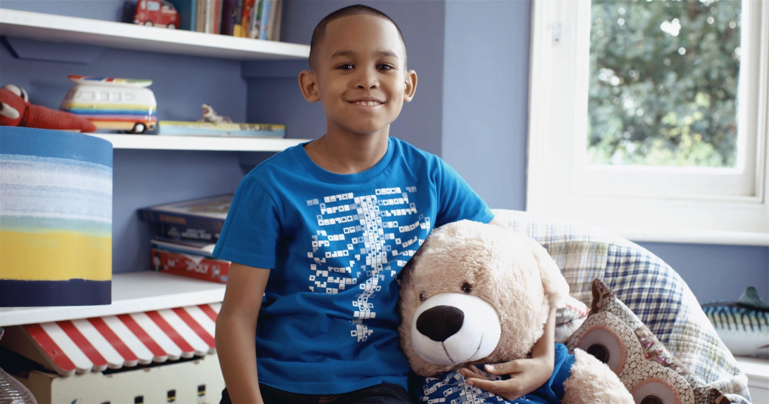

Digestive System
Middle / Intermediate Years
“The world is full of magic! We created the Virtuali-Tee and these resources to enable you to unlock the curiosity that exists within every student”

Slide 2
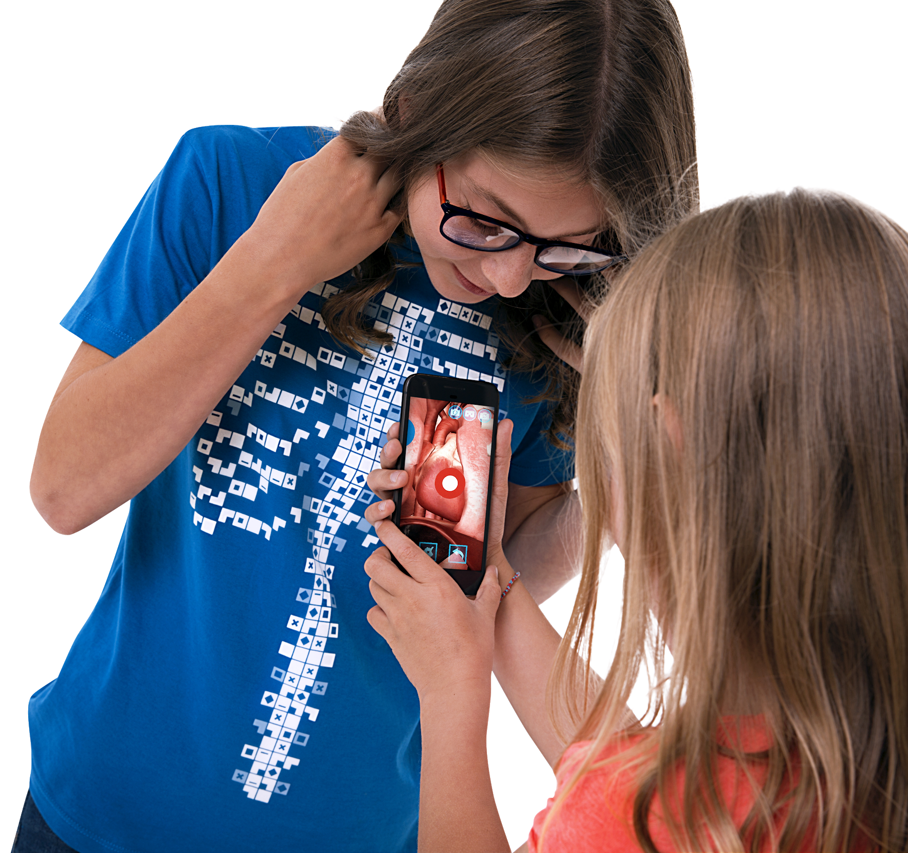
OVERALL LEARNING OUTCOMES
Middle / Intermediate Years
The Digestive System Objectives
To identify parts of the digestive system
To describe their function
To identify examples of enzymes that break down food
To identify where water and nutrients are absorbed and enter the bloodstream
To describe what happens to food as it goes through the body

Slide 3
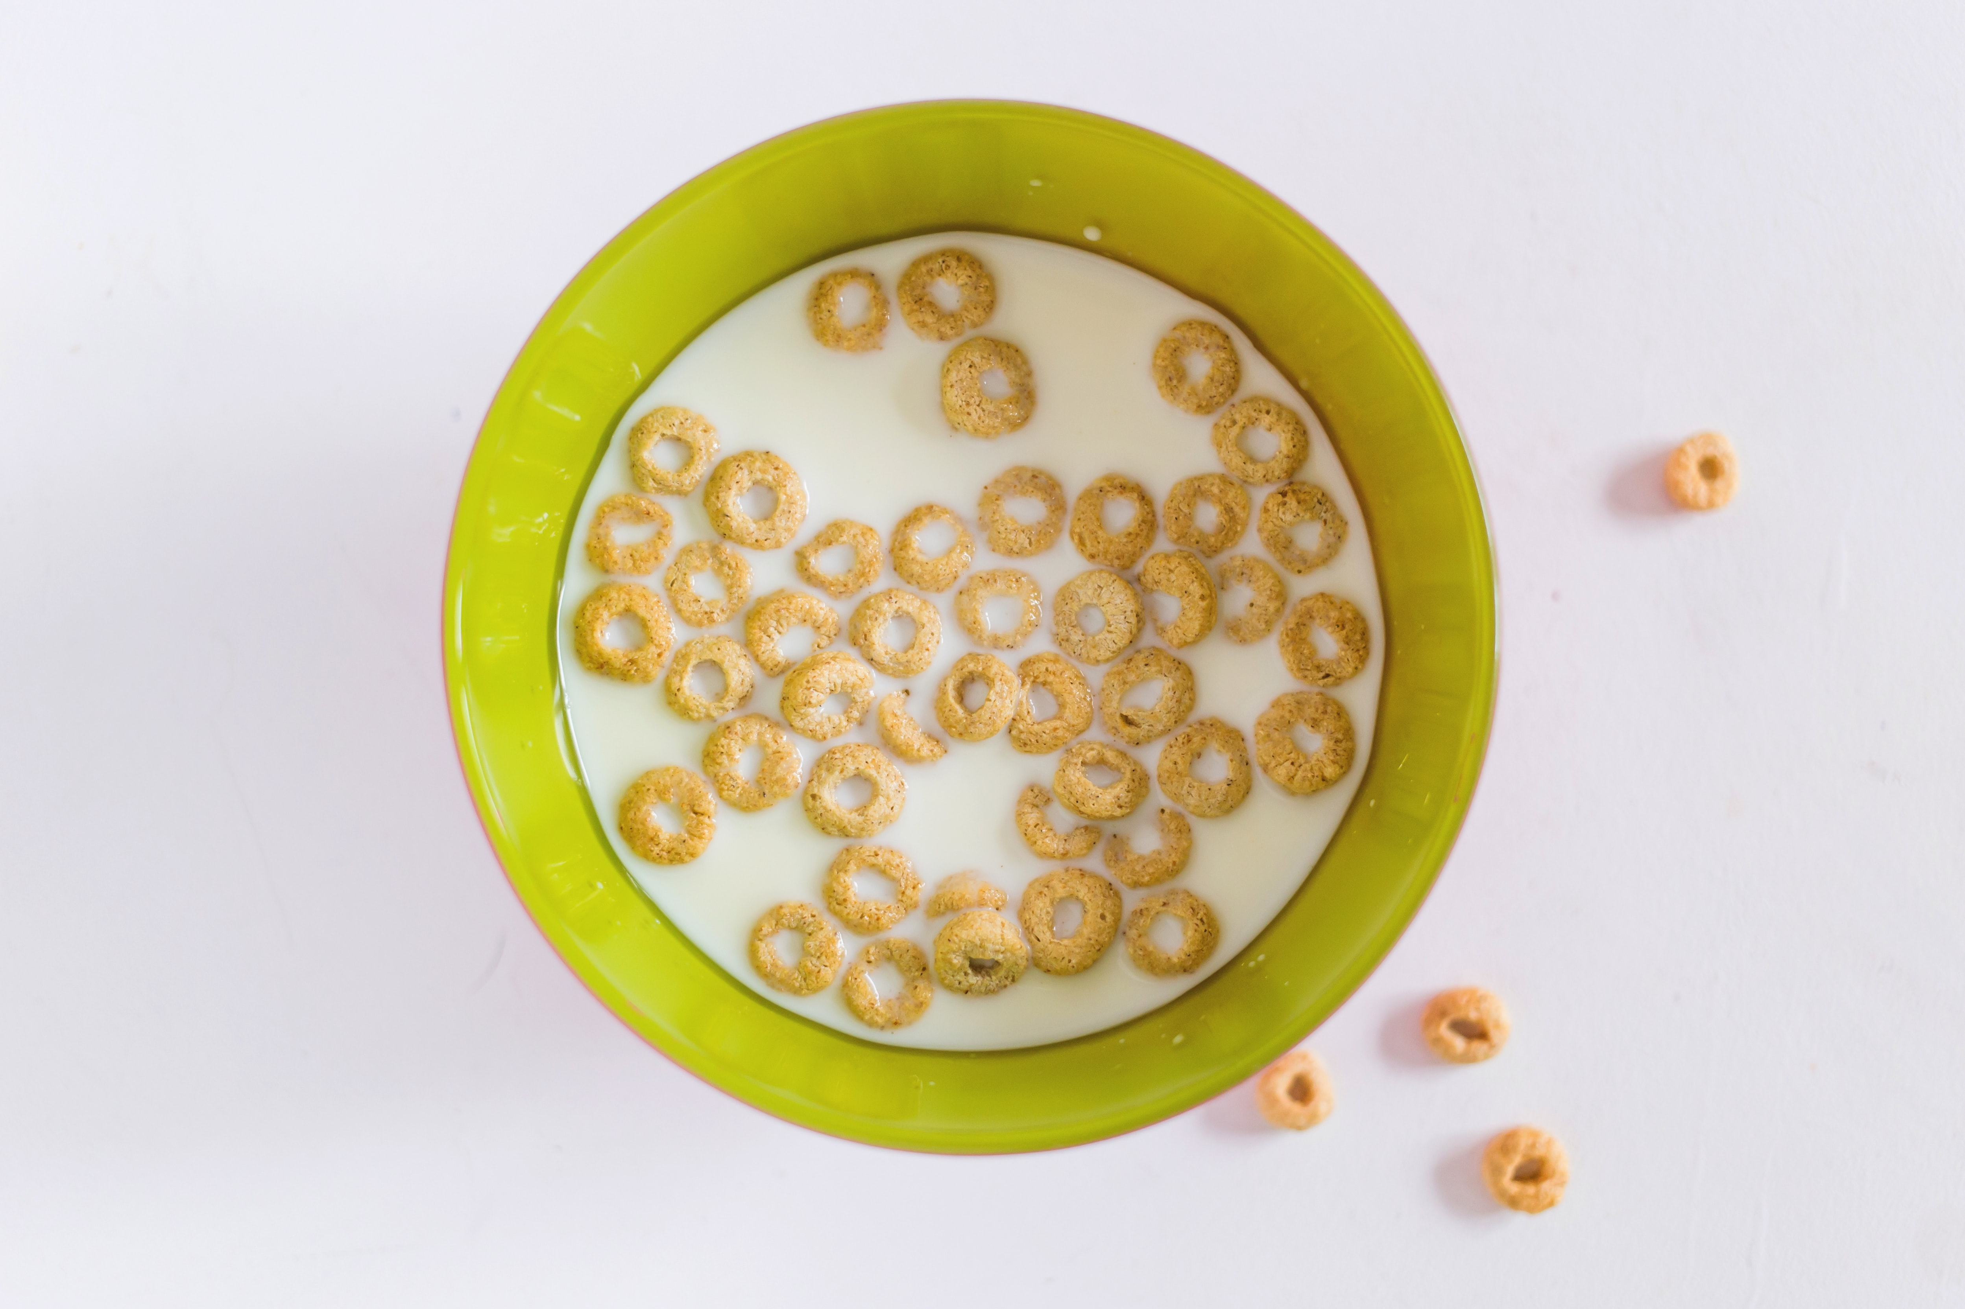
?
THINK – PAIR – SHARE
What happens to food once we’ve eaten it?
What does our digestive system do?
Which organs can you list from our digestive system?
What did you have for breakfast this morning?
Where do you think it is along your gastro-intestinal (GI) tract?
Notes:
Think-pair-share (TPS) is a collaborative learning strategy where students work together to solve a problem or answer a question. This strategy requires students to (1) think individually about a topic or answer to a question; and (2) pair up with another student to communication to come to a consensus with the ideas and (3) share ideas with classmates.

Slide 4
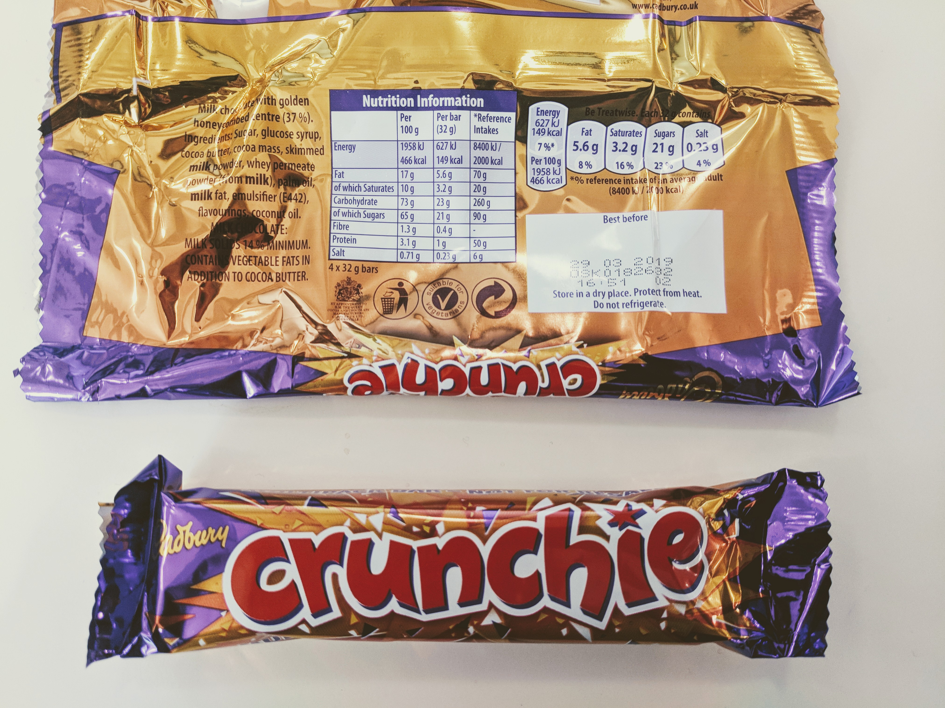
So what is digestion?
Digestion is chemical and physical breakdown of food into smaller pieces (nutrients) that our body can use for energy production, growth and repair.
Nutrients from food:
Carbohydrates
Proteins
Fats (Lipids)
Vitamins
Minerals
Water

Slide 5
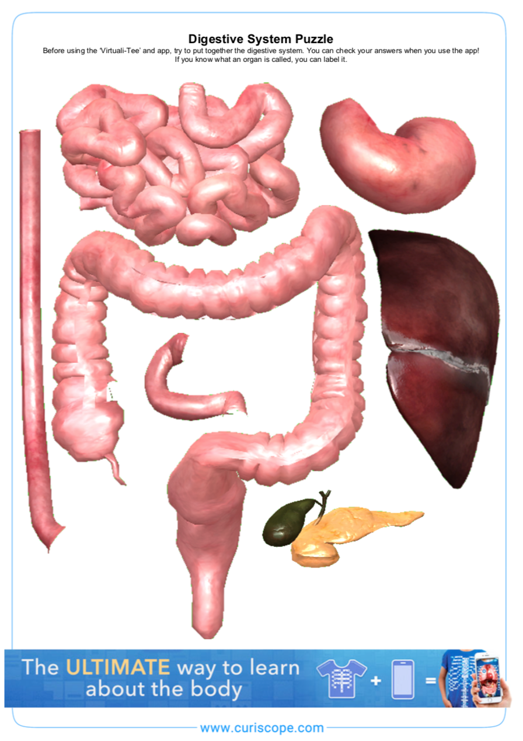
The digestive system puzzle
Have a try at putting together your digestive system puzzle and labelling the organs.
Do your best. You can check all of your answers on the Virtuali-Tee app!

Slide 6
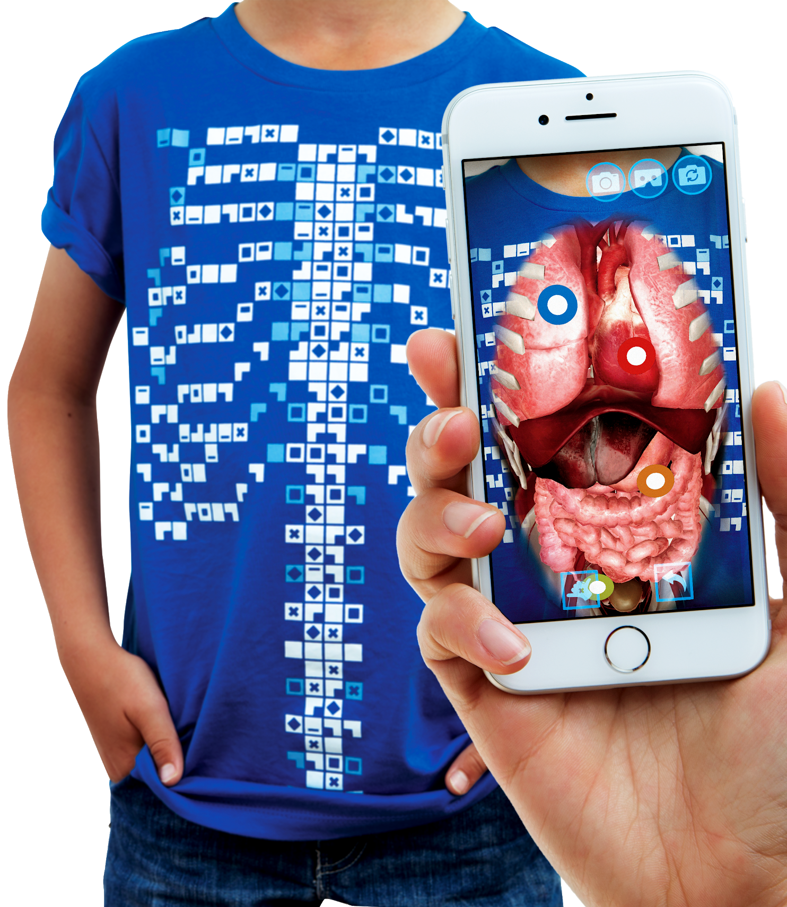
The Virtuali-Tee
Today we are going to be using a very special t-shirt to explore your digestive system
“Explore the Human Body….
On a Human Body…..”

Slide 7
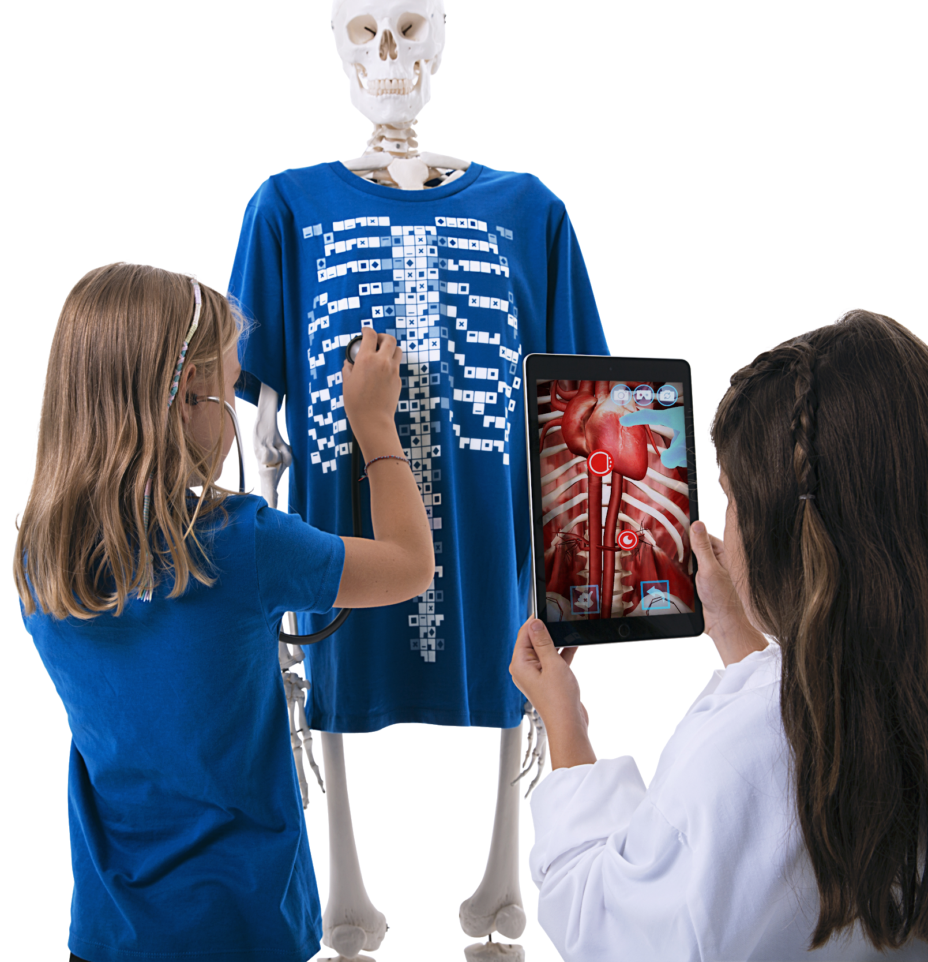
What is the Virtuali-Tee?
A t-shirt that lets us see inside YOUR body using Augmented Reality!
We’ll use a mobile devices to scan the tshirt with the app and open a portal so we can explore what is going on under your skin.

Slide 8
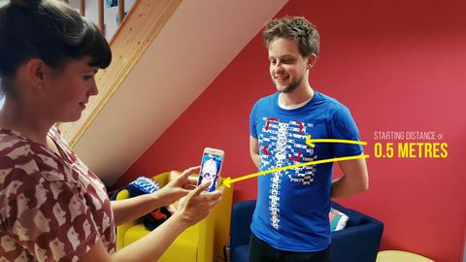
Step 1 - Getting started
To get started, simply open the Virtuali-Tee app and point at the t-shirt. The tracker image is best picked up by initially pointing at the upper chest with the device 0.5m/1.5ft from the t-shirt.
The tracking of the t-shirt requires that you are in a well lit space without heavy shadows and that the t-shirt is not stretched or heavily wrinkled.

Slide 9
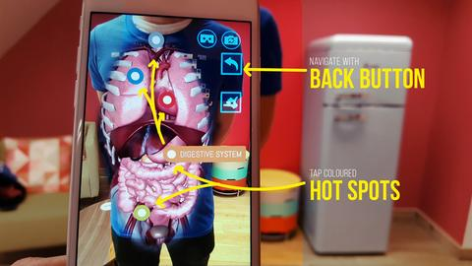
Step 2 - Wow, the organs look amazing…now what!?
Well, we have implemented some pretty cool features into the app. Just tap the screen to get started. You can then isolate the physiological system by tapping on the coloured hot spots. You’ll see some buttons floating outside the chest, use the back button to navigate between systems.
We encourage you to explore, if you see a button….tap it to find out what it does!

Slide 10
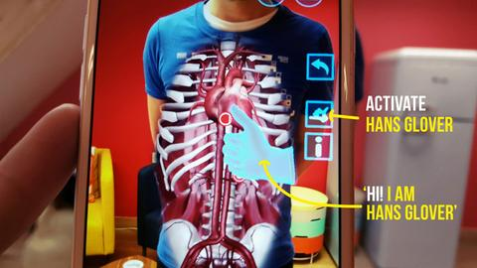
Step 3 - Surprise! Meet Dr Glover….your virtual expert on the body!
Think of Dr Glover as a holographic guide to the body. He’ll talk you through the anatomy and physiological systems in the body. Just tap the Hans button and he’ll appear.

Slide 11

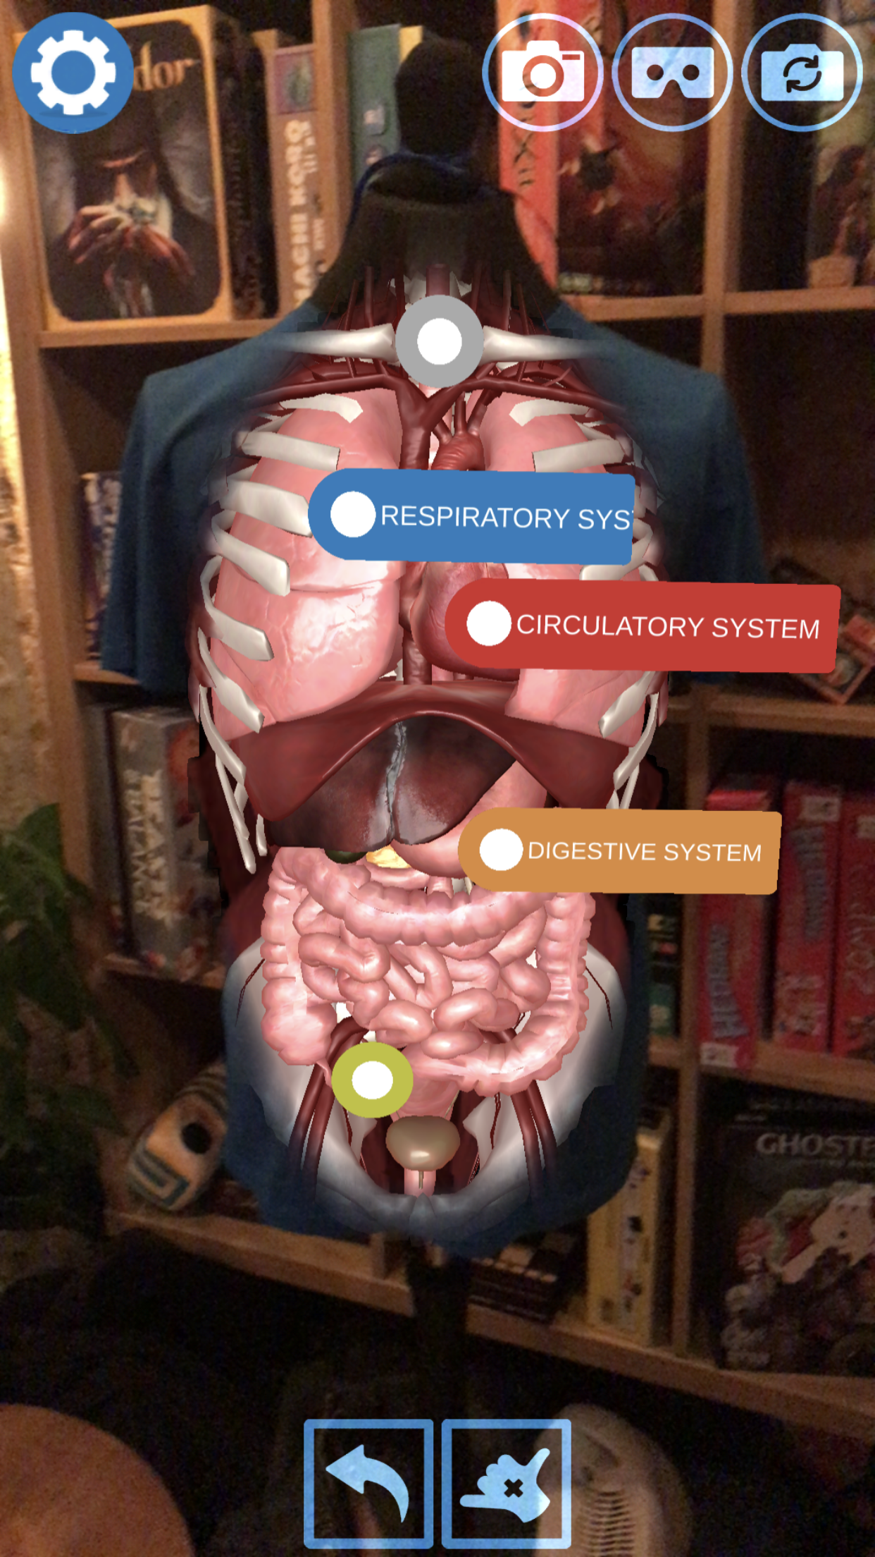


Getting into your digestive system
Tap on the orange digestive system hotspot and the app will isolate to just that system. See through to your spine!
Tap on the button to call Dr Glover, who will give you a guided tour!
Tap the button if you would like subtitles.

Slide 12
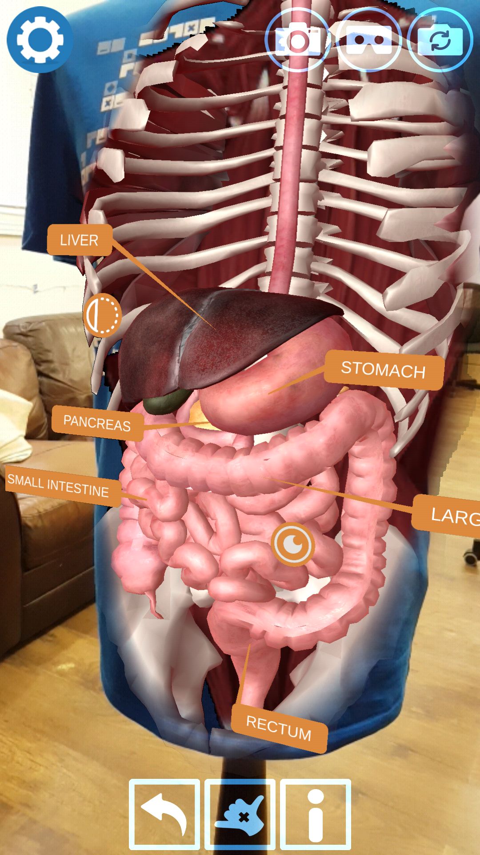

Discovering your digestive organs
Tap on the button to bring up the labels for the digestive system.
Study these as they will help your next activity.

Slide 13
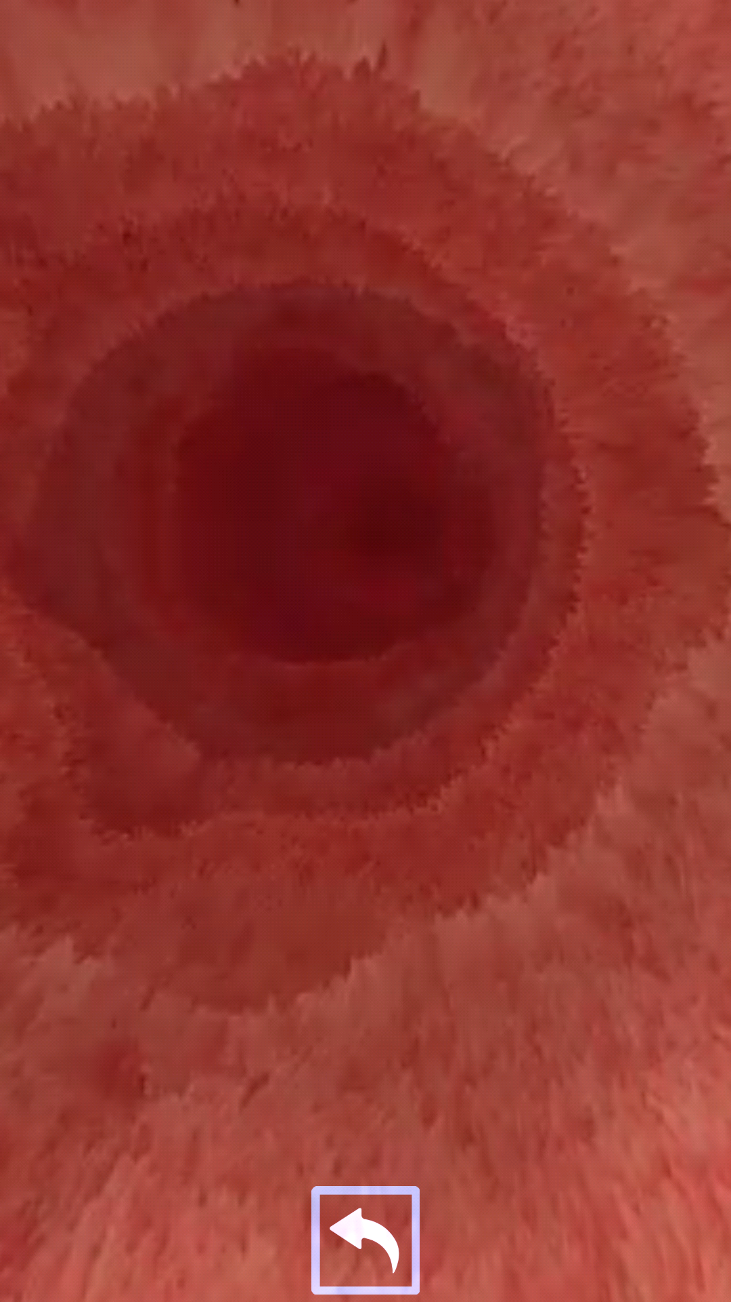

Your small intestine is amazing!
Tap on the icon in the digestive system to look inside your small intestine.
You can see the tiny wavy finger-like structures on the walls of the small intestine. These are known as villi.
Why would this be a better adaptation than having a smooth intestinal lining?
Notice the expanding and contracting of the walls. This is like a mexican wave that travels along the small intestine, colon and even your oesophagus called peristalsis. This is how the food gets pushed down into the stomach, and along through to the toilet!
Notes:
Villi allow for a large surface area which maximises the amount of nutrients that can be absorbed into your bloodstream.

Slide 14
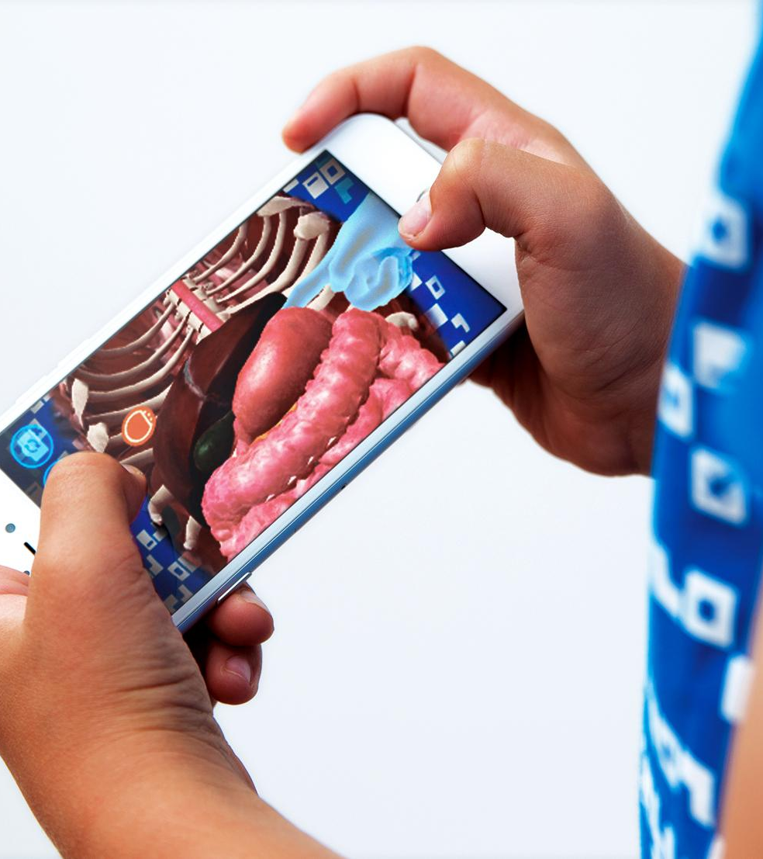
Let’s explore and create a flow chart:
Explore the digestive system and create a flow chart showing all of the organs that are part of the GI-tract (alimentary canal).

Slide 15
Mechanical Digestion
Mechanical digestion is food physically being broken into small pieces. Discover the three places where mechanical digestion occurs:
1.
2.
3.

Slide 16
Mechanical Digestion
Mechanical digestion is food physically being broken into small pieces. Discover the three places where mechanical digestion occurs:
1. Mouth (chewing)
2. Stomach (churning)
3. Small intestine (expansion and contraction of peristalsis)

Slide 17
Chemical Digestion
The breakdown of food by the action of chemicals. Listen closely to the information given on the Virtuali-Tee app and list the types of substances that aid the chemical digestion of food:
1.
2.
3.
A detailed chemical digestion summary table is available in the teacher resources repository:
https://drive.google.com/drive/folders/17N-hPZnEAdBwevuxAYoTi-yasNatYQM9?usp=sharing

Slide 18
Chemical Digestion
The breakdown of food by the action of chemicals. Listen closely to the information given on the Virtuali-Tee app and list the types of substances that aid the chemical digestion of food:
1. Acids
2. Enzymes
3. Bile
A detailed chemical digestion summary table is available in the teacher resources repository:
https://drive.google.com/drive/folders/17N-hPZnEAdBwevuxAYoTi-yasNatYQM9?usp=sharing

Slide 19
Quiz
Can you fill in the blanks and show what you’ve learnt today? Use the words in blue to help you.
Our body needs food so that we have enough ______ to survive. Our _______ system is made up of organs that work _______ to ______ down food. Digestion begins in the _____. The __________ squeezes the food down into the _______ by the process of __________. The food goes through the _________ and then the ___________ where the proteins, fats, sugars, vitamins, minerals and some water is absorbed. Finally the remaining water is absorbed in the ______ and the left over waste is stored in the _________ until it is expelled through the anus.
together - energy - duodenum - small intestine - colon (large intestine) - mouth - rectum
stomach - digestive - break - oesophagus - peristalsis

Slide 20
Quiz
Can you fill in the blanks and show what you’ve learnt today? Use the words in blue to help you.
Our body needs food so that we have enough ______ to survive. Our _______ system is made up of organs that work _______ to ______ down food. Digestion begins in the _____. The __________ squeezes the food down into the _______ by the process of __________. The food goes through the _________ and then the ___________ where the proteins, fats, sugars, vitamins, minerals and some water is absorbed. Finally the remaining water is absorbed in the ______ and the left over waste is stored in the _________ until it is expelled through the anus.
energy
digestive
together
break
mouth
oesophagus
stomach
peristalsis
duodenum
small intestine
colon
rectum

Slide 21
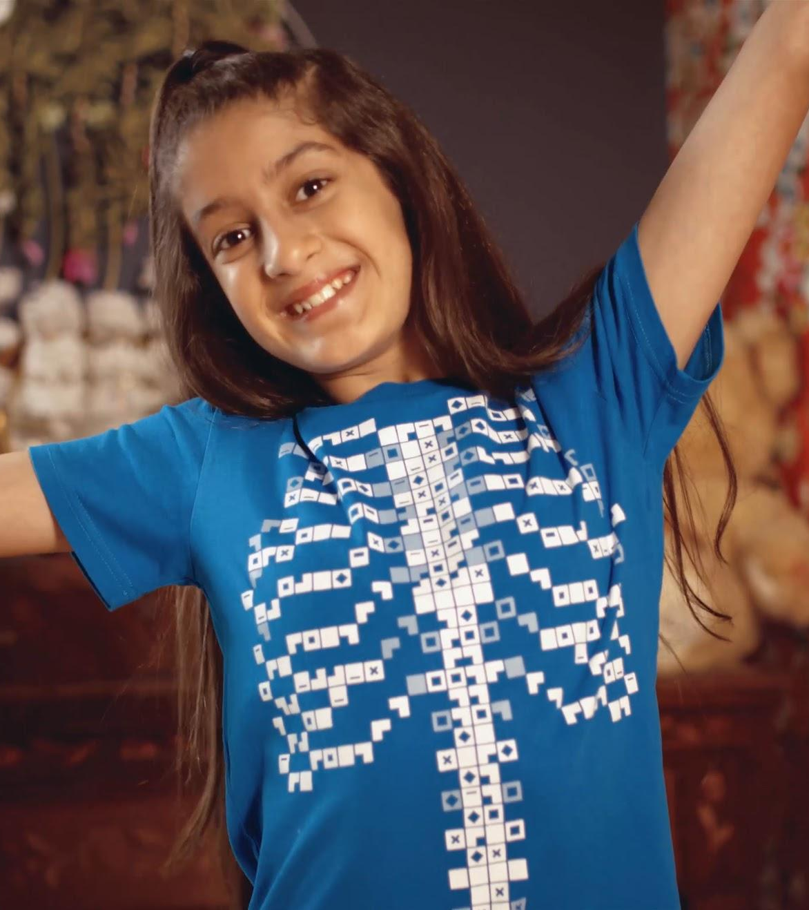
Curious facts!
Did you know that it takes food around 6 hours to complete digestion but it only takes around 7 seconds for food to travel from your oesophagus to the stomach?
It can take 10 hours to several days from mouth to rectum.
An adult stomach can hold up to 1.5 litres of food and this will stay here for around 2-3 hours
The stomach wall has three layers of muscle!

Slide 22
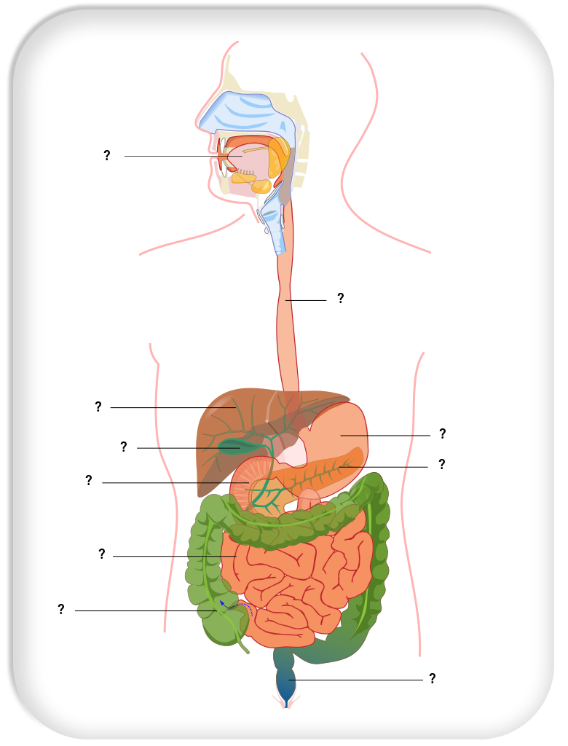
Print friendly take home sheet
Students can enjoy labelling a digestive system diagram. Indicating which organs are which. Arrows to be added to show the direction of food.
The take home sheet is available in the teacher resources repository:
https://drive.google.com/drive/folders/17N-hPZnEAdBwevuxAYoTi-yasNatYQM9?usp=sharing

