Slide 1
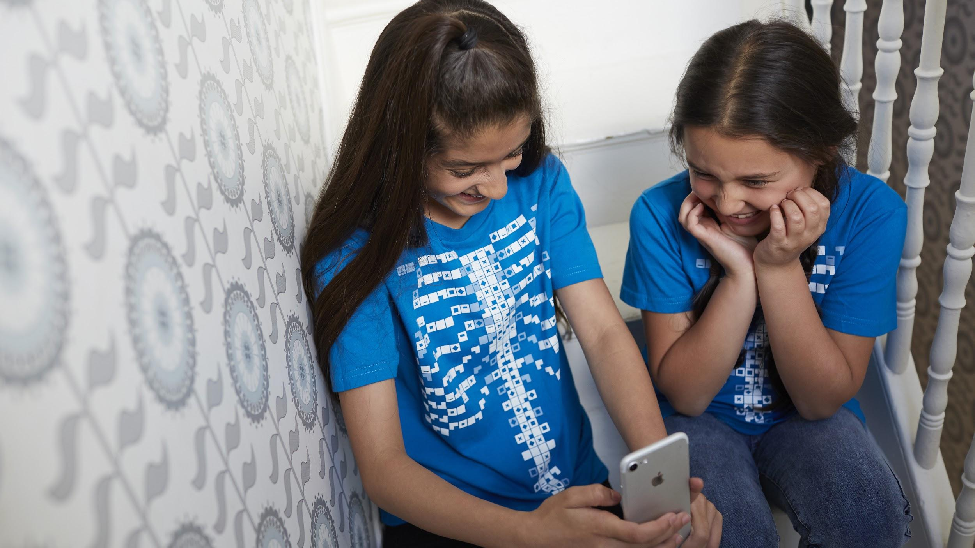

The Circulatory System
Middle / Intermediate Years
“The world is full of magic! We created the Virtuali-Tee and these resources to enable you to unlock the curiosity that exists within every student”

Slide 2
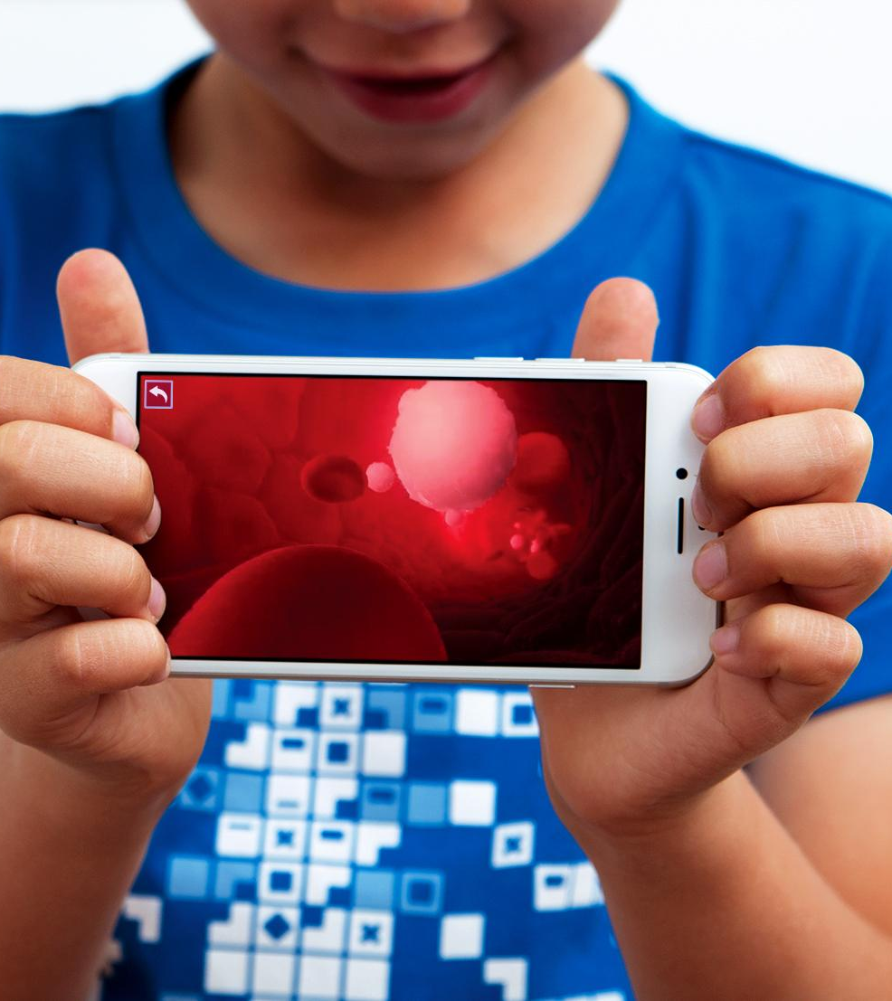
OVERALL LEARNING OUTCOMES Middle/Intermediate Years
The Circulatory System Objectives
  To observe and describe the relationship between the structure and function of the circulatory system

Slide 3
Let’s get curious...
?
What is the purpose of blood and the circulatory system?
How do you know the difference between a minor and serious cut?
What is a heart attack?
Let’s find out some more…..
A KWL Inquiry worksheet for the circulatory system is available in the teacher’s resources repository at:
https://www.curiscope.com/pages/science-lesson-plans-human-body

Slide 4
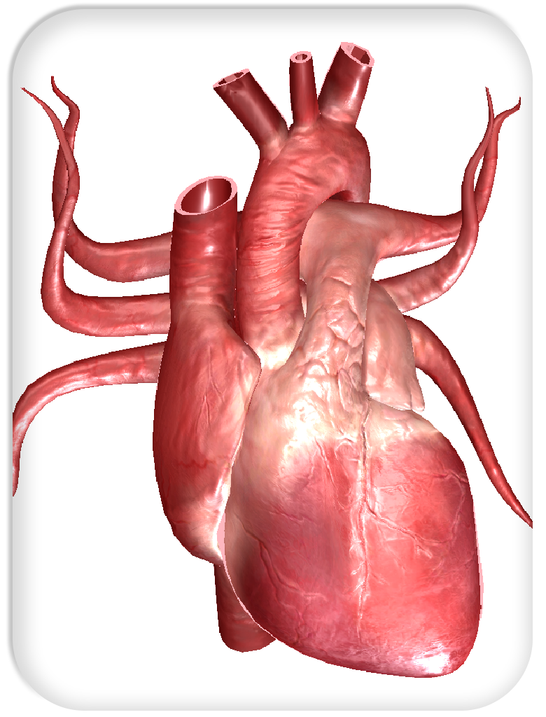
Your heart is AMAZING!
Your heart is a muscle which pumps your blood around your body.
In young people it beats at about 70 to 90 beats per minute
It never takes a rest and keeps beating day and night for your whole life.
Doctors can listen to your heart with a stethoscope and you can feel your pulse on your wrist.
How fast is your heart beating now?

Slide 5
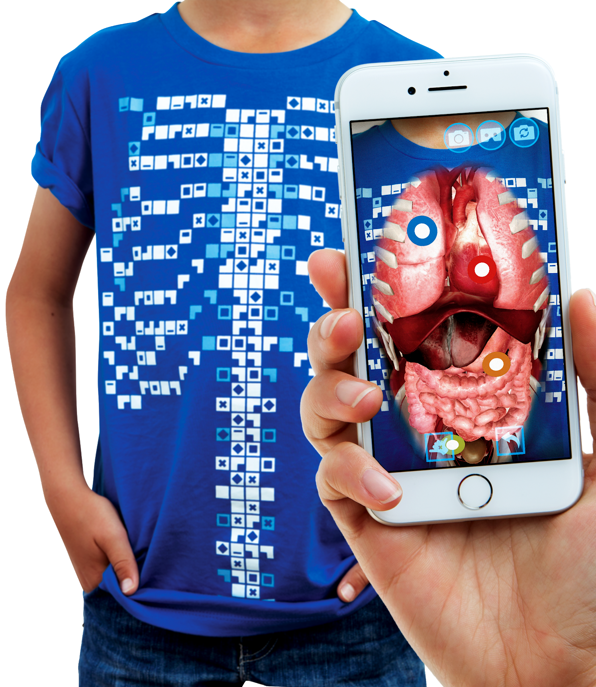
The Virtuali-Tee
Today we are going to be using a very special t-shirt to explore your circulatory system
“Explore the Human Body….
On a Human Body…”

Slide 6
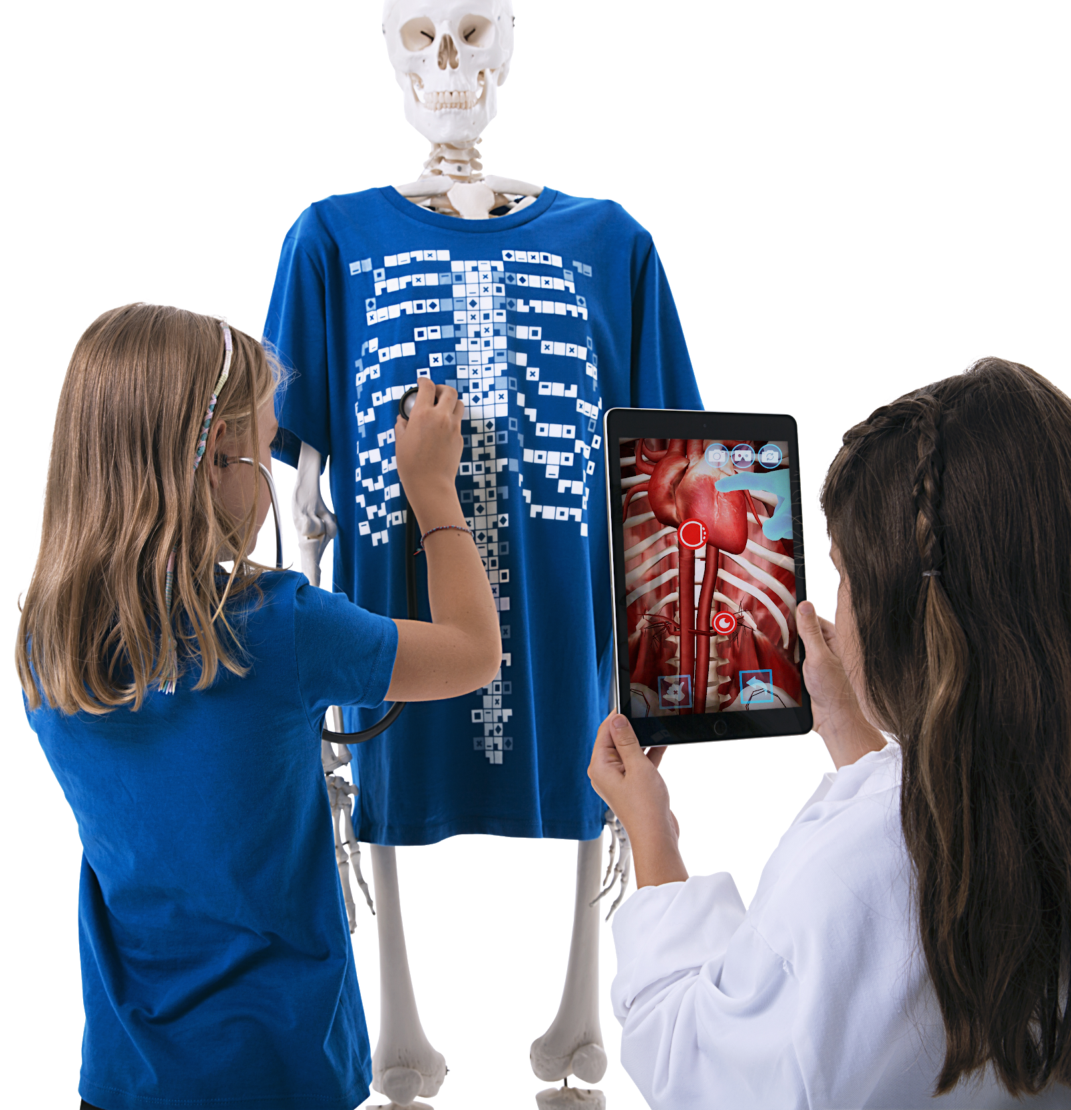
What is the Virtuali-Tee?
A t-shirt that lets us see inside YOUR body using Augmented Reality!
We’ll use a mobile device to scan the t-shirt with the app and open a portal so we can explore what is going on under your skin.

Slide 7
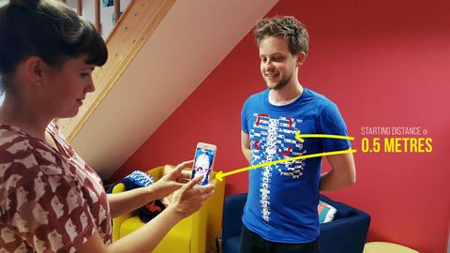
Step 1 - Getting started
To get started, simply open the Virtuali-Tee app and point at the t-shirt. The tracker image is best picked up by initially pointing at the upper chest with the device 0.5m/1.5ft from the t-shirt.
The tracking of the t-shirt requires that you are in a well lit space without heavy shadows and that the t-shirt is not stretched or heavily wrinkled.

Slide 8
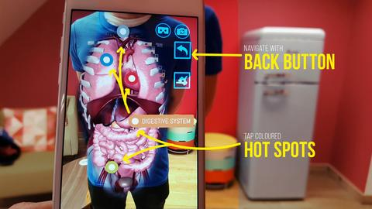
Step 2 - Wow, the organs look amazing…now what!?
Well, we have implemented some pretty cool features into the app. Just tap the screen to get started. You can then isolate the physiological system by tapping on the coloured hot spots. You’ll see some buttons floating outside the chest, use the back button to navigate between systems.
We encourage you to explore, if you see a button….tap it to find out what it does!

Slide 9
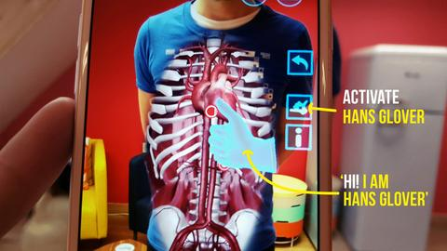
Step 3 - Surprise! Meet Hans Glover….your virtual expert on the body!
Think of Hans as a holographic guide to the body. He’ll talk you through the anatomy and physiological systems in the body. Just tap the Hans button and he’ll appear.

Slide 10
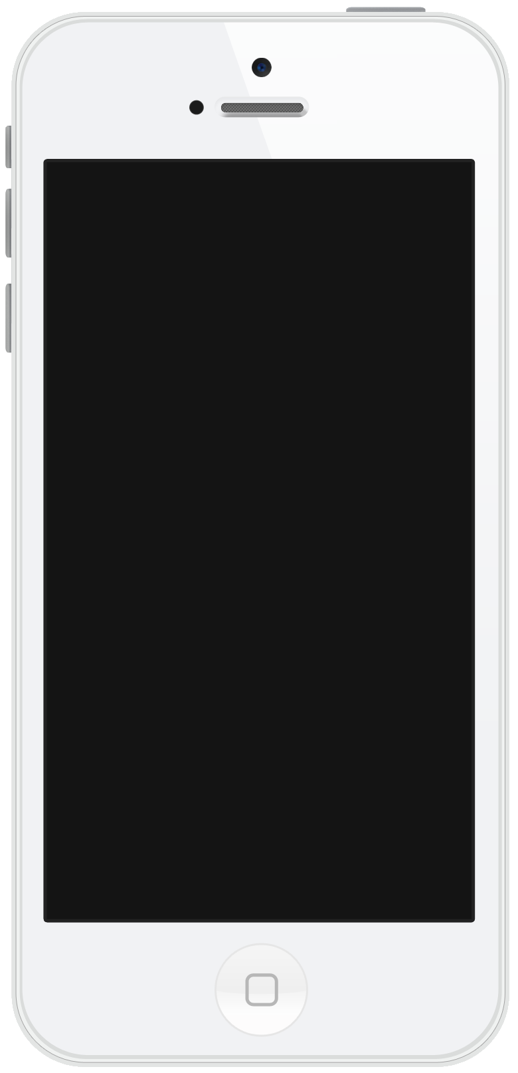
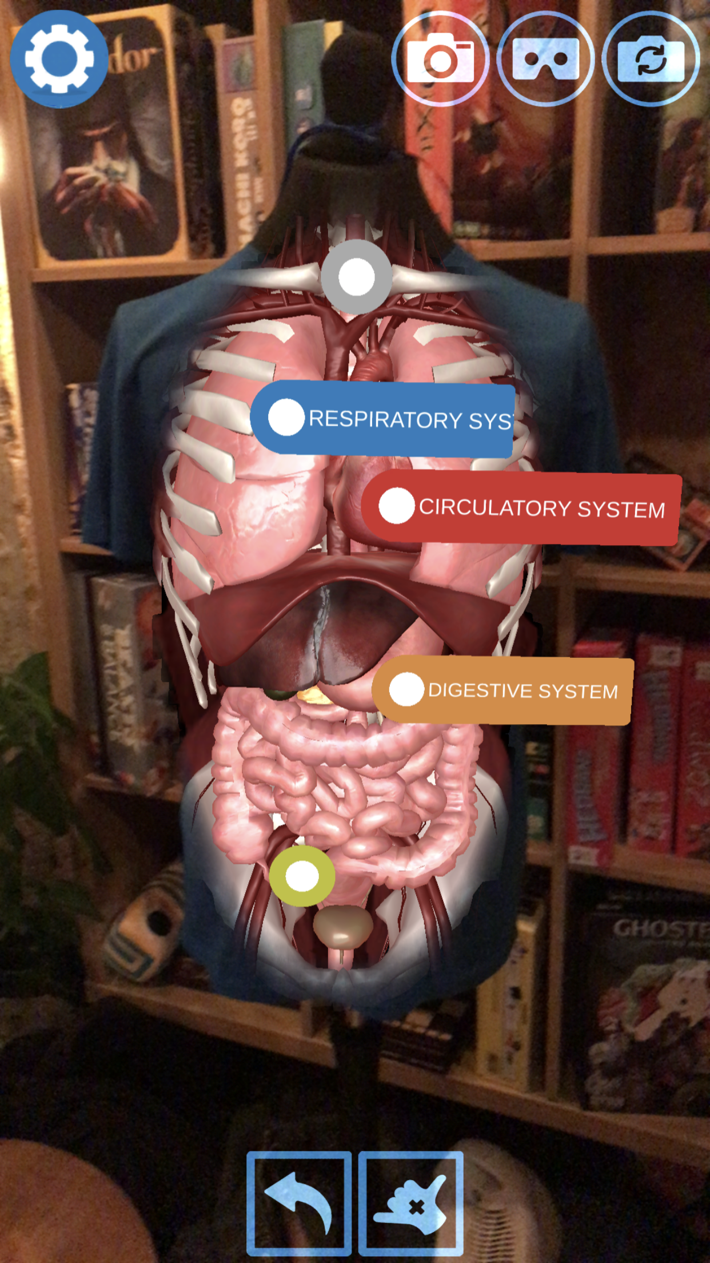


Getting into your circulatory system
Tap on the circulatory system hotspot and the app will isolate to just that system. See your heart beating!
Tap on the button to call Dr Hans, who will give you a guided tour!
Tap the button if you would like subtitles.

Slide 11

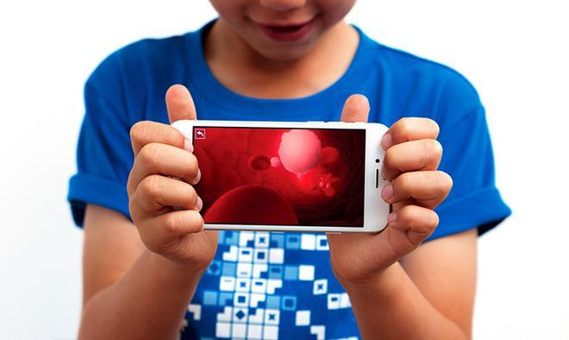
Your blood is amazing!
Tap on the icon in the circulatory system to look inside your bloodstream.
You can see the red blood cells and white blood cells and hear what they do.
Blood is made up of plasma (a yellowish watery liquid).
Inside the plasma are blood cells.
The red blood cells carry oxygen and make blood red.
White blood cells fight infection.
FUN FACT There are 250 million red blood cells in a single drop of blood!

Slide 12
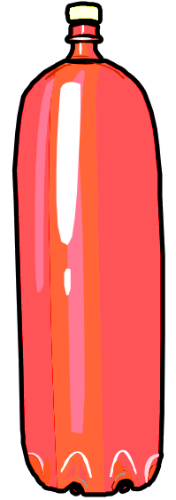
How much blood do you have?
An average 10 year old has 3 litres
The average adult has 5 litres
The amount of blood you have depends on your height and weight.

Slide 13
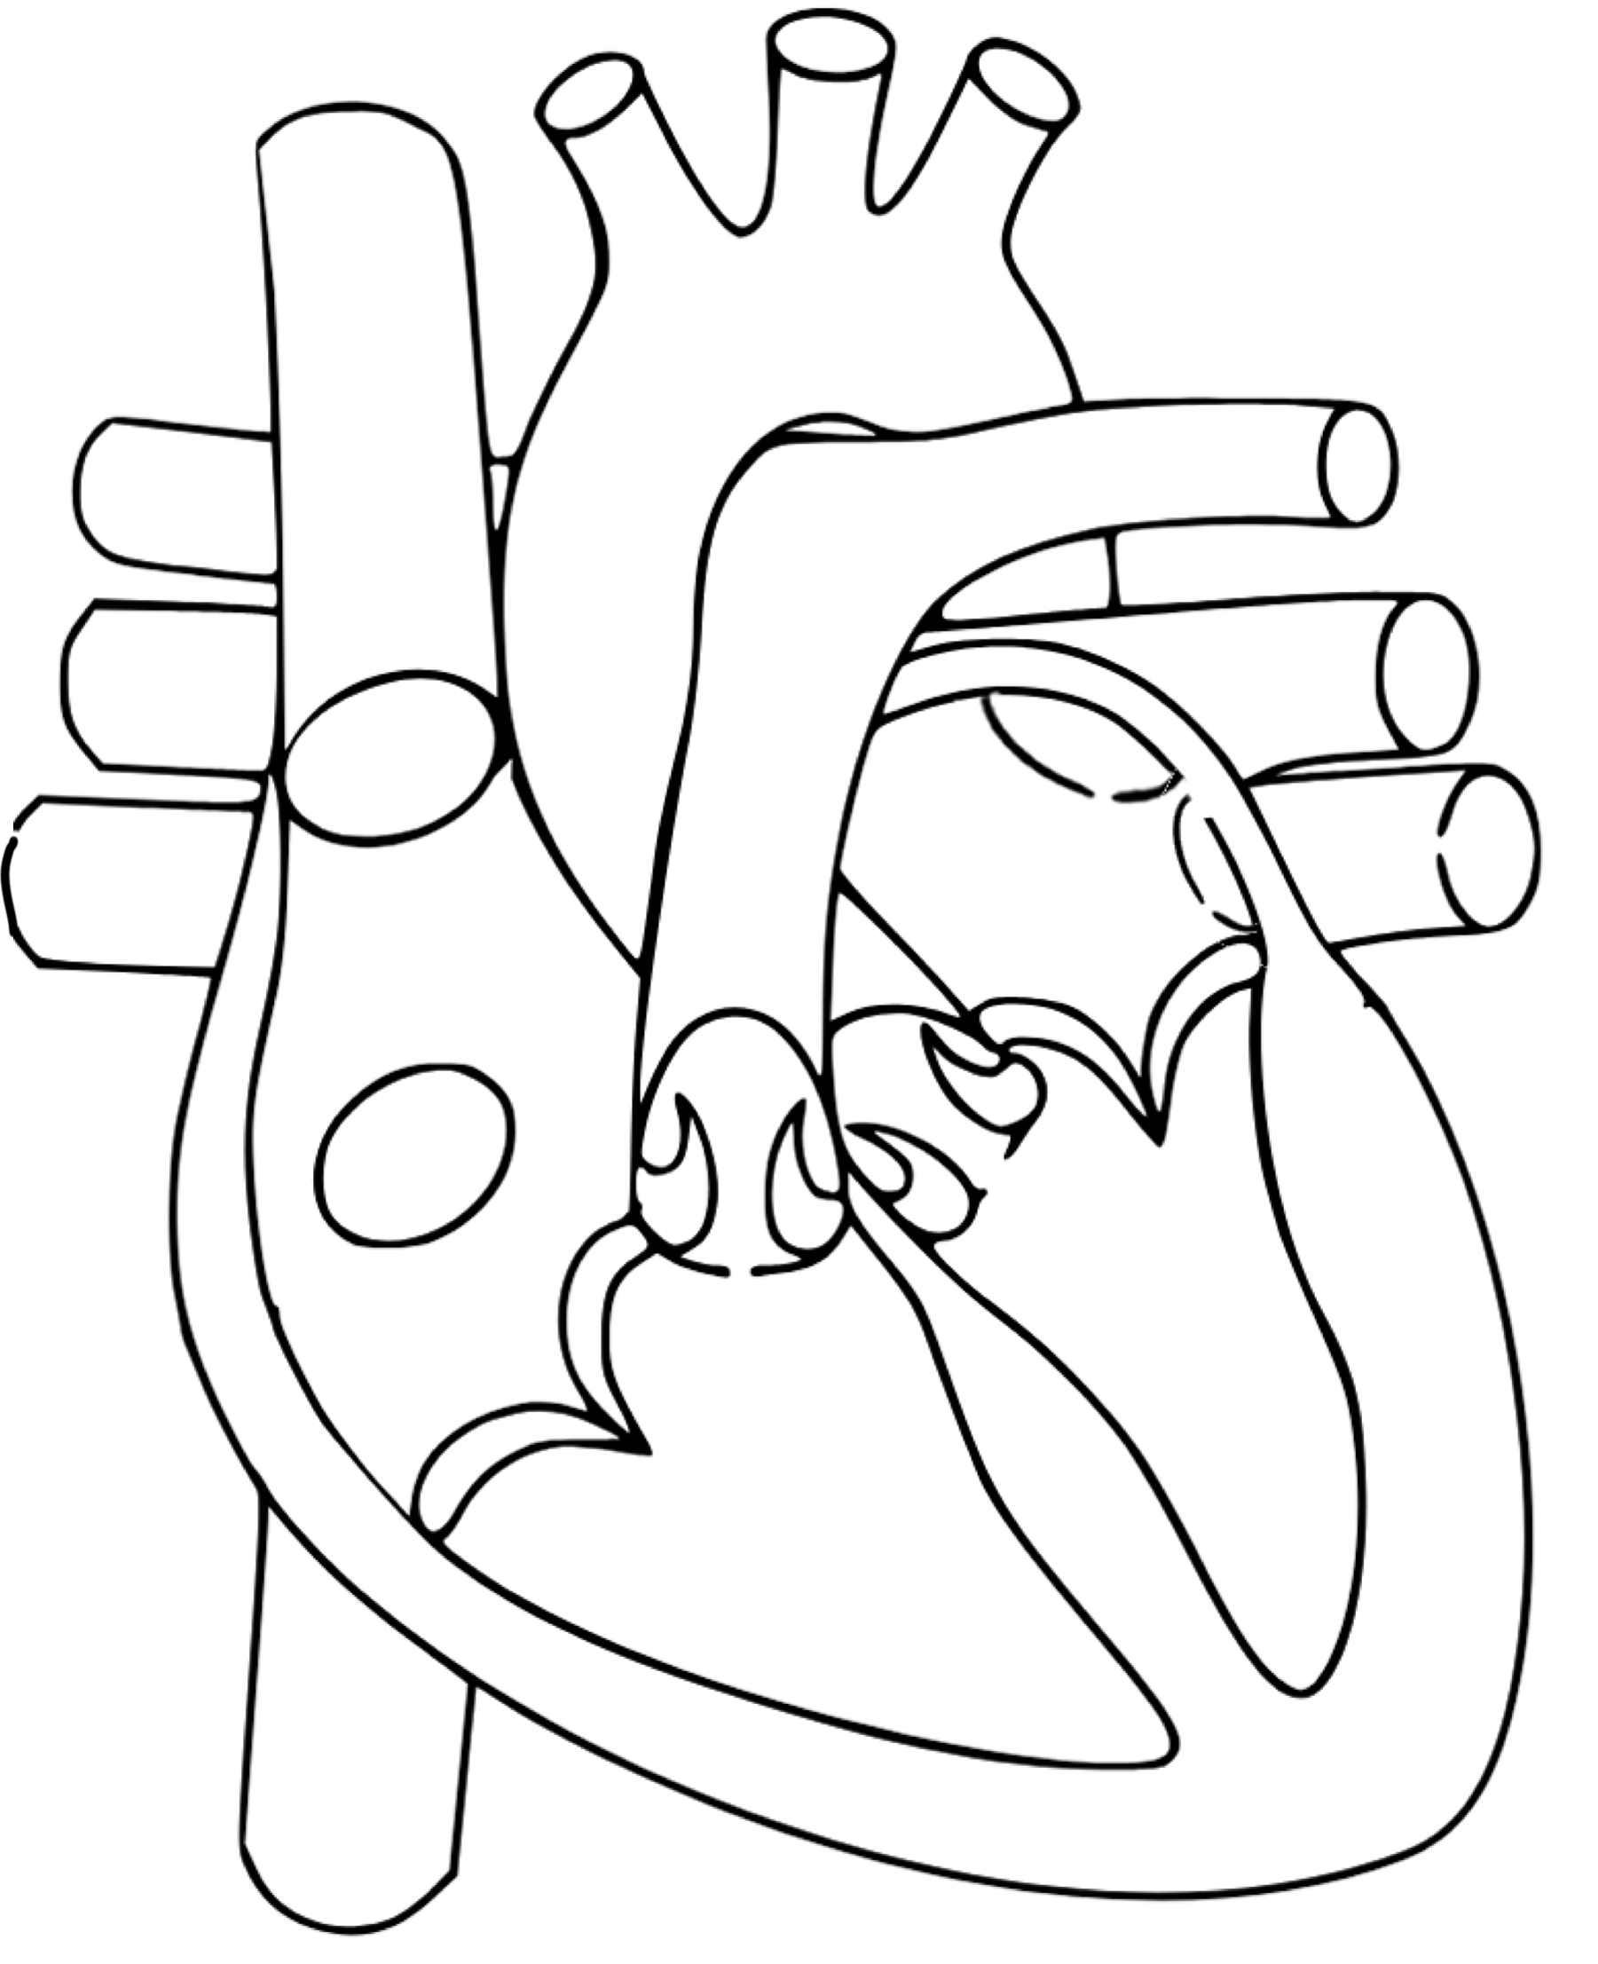
Circulatory system:
Use the clues to complete the diagram
Worksheet available in the teacher’s resources repository at: https://drive.google.com/drive/folders/17N-hPZnEAdBwevuxAYoTi-yasNatYQM9?usp=sharing
The heart pumps blood from the left side of the heart through thick blood vessels around your body to deliver oxygen and nutrients to your organs and muscles.
Blood then returns to the right side of the heart with the oxygen and nutrients used up and carrying carbon dioxide to be exhaled.
This deoxygenated blood is pumped from the right side of the heart toward the lungs where carbon dioxide is removed and oxygen is received.
Blood is returned back to the left side of the heart.
Tubes called Arteries take the blood away from the heart.
Tubes called Veins take the blood back to the heart.
Left
Right
When we describe the sides of the heart, we imagine the heart as if it was on a person. Their left and their right.

Slide 14
Movement of gases from the Respiratory to Circulatory System
In the alveoli of the lungs, the moist lining is only one cell thick.
You can observe the red blood cells on the right →
(and live on the ‘Virtuali-Tee’ app) moving through the capillaries of an alveolus to remove carbon dioxide and to receive oxygen.
These gases move by a process called DIFFUSION.
This is the movement of a gas from an area of high concentration to an area of low concentration.
In the blood, there is a high concentration of carbon dioxide to be removed, and a low concentration of oxygen which allows diffusion to occur.

Slide 15
What is a
Heart Attack?
A blood clot can block an artery that supplies blood to the heart itself.
The heart muscle becomes "starved" of oxygen.
Within a short time, death of heart muscle cells can occur, which can cause permanent damage.
Smoking and obesity are two of the main contributors to heart attacks.

Slide 16
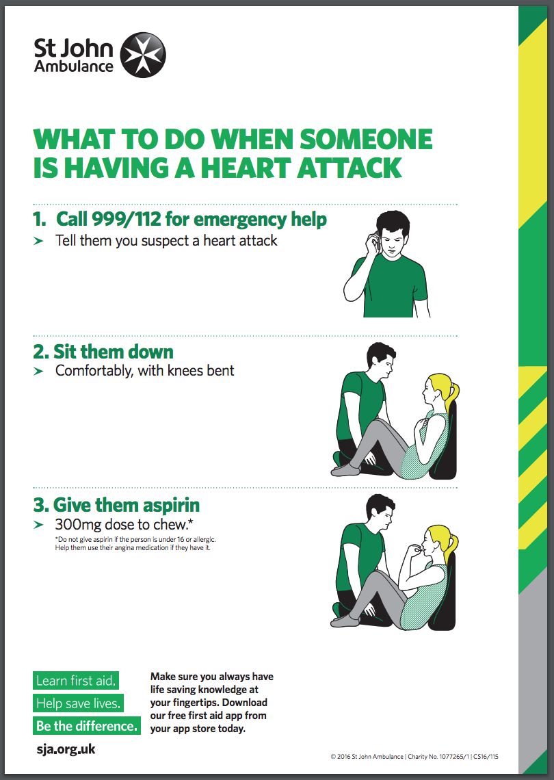
Some Symptoms of a Heart Attack
Pain or discomfort in chest
Lightheadedness, nausea or vomiting
Jaw, neck or back pain
Discomfort or pain in arm or shoulder
Shortness of breath
Cold sweats
What to do:
See the St. John’s Ambulance Fact Sheet
http://www.sja.org.uk/sja/pdf/What-to-do-if-an-adult-is-having-a-heart-attack-first-aid-poster-2016.pdf
Also available in the teacher’s resources repository at:
https://drive.google.com/drive/folders/17N-hPZnEAdBwevuxAYoTi-yasNatYQM9?usp=sharing

Slide 17
Keeping your heart healthy
Take regular exercise that makes your heart beat faster
Eat healthily – fresh fruit and vegetables and not too much salt, sugar or fat
Avoid foods that are high in saturated fats and trans-fats
(such as animal fats, fried foods, commercial baked goods)
Take time to relax and avoid too much stress
Don’t smoke
Photo: Thomas Bresson

Slide 18
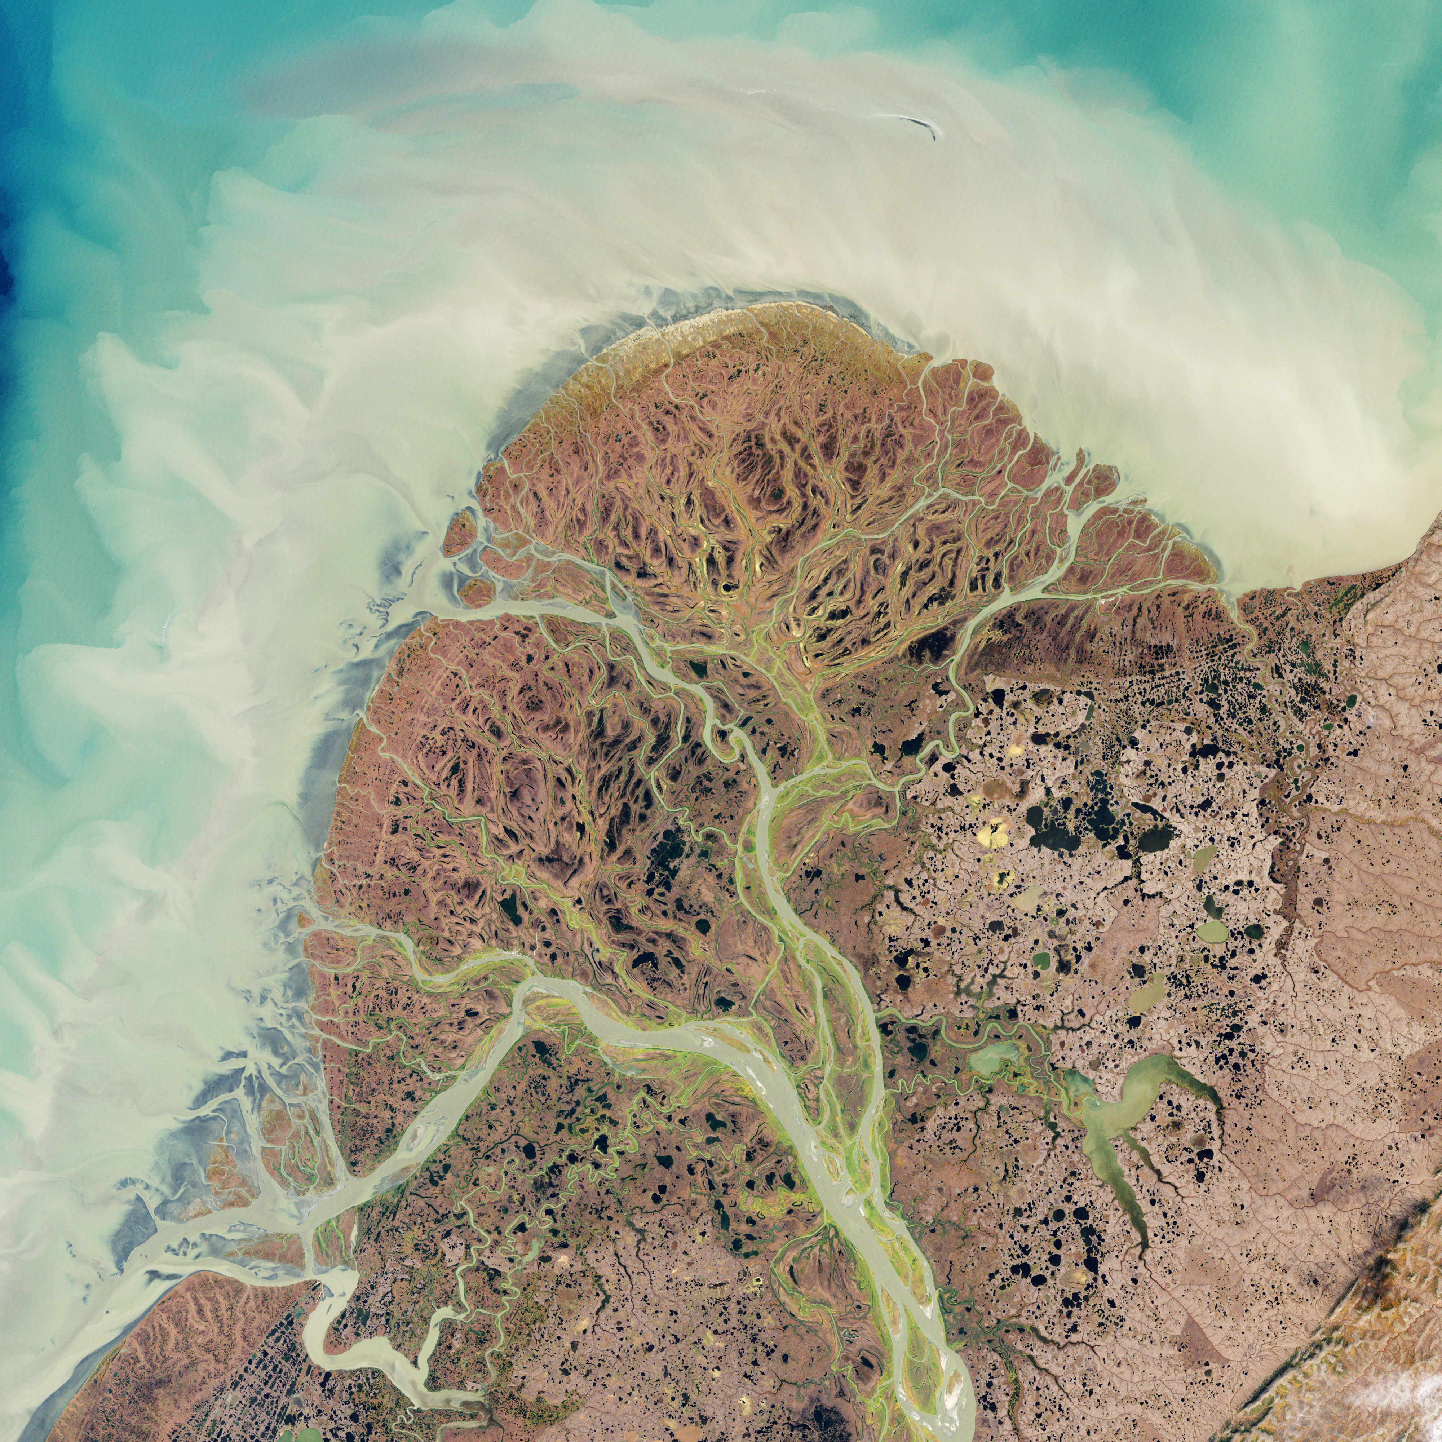
Curious facts!
If you were to lay all your blood vessels in a long line they would stretch about 60,000 miles (96,560 km)! (that’s over two times around the entire world).
Your heart beats about 100,000 times a day.
Your heart beats without you having to think about it.
The image on the right is a satellite image of rivers in Alaska. It’s interesting that they look like blood vessels.

Slide 19
Quiz
Can you fill in the blanks and show what you’ve learnt today? Use the words in blue to help you.
Our heart is a _______ which pumps blood through our body. You can feel your _______ in your wrist. You can feel your heartbeat by placing your hand on your________. If you get excited or do exercise your heart rate gets ________. Your blood delivers oxygen and nutrients to your body. A ten year old has about _________of blood in their body. Blood is made of plasma and blood cells. ________ is carried in red blood cells. White blood cells fight _________. The heart has 4 chambers. On the right side is the _________and the right ventricle. On the left side is the left atrium and the_____________. The right side of the heart receives blood from the body and the left side sends _____________ from the lungs to the rest of the body. The process of blood going round the body is called ___________.
Oxygen - infection - faster - muscle - chest - pulse - right atrium
left ventricle - circulation - 3 litres - oxygen-rich blood

Slide 20
Quiz
Can you fill in the blanks and show what you’ve learnt today? Use the words in blue to help you.
Our heart is a muscle which pumps blood through our body. You can feel your pulse in your wrist. You can feel your heartbeat by placing your hand on your chest. If you get excited or do exercise your heart rate gets faster. Your blood delivers oxygen and nutrients to your body. A ten year old has about 3 litres of blood in their body. Blood is made of plasma and blood cells. Oxygen is carried in red blood cells. White blood cells fight infection. The heart has 4 chambers. On the right side is the right atrium and the right ventricle. On the left side is the left atrium and the left ventricle. The right side of the heart receives blood from the body and the left side sends oxygen-rich blood from the lungs to the rest of the body. The process of blood going round the body is called circulation.

