Slide 1
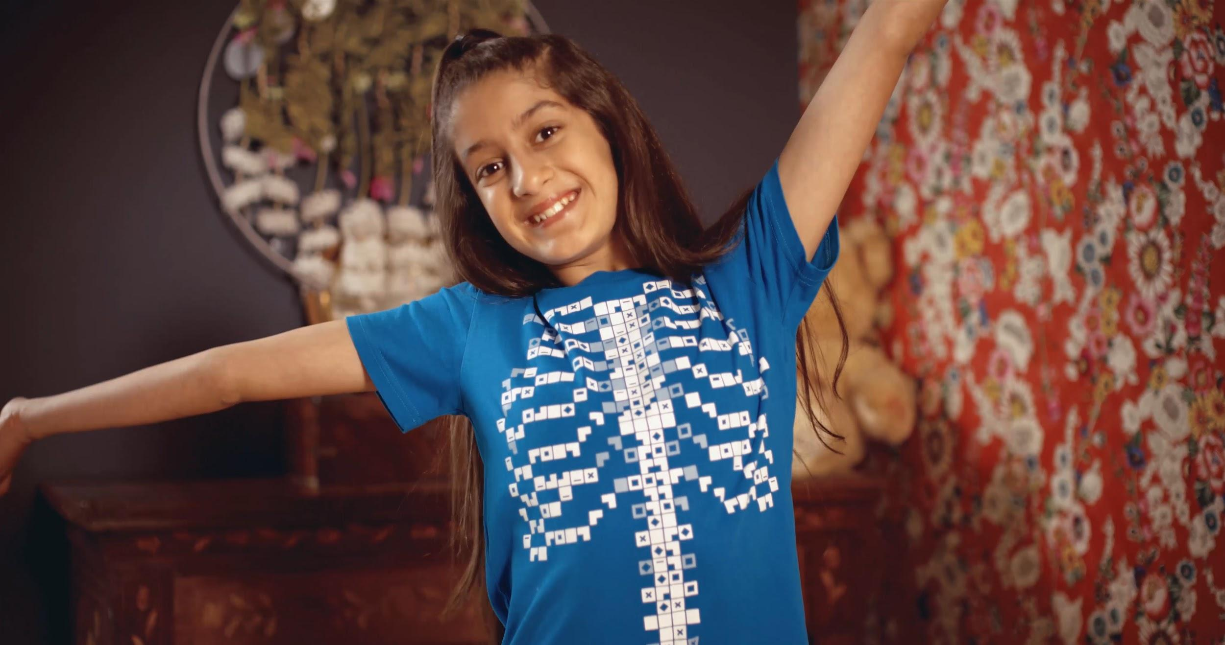

The Skeletal System
Primary/Elementary Resource
“The world is full of magic! We created the Virtuali-Tee and these resources to enable you to unlock the curiosity that exists within every student”

Slide 2
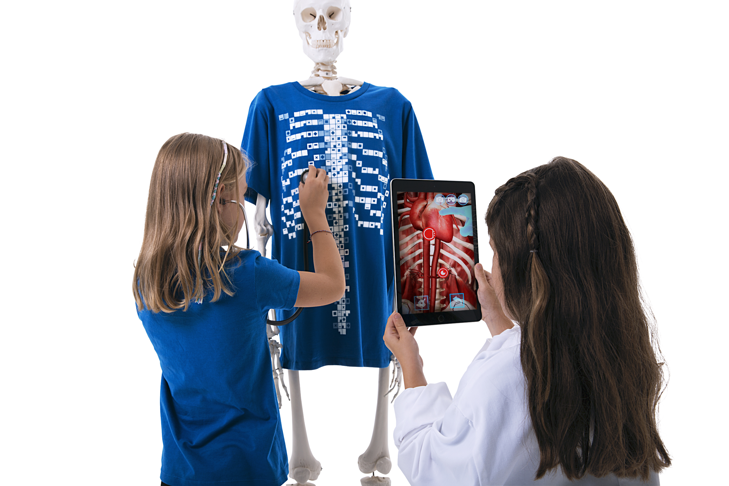
OVERALL LEARNING OUTCOMES
Primary / Elementary
The Musculoskeletal System Objectives
To identify the functions of the skeleton
To relate images of bones, muscles and joints to diagrams and the body

Slide 3
Let’s get curious...
?
Have you ever seen a skeleton?
Do you have a skeleton?
How do you know?
What would happen if you didn’t have a skeleton?
Let’s find out some more…..
A KWL Inquiry worksheet for the skeletal system is available in the teacher’s resources repository at:
https://www.curiscope.com/pages/science-lesson-plans-human-body

Slide 4
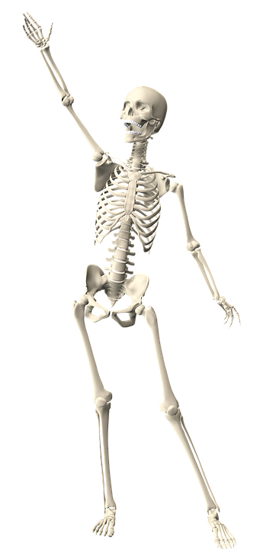
The human skeleton
How many bones do you think there are?
A) 98
B) 206
C) 150
Answer: B (206)
"Children are born with around 300 bones which
fuse together as we grow.”

Slide 5
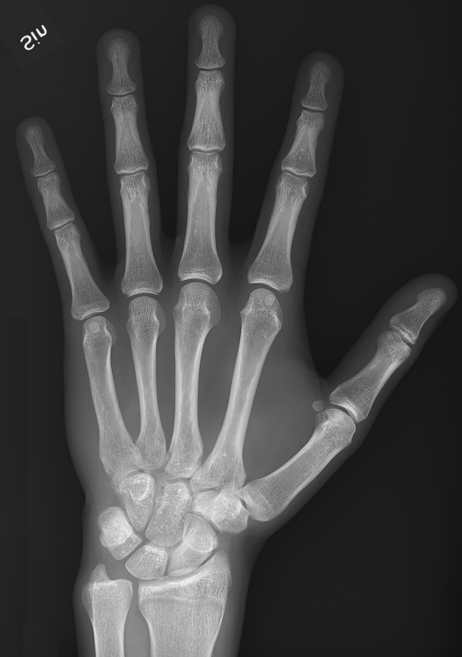
Why so many bones?
Some parts of your body have lots of small bones.
There are 27 bones in each hand
and 26 in each foot
Why do you think that is?
We have lots of bones in our hands and feet because they need to be very adaptable and dextrus. What do you think this means?
“106 out of all 206 bones are in your hands and feet!!”

Slide 6
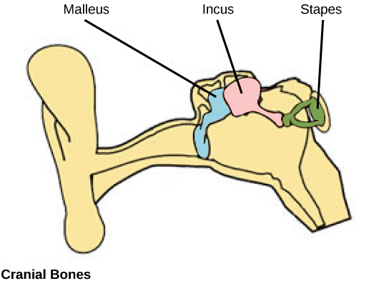
Little and large bones
The smallest bones in the human body are found in the inner ear and vibrate helping us to hear
The smallest bone of all is the stirrup or stapes bone which is about 3 mm long
The largest and strongest bone is the Femur or thigh bone which extends from the hip to the knee.

Slide 7
Why do we need a skeleton?
Protection
Support
Movement

Slide 8
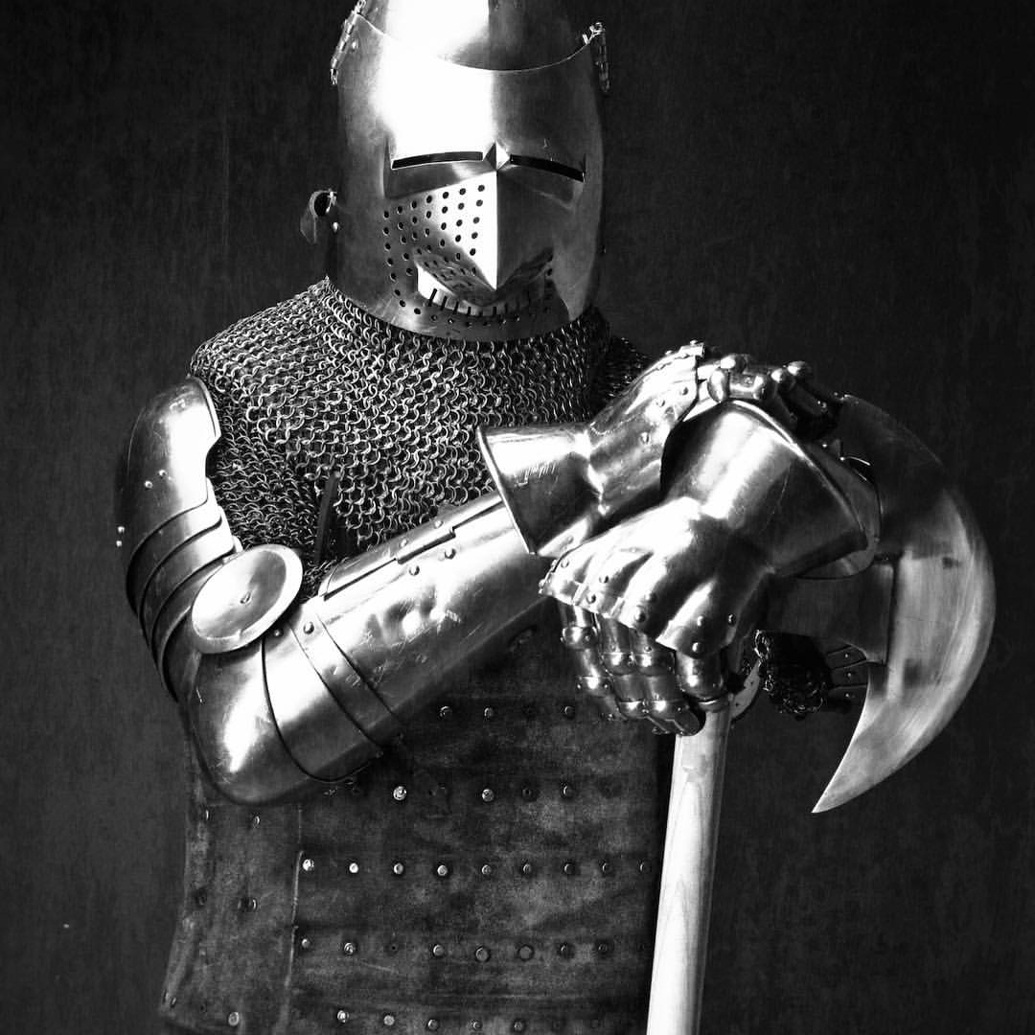
Protection
The skeleton protects important organs in
the body
Most of your organs are soft and squishy.
The skeleton stops them from getting damaged.
What protects your brain?
Source: NinDerryStudios

Slide 9
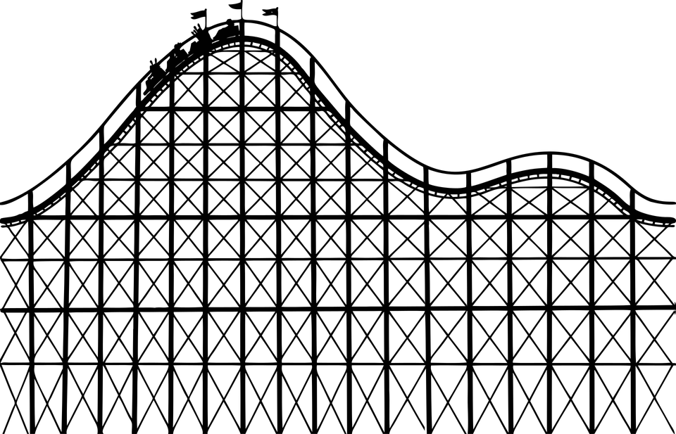
Support
Bones are hard and strong.
Your skeleton helps you to stand up and holds your body parts in place.

Slide 10
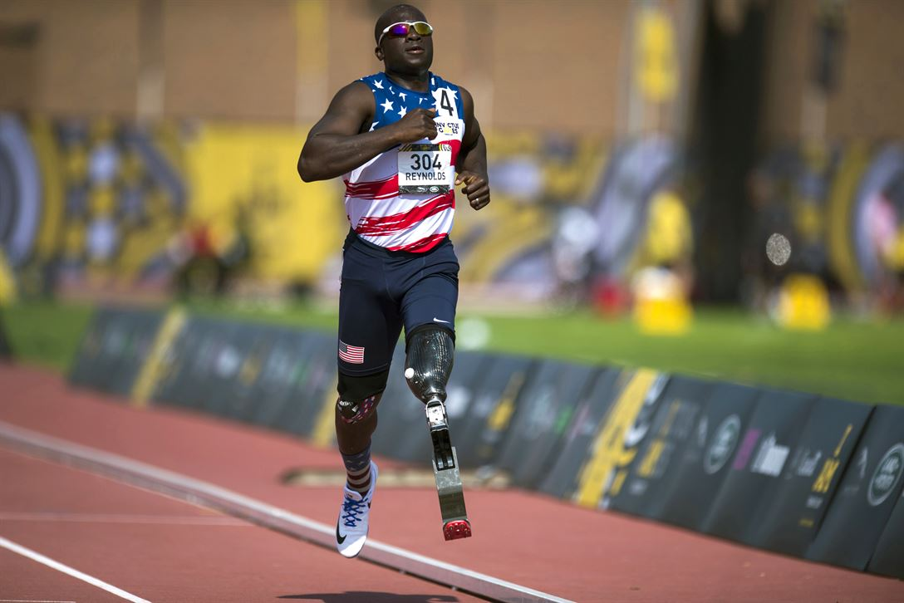
Movement
Your body can bend because parts of the skeleton are jointed.
Tendons and ligaments are joined to your bones helping you to move.
Bones are so important to movement, that if we lose a limb we replace it with prosthetics.

Slide 11
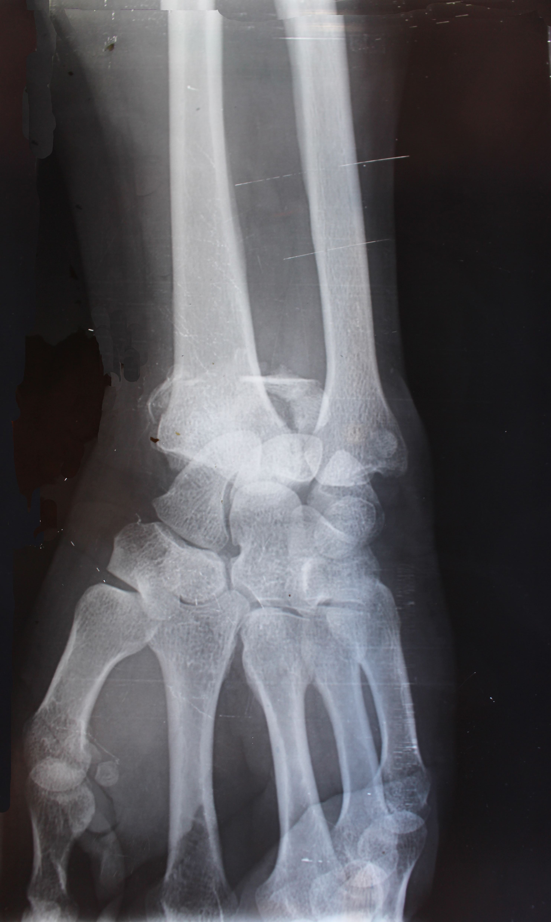
X-RAYS
Doctors can use x-rays to see inside your body.
They can see if any bones are broken.
A cast or support will be put on to hold the bone still and in place whilst it grows back and heals.
Bones are growing all the time and can fix themselves!

Slide 12
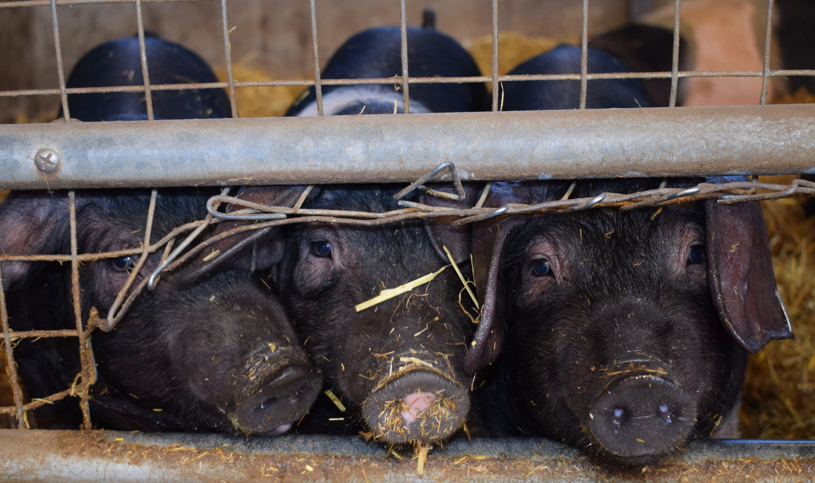
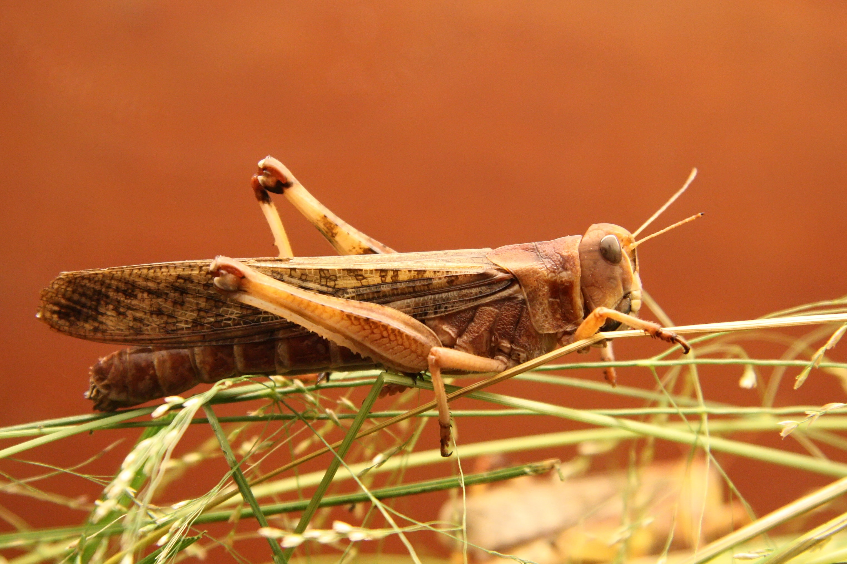
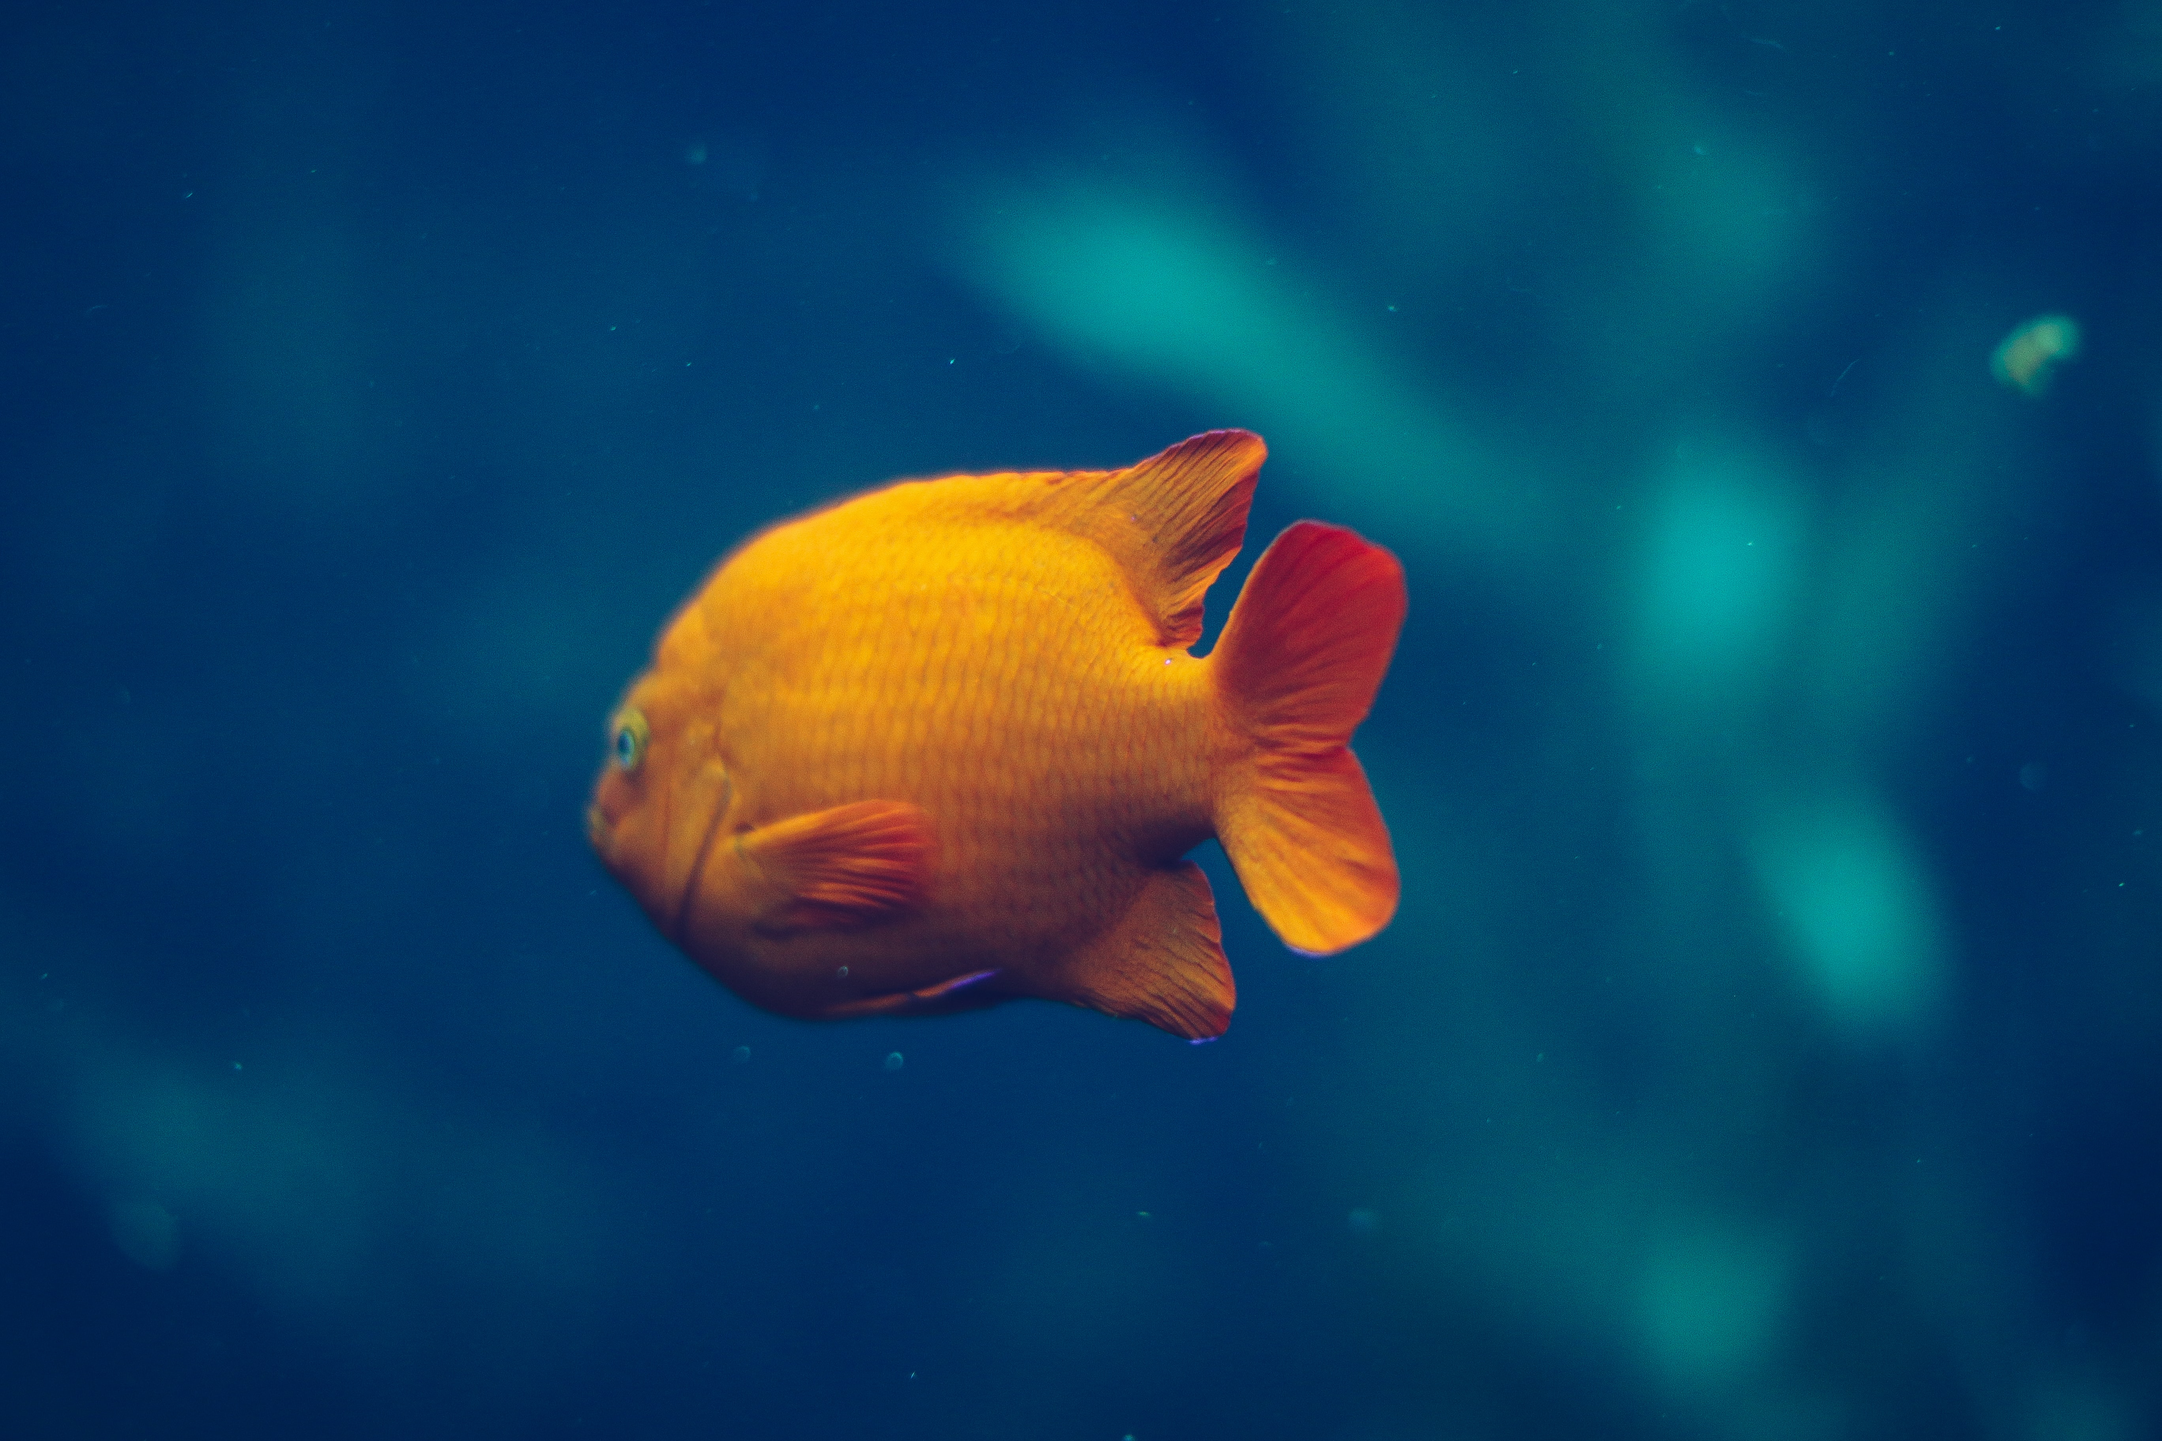
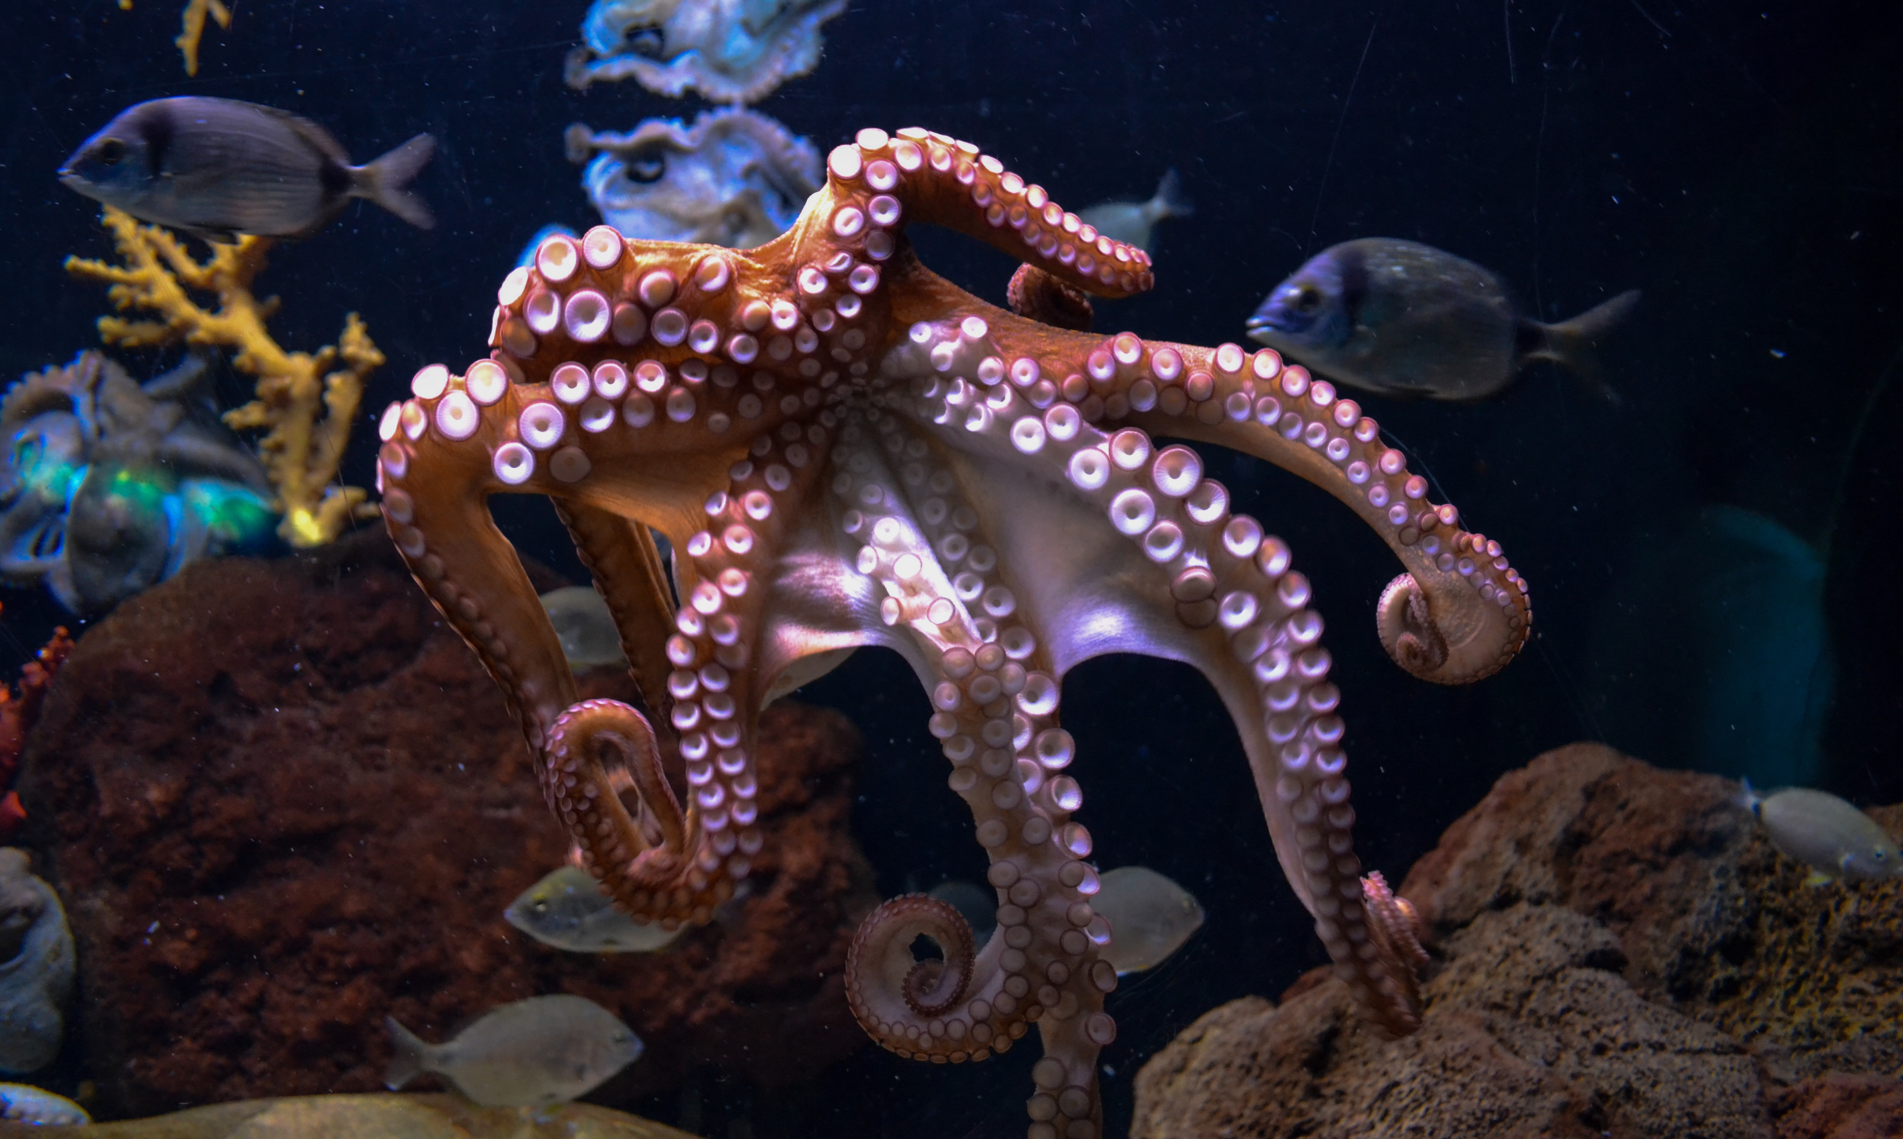
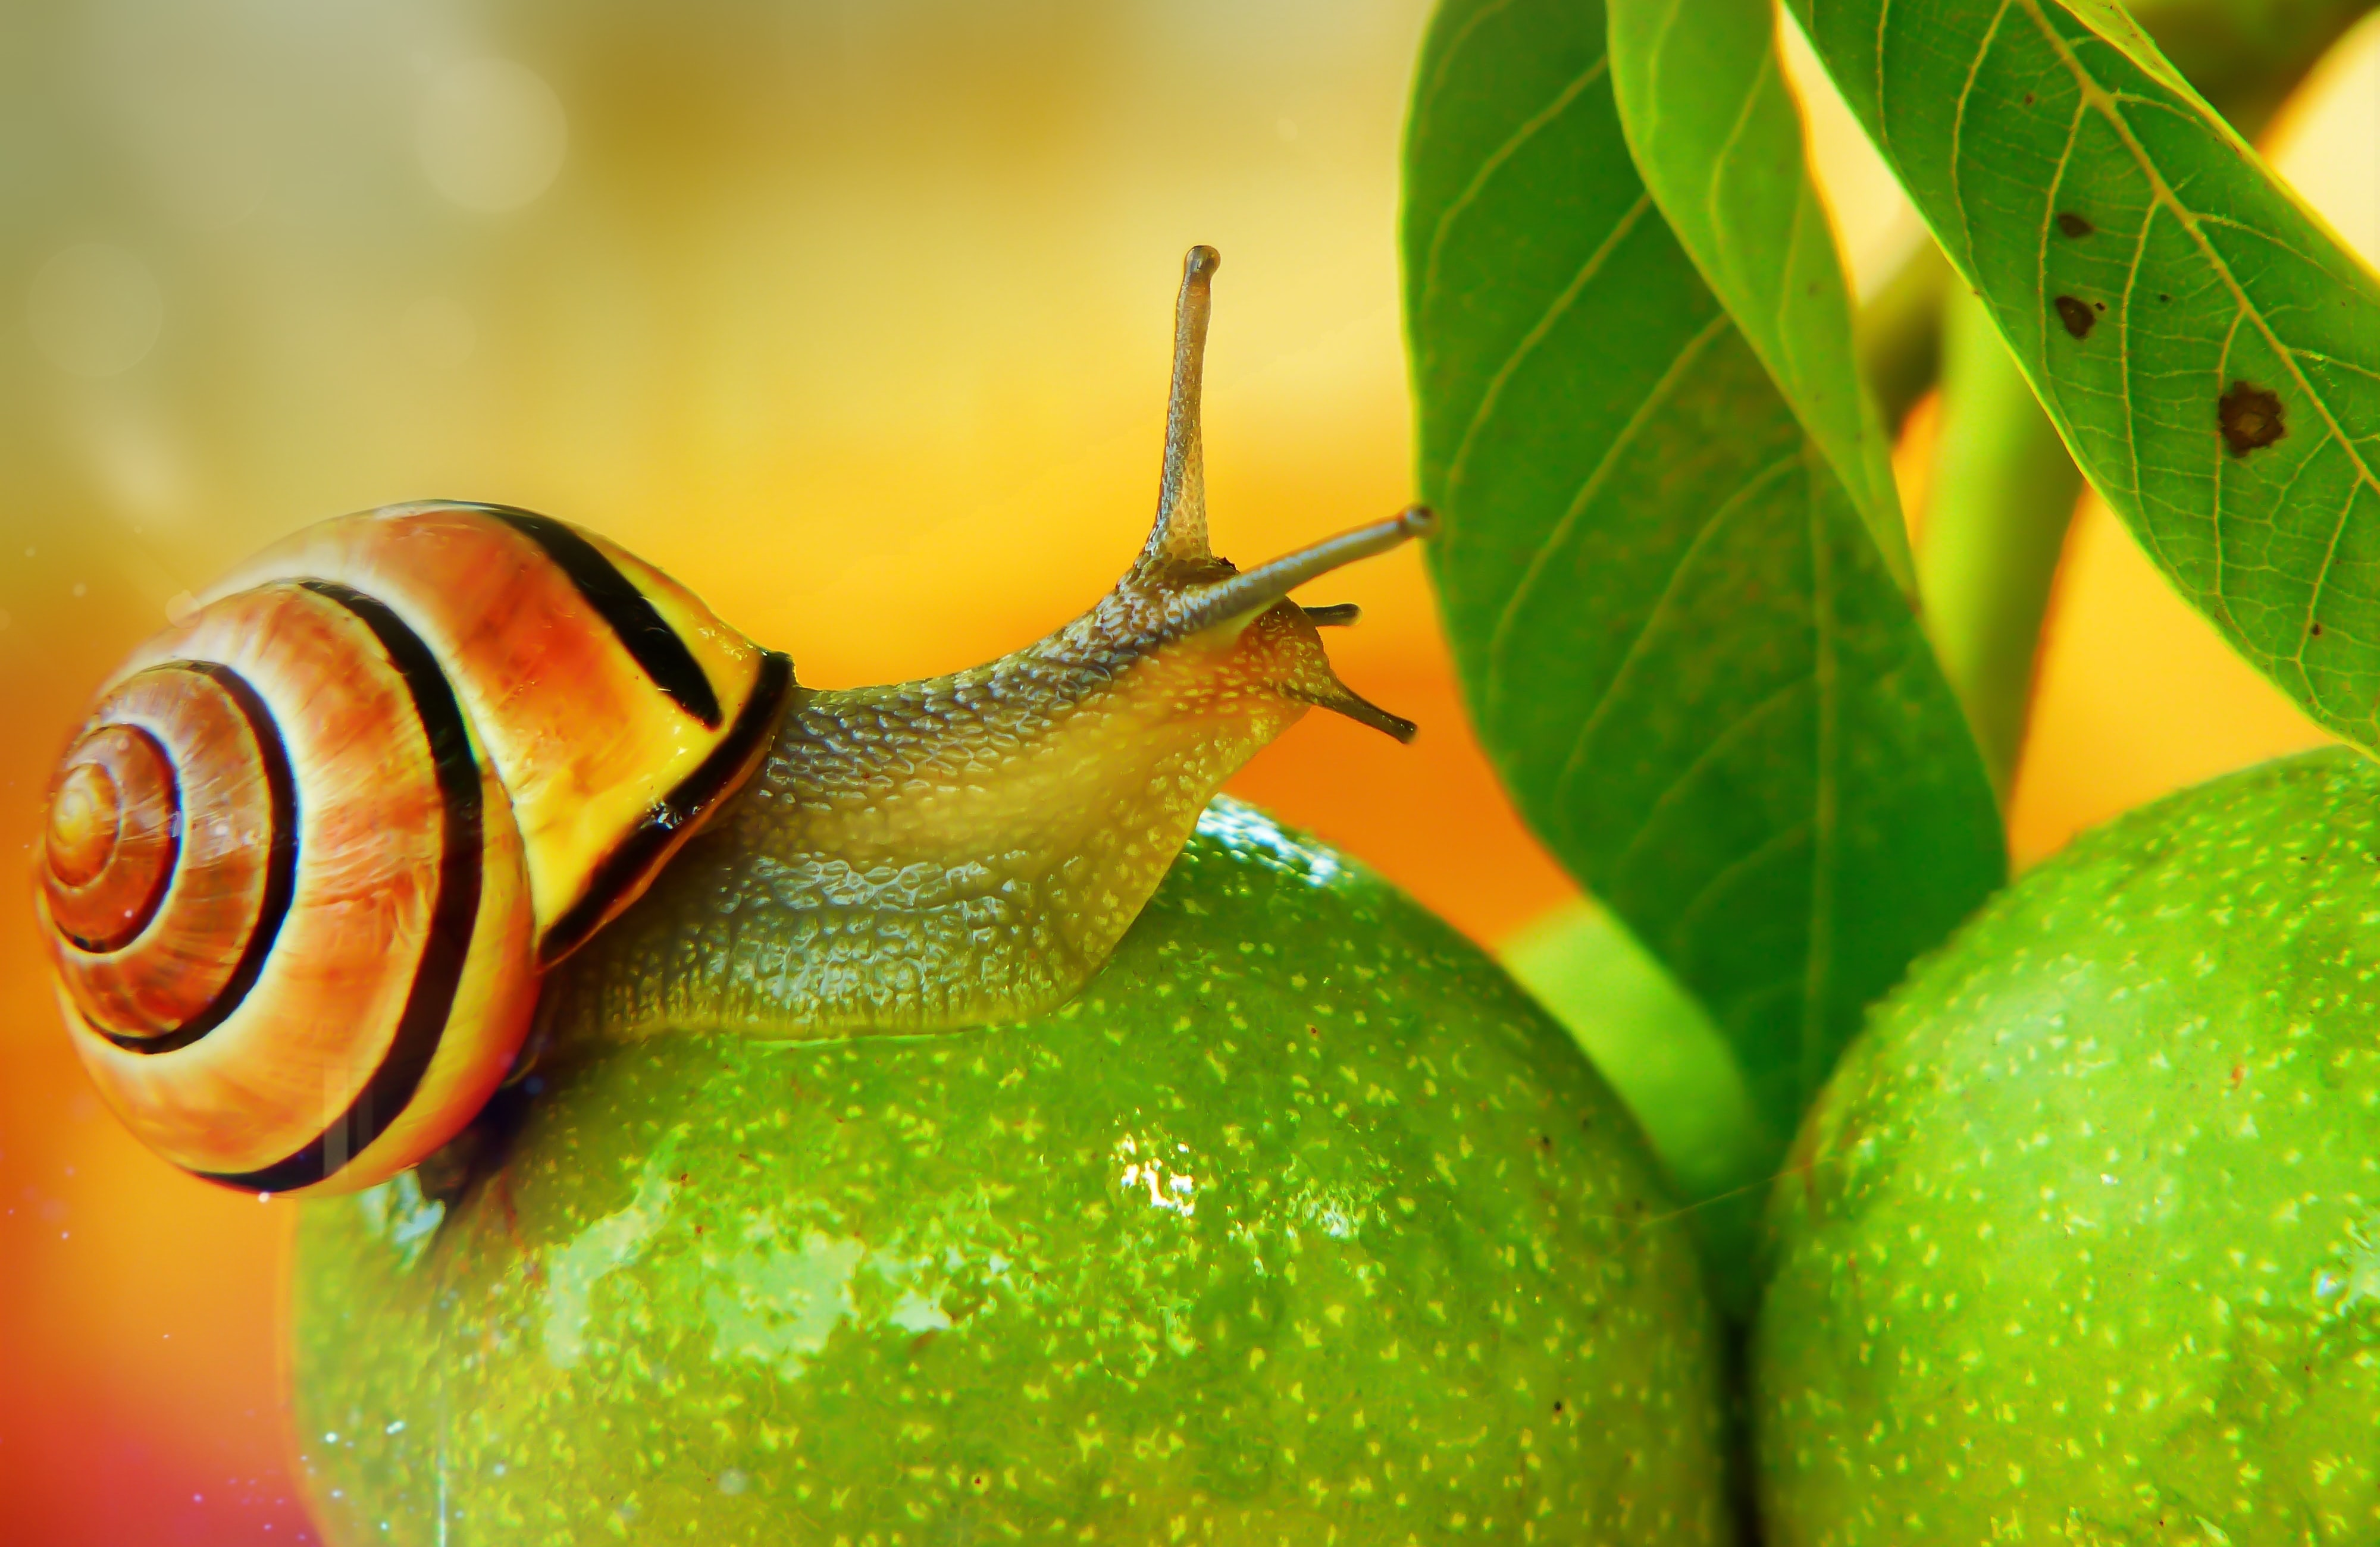
Do all animals have skeletons?
Scientists classify animals into vertebrates (with a backbone) and invertebrates (without a backbone)
Discuss which these are invertebrates and which ones are vertebrates:

Slide 13
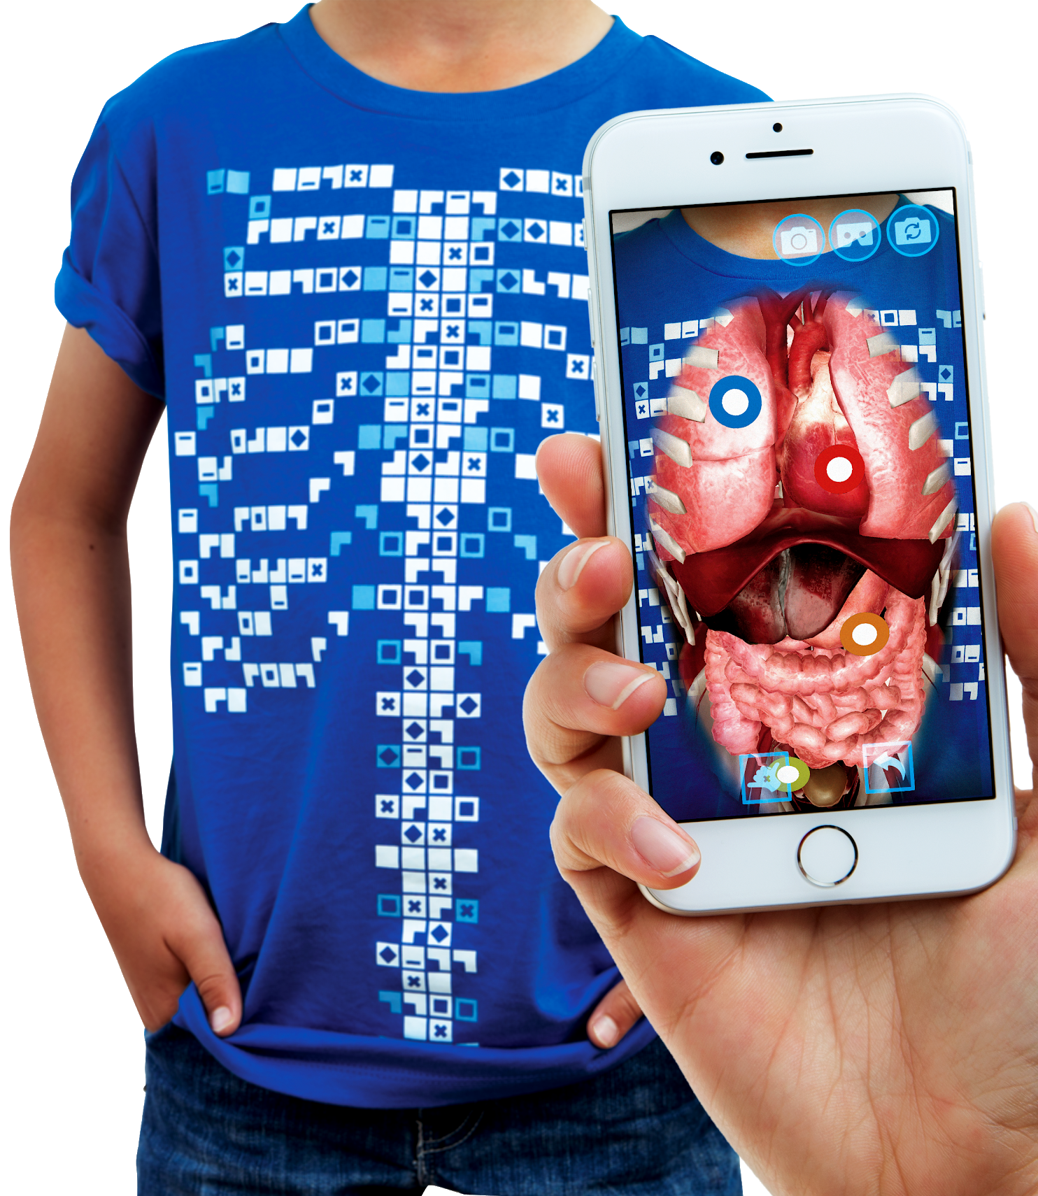
The Virtuali-tee
Today we are going to be using a very special t-shirt to explore your skeletal system
“Explore the Human Body…
On a Human Body…..”

Slide 14
What is the Virtuali-Tee?
A t-shirt that lets us see inside YOUR body using Augmented Reality!
We’ll use a mobile device to scan the tshirt with the app and open a portal so we can explore what is going on under your skin.

Slide 15
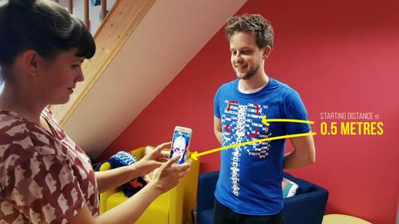
Step 1 - Getting started
To get started, simply open the Virtuali-Tee app and point at the t-shirt. The tracker image is best picked up by initially pointing at the upper chest with the device 0.5m/1.5ft from the t-shirt.
The tracking of the t-shirt requires that you are in a well lit space without heavy shadows and that the t-shirt is not stretched or heavily wrinkled.

Slide 16
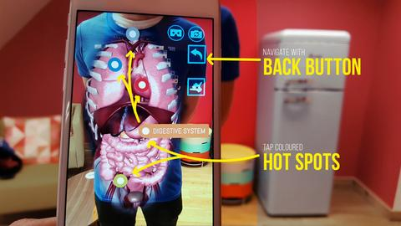
Step 2 - Wow, the organs look amazing…now what!?
Well, we have implemented some pretty cool features into the app. Just tap the screen to get started. You can then isolate the physiological system by tapping on the coloured hot spots. You’ll see some buttons floating outside the chest, use the back button to navigate between systems.
We encourage you to explore, if you see a button….tap it to find out what it does!

Slide 17
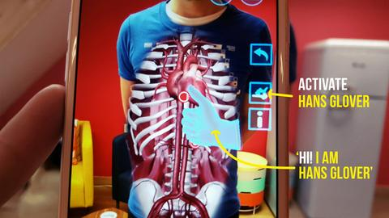
Step 3 - Surprise! Meet Hans Glover….your virtual expert on the body!
Think of Hans as a holographic guide to the body. He’ll talk you through the anatomy and physiological systems in the body. Just tap the Hans button and he’ll appear.

Slide 18

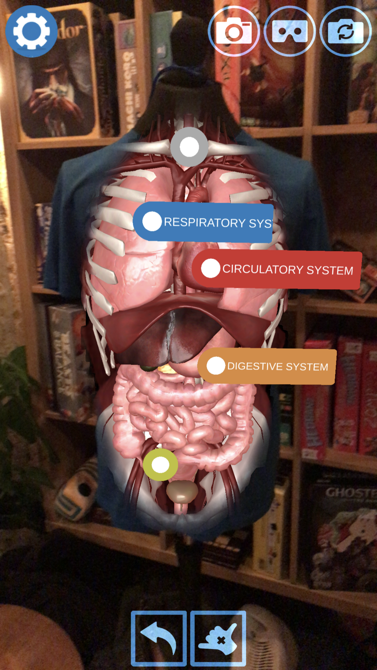


Getting into your skeletal system
Tap on the grey skeletal system hotspot and the app will isolate to just that system. See through to your spine!
Tap on the button to call Dr Han’s, who will give you a guided tour!
Tap the button if you would like subtitles.

Slide 19
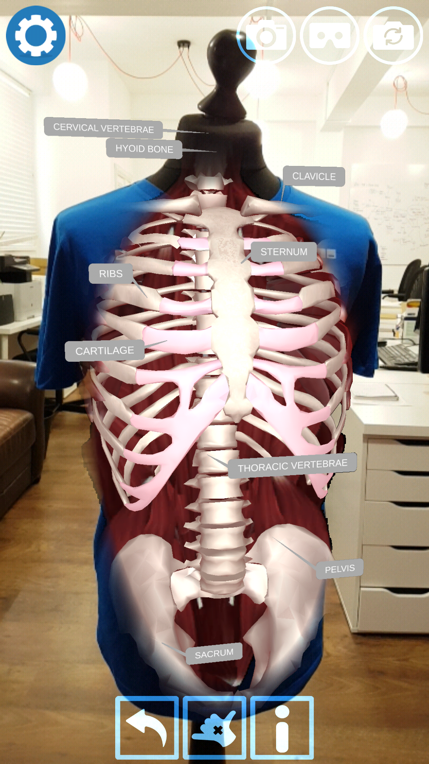

Discovering your bones
Tap on the button to bring up the labels for the skeletal system.
Study these as they will help your next activity.

Slide 20
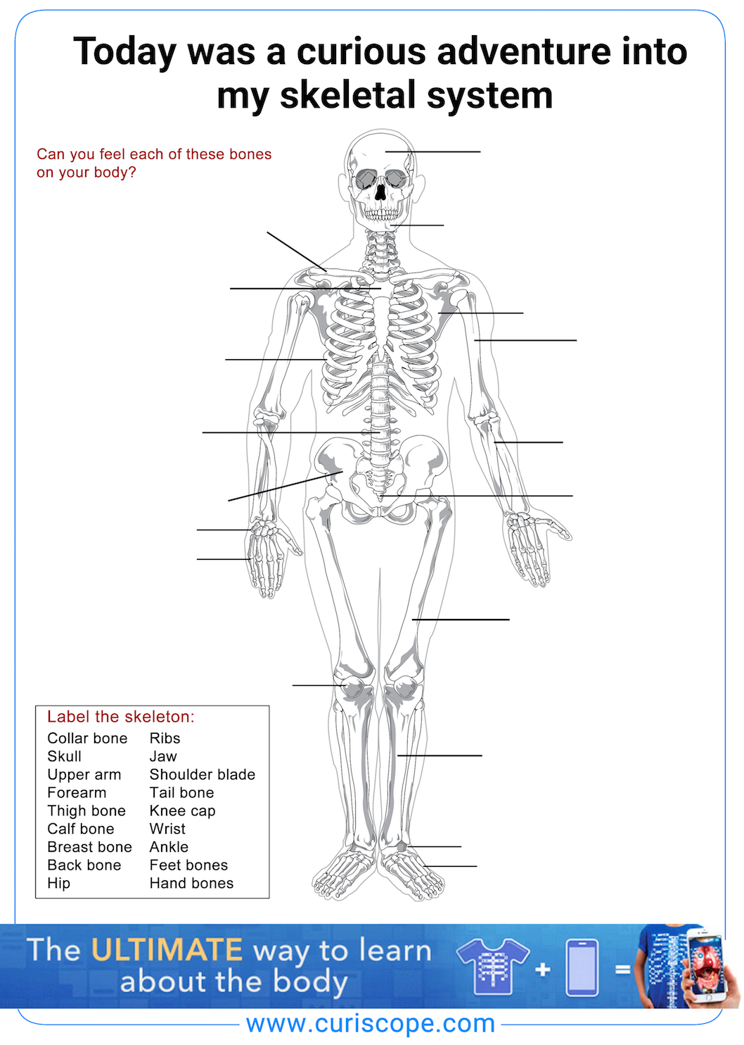
Label the skeletal system
Can you feel each of these bones on your body?
In pairs or groups make and label your own model/picture of a skeleton using the materials your teacher gives you.
The print friendly take home sheet is available in the teacher resources repository:
https://goo.gl/3UWxYK

Slide 21
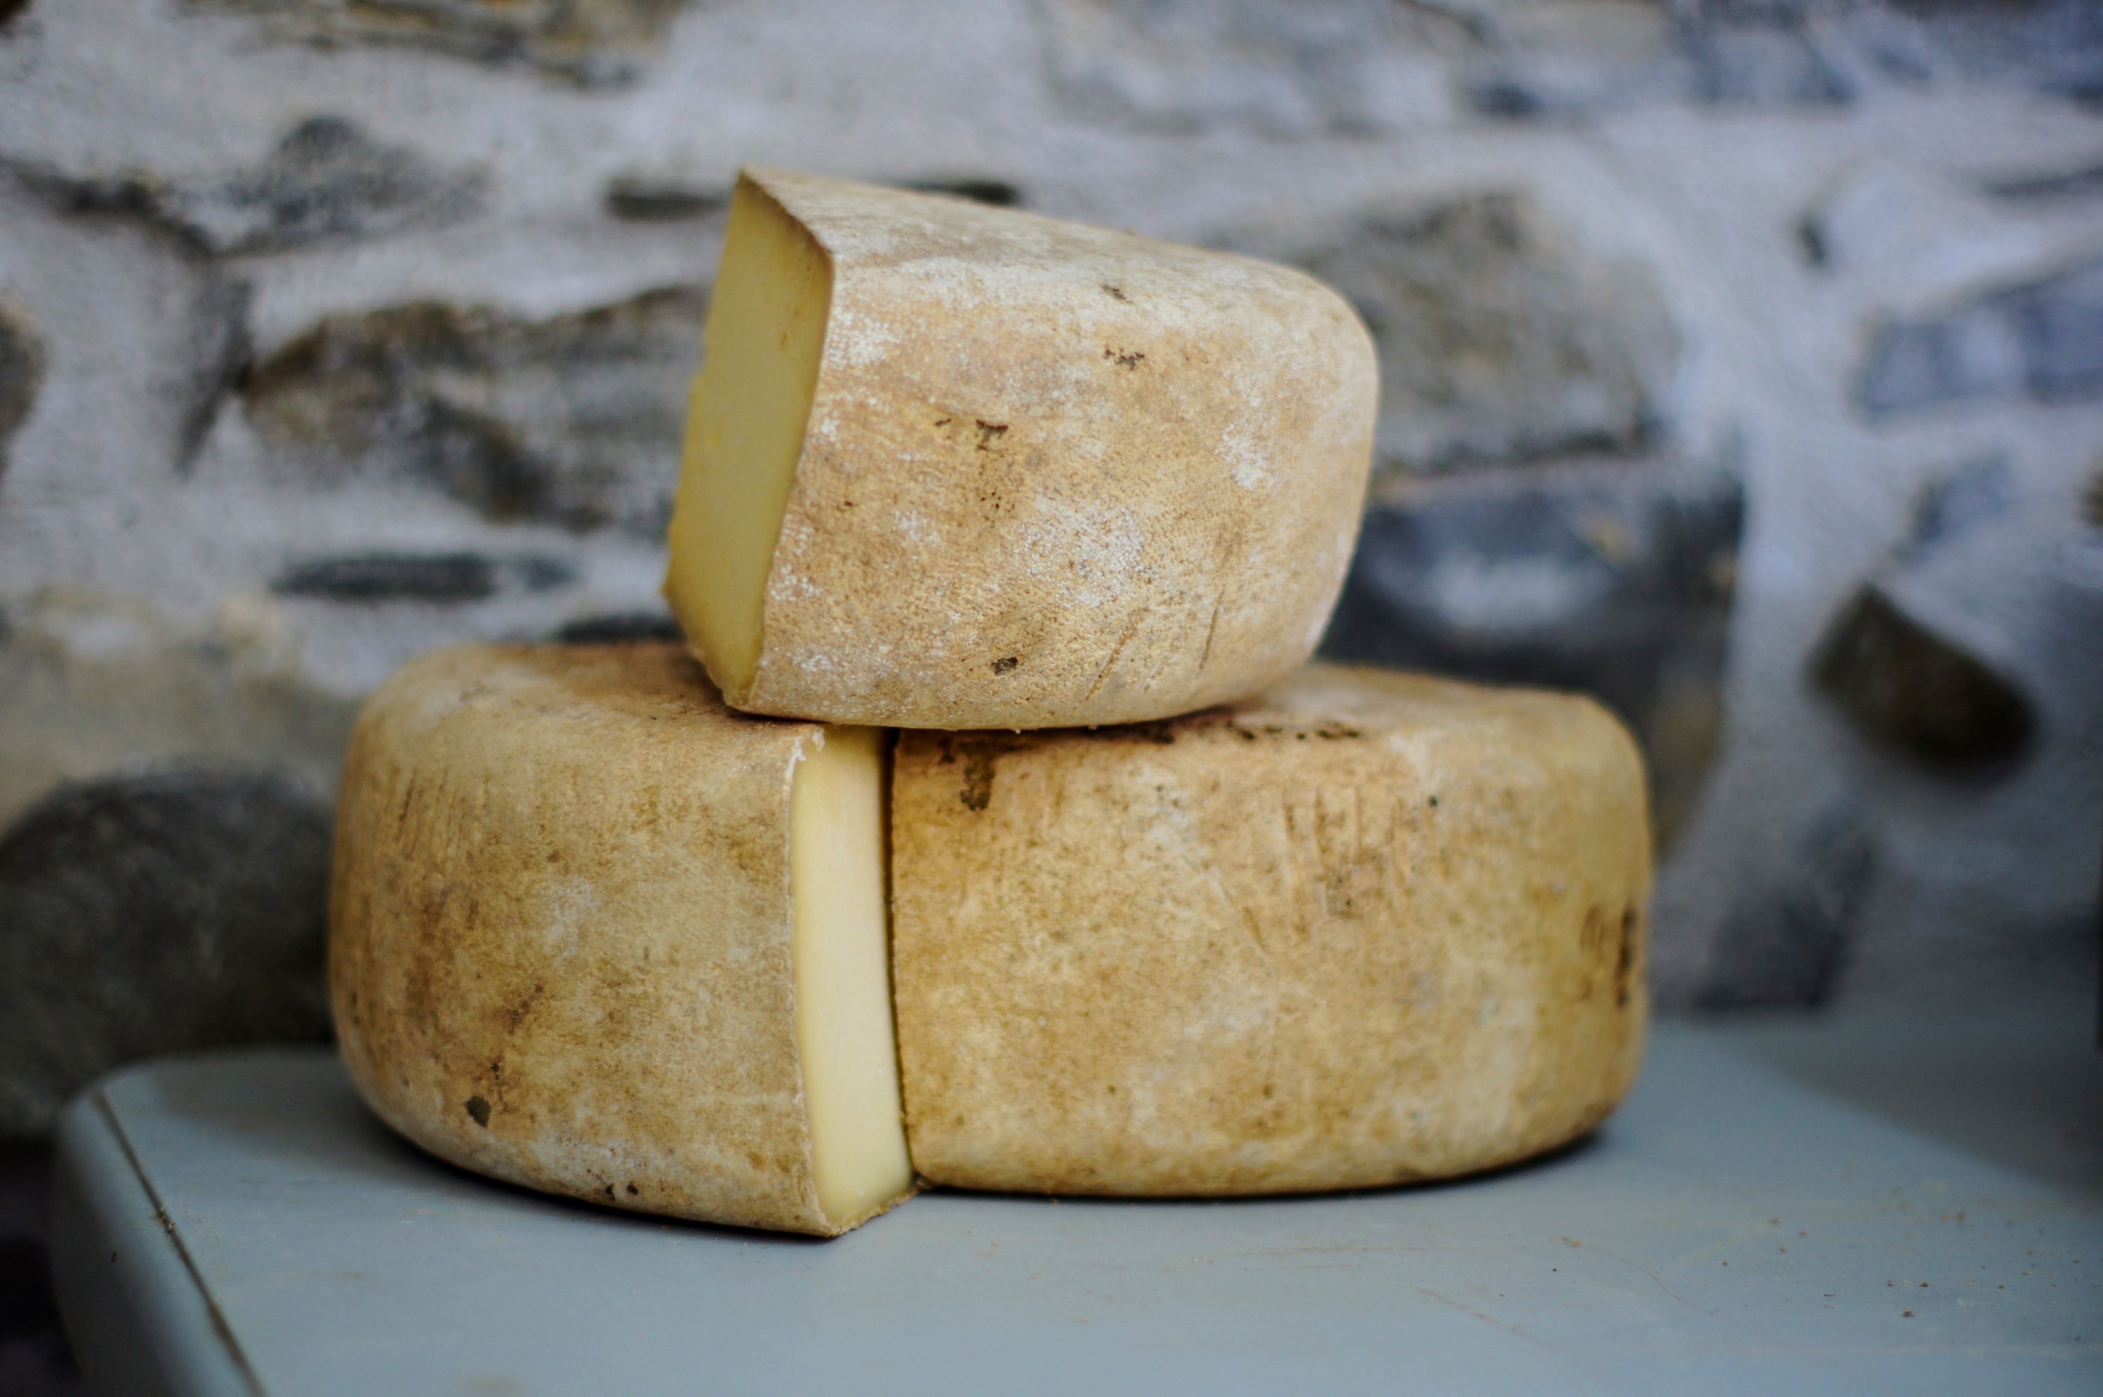
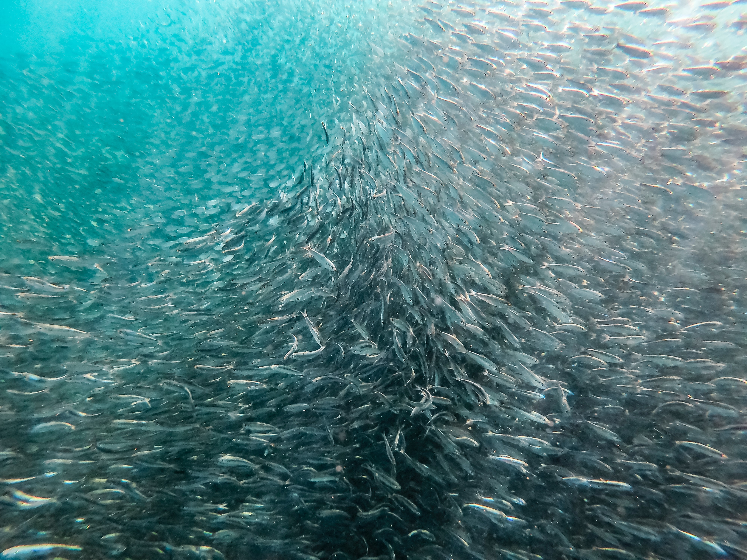
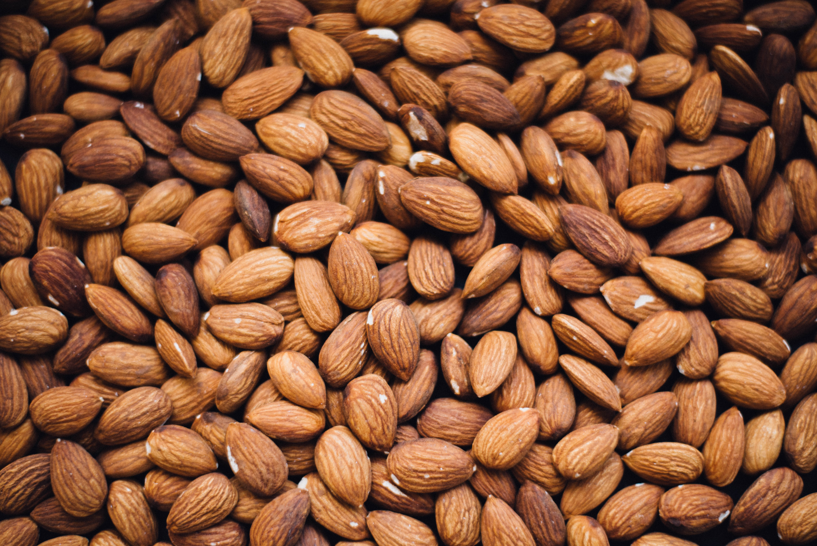
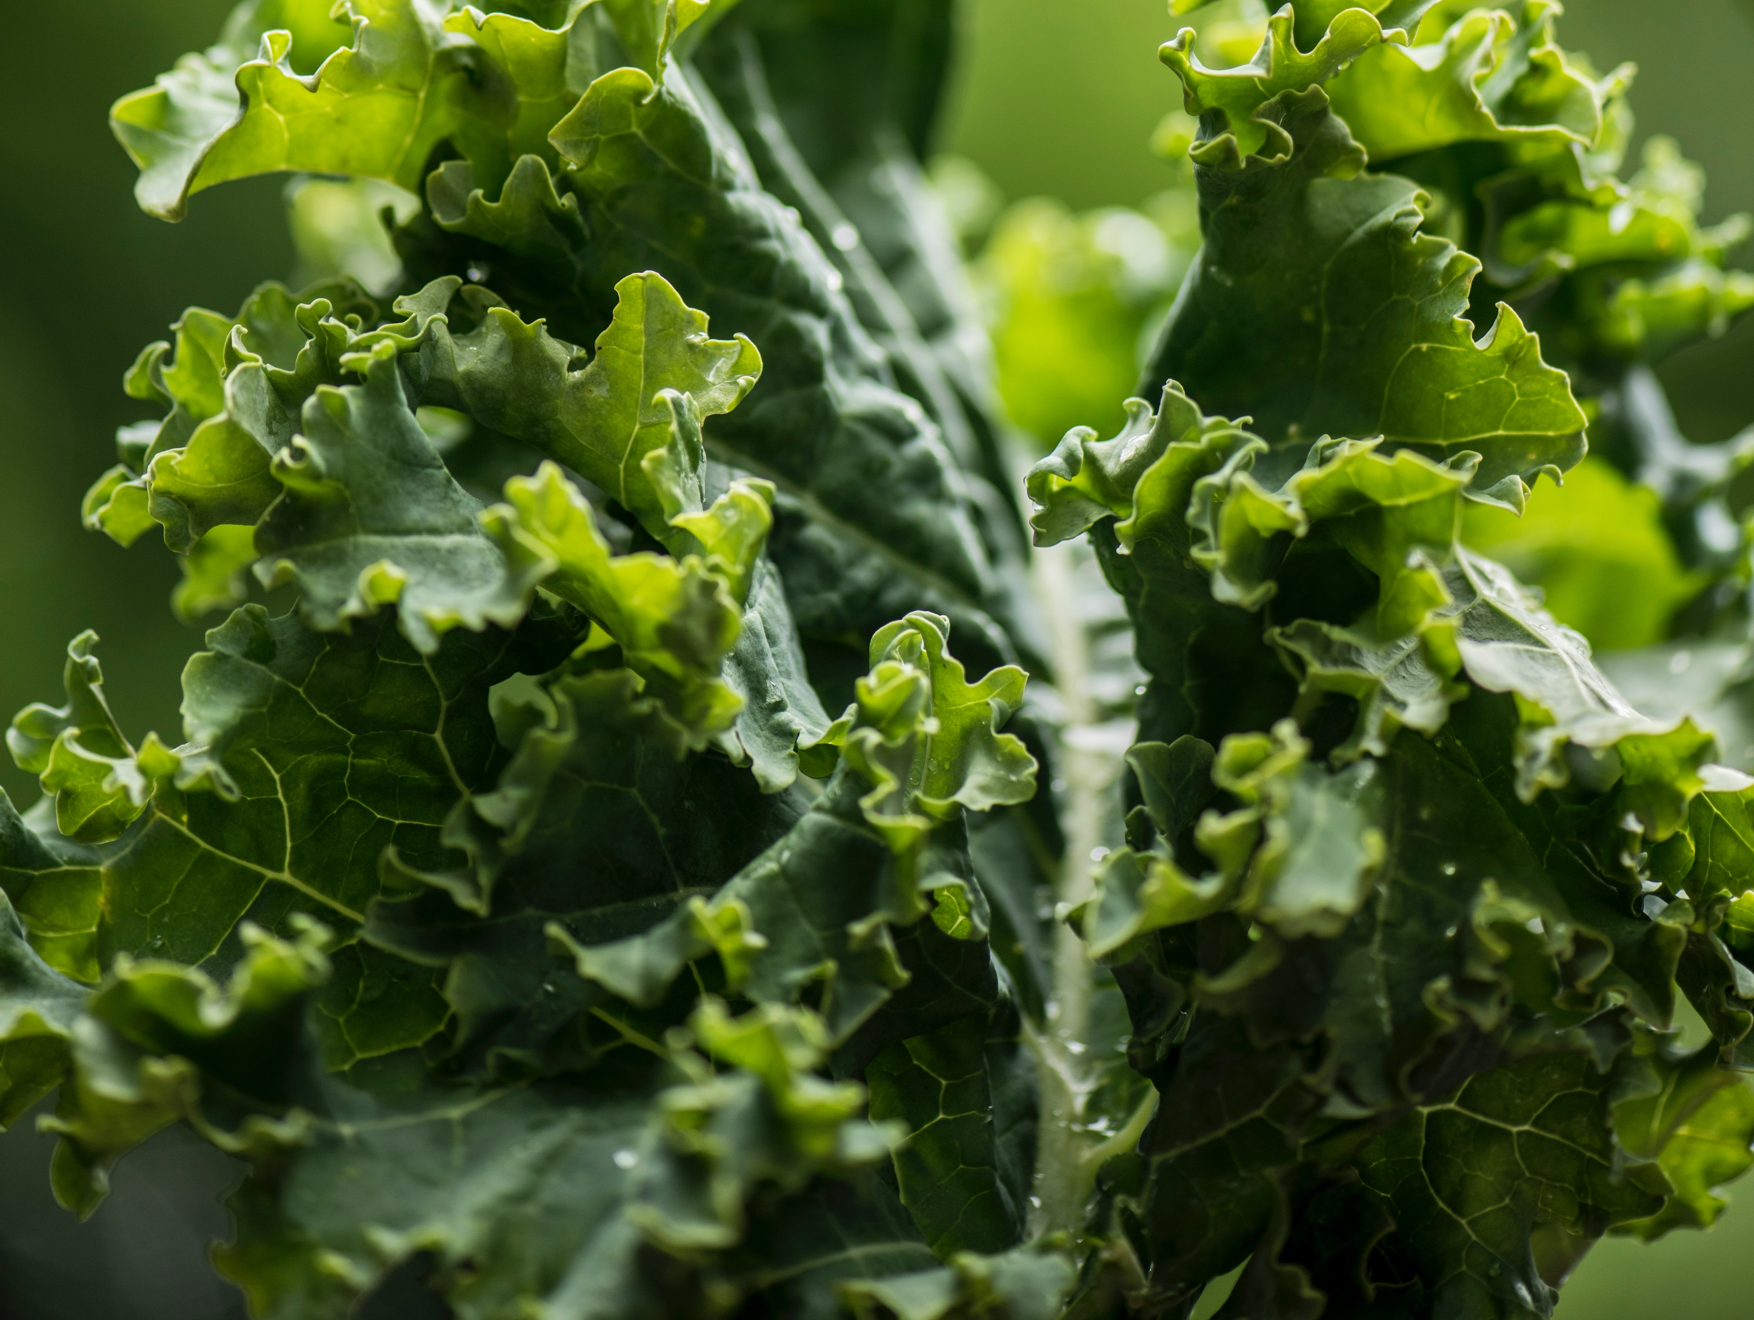
What are bones made out of?
About 70% of each bone is made from hard minerals like Calcium.
We need to eat calcium-rich foods such as milk and dairy products to keep our bones strong. Sardines, almonds and kale are wonderful ways to get your calcium dairy-free!

Slide 22
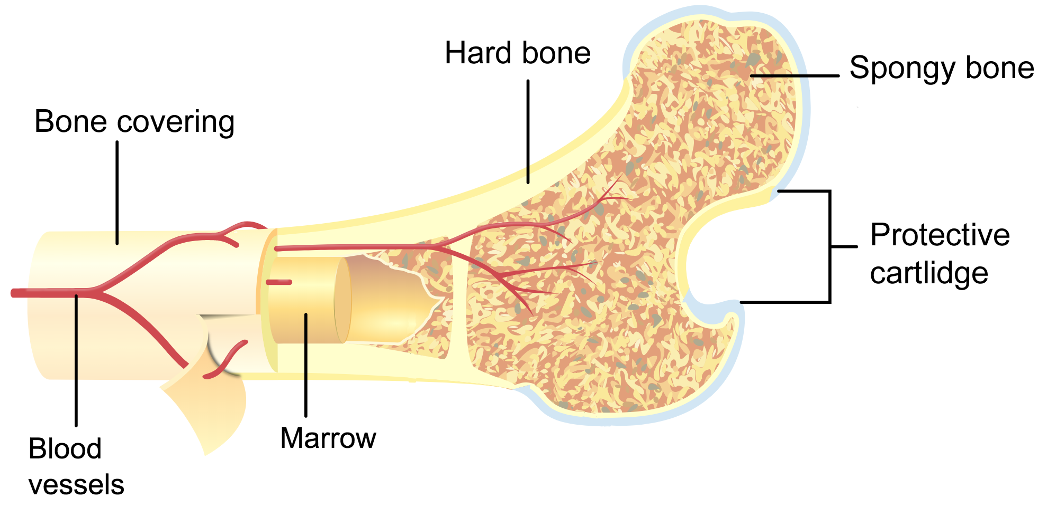
What is inside a bone?
The outside of the bone is hard whilst the inside is more spongy to make it lighter and easier to move around.
The centre of the bone is a soft substance called bone marrow.
Bone marrow makes new blood cells for your body.

Slide 23
Review Questions
How many bones are in the human body?
What is the biggest bone in your body?
Where is the smallest bone found?
What are the three functions of the skeleton?
Which bones protect the heart and lungs?
What is at the centre of bones?
Which foods keep our bones healthy?
206.
Femur or thigh bone in leg.
Inside the ear (stapes or stirrup bone).
Support, protection, movement.
Ribs or rib cage.
Bone marrow, spongy material and blood vessels.
Foods containing calcium such as milk and dairy.

