Slide 1
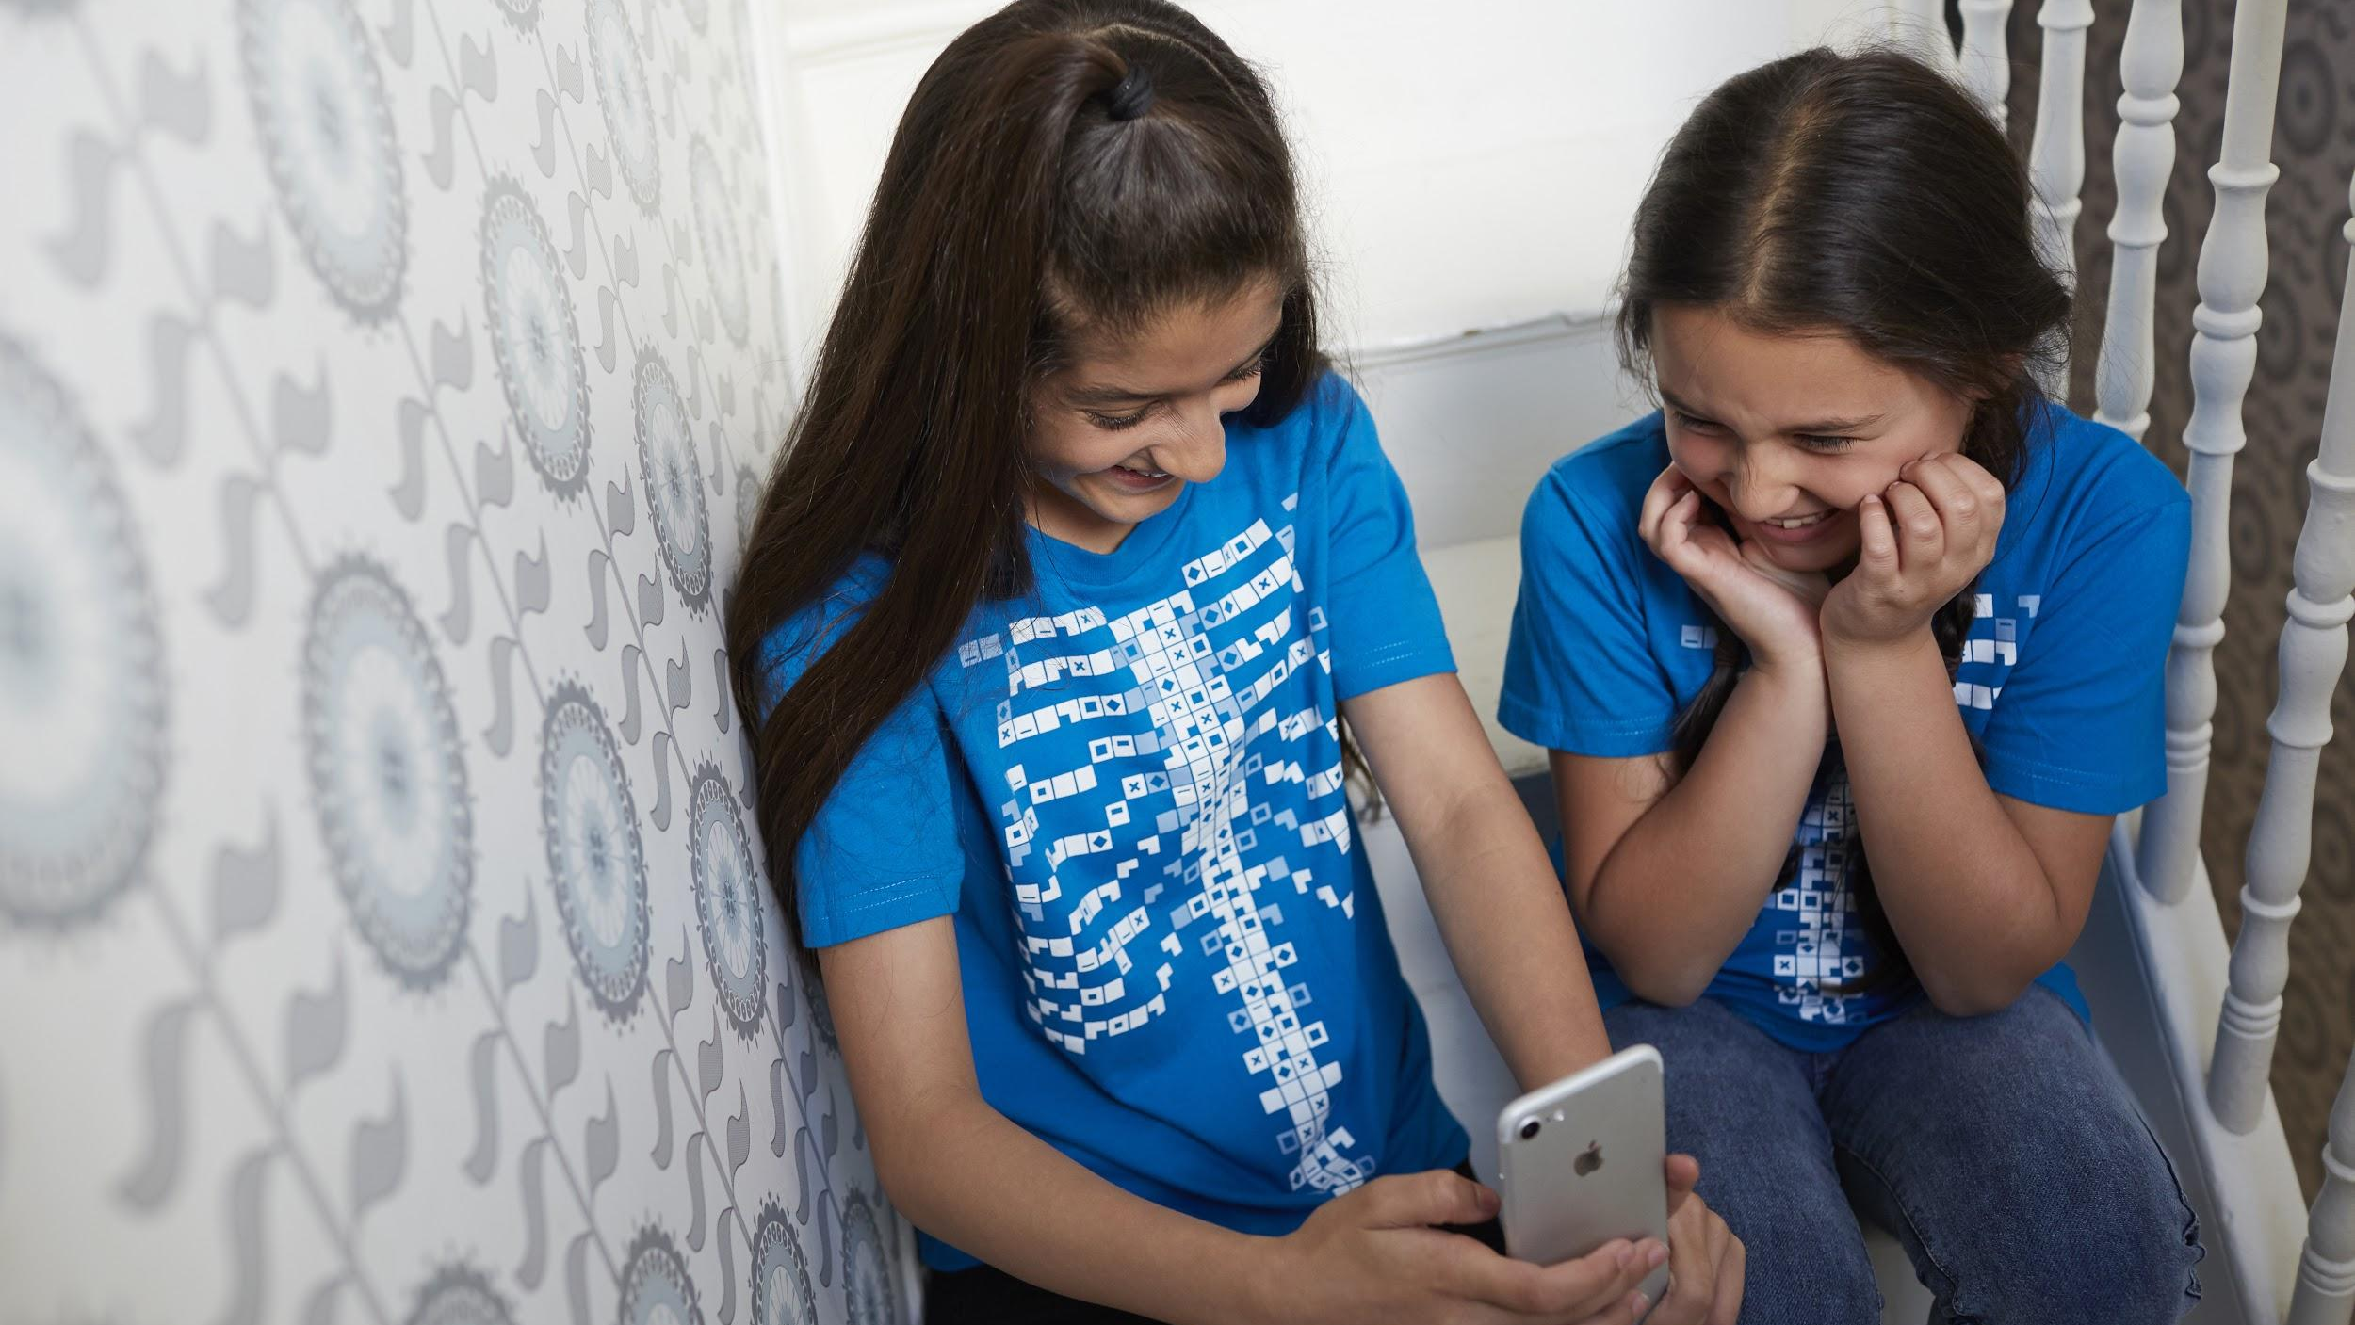

The Circulatory System
Primary/Elementary
“The world is full of magic! We created the Virtuali-Tee and these resources to enable you to unlock the curiosity that exists within every student”

Slide 2
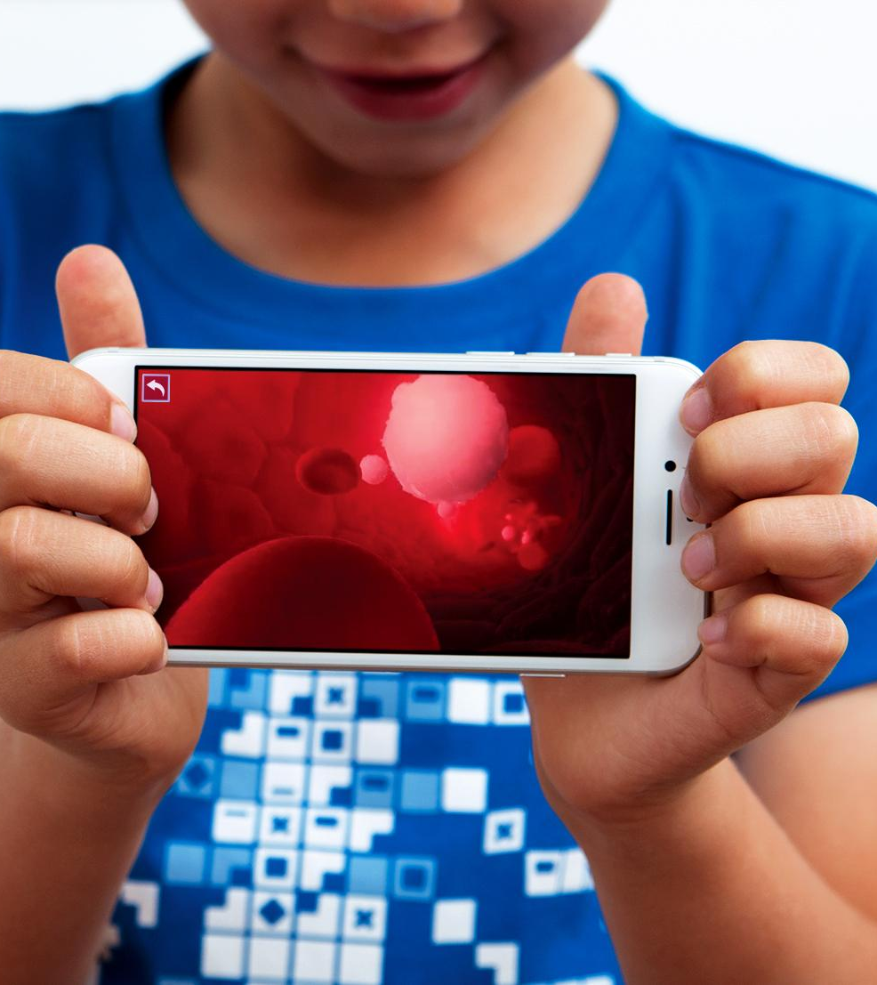
OVERALL LEARNING OUTCOMES Primary / Elementary
The Circulatory System Objectives
  To describe how the circulatory system works
  To describe the purpose of the main parts of the circulatory system and their function

Slide 3
Let’s get curious...
?
Have you ever cut your finger?
Where does the blood come from?
How does it get to your finger?
What would happen if you didn’t stop bleeding?
Let’s find out some more…..
A KWL Inquiry worksheet for the circulatory system is available in the teacher’s resources repository at:
https://www.curiscope.com/pages/science-lesson-plans-human-body

Slide 4
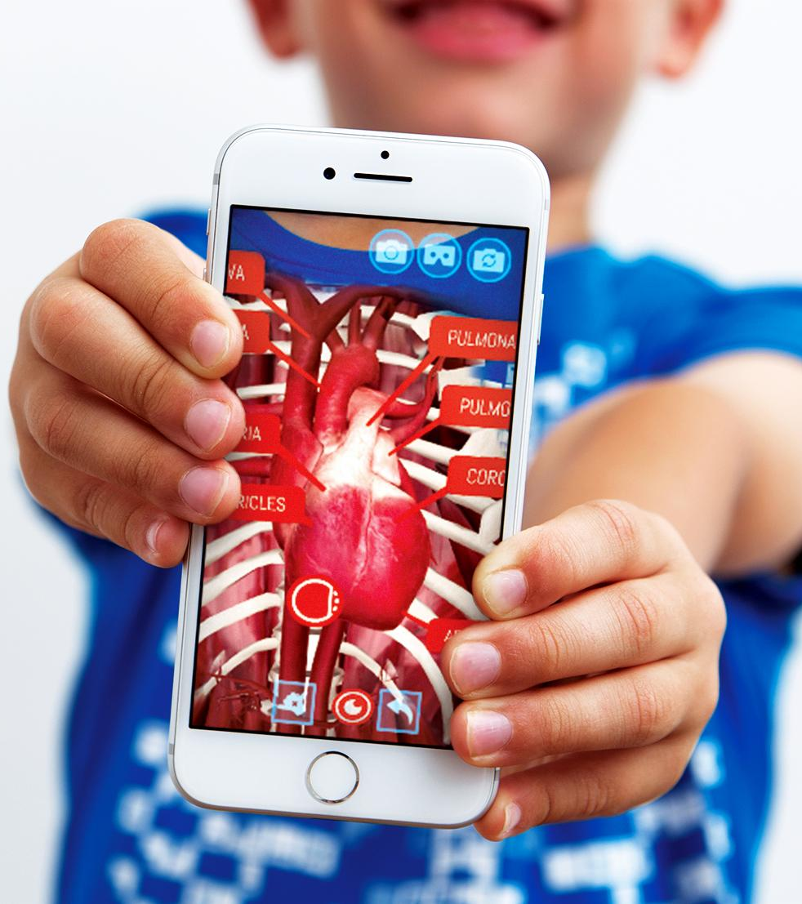
Your heart.
Can you feel your heart beating?
Place your hand in the middle of your chest.
What is happening when your heart beats?
Is it sometimes faster or slower?
Why?

Slide 5
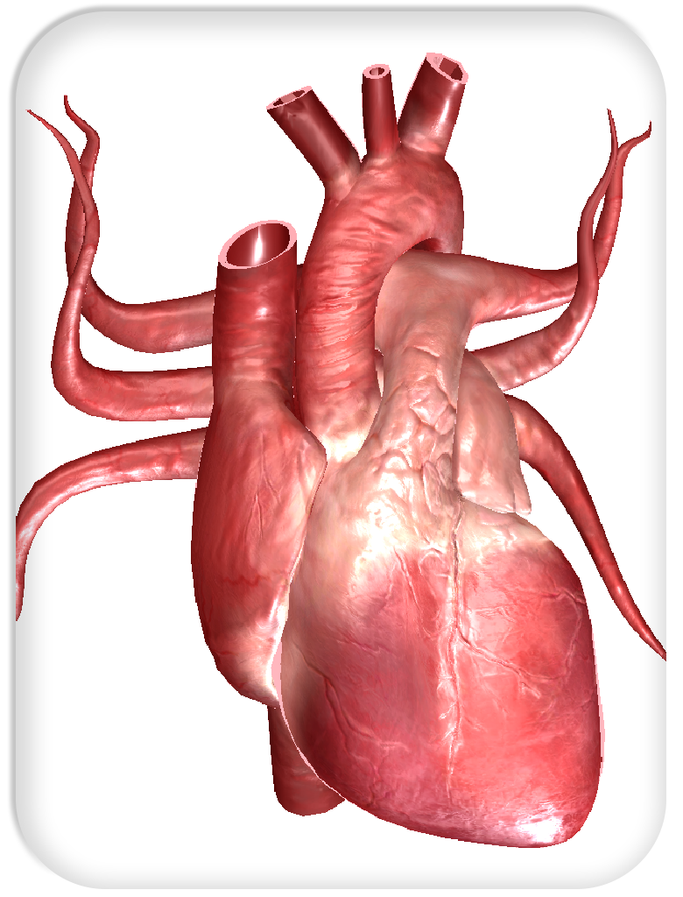
Your heart is AMAZING!
Your heart is a muscle which pumps your blood around your body.
In young people it beats at about 70 to 90 beats per minute (your heart rate or pulse)
It never takes a rest and keeps beating day and night for your whole life.
Doctors can listen to your heart with a stethoscope and you can feel your pulse on your wrist.
How fast is your heart beating now?

Slide 6
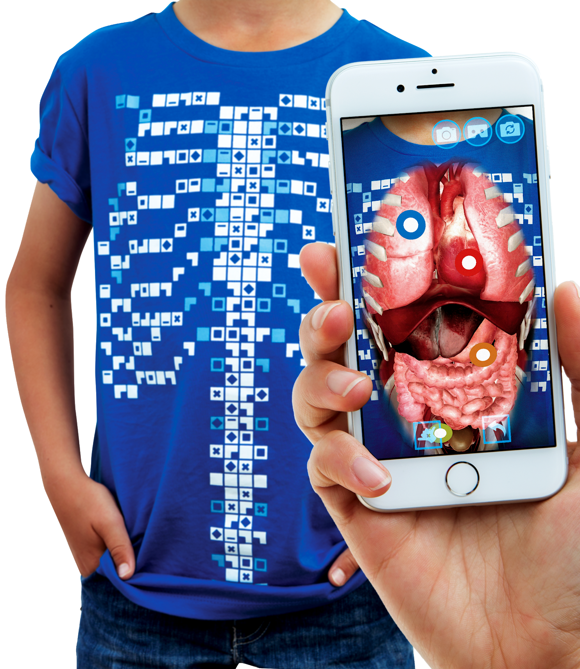
The Virtuali-Tee
Today we are going to be using a very special t-shirt to explore your circulatory system
“Explore the Human Body….
On a Human Body…”

Slide 7
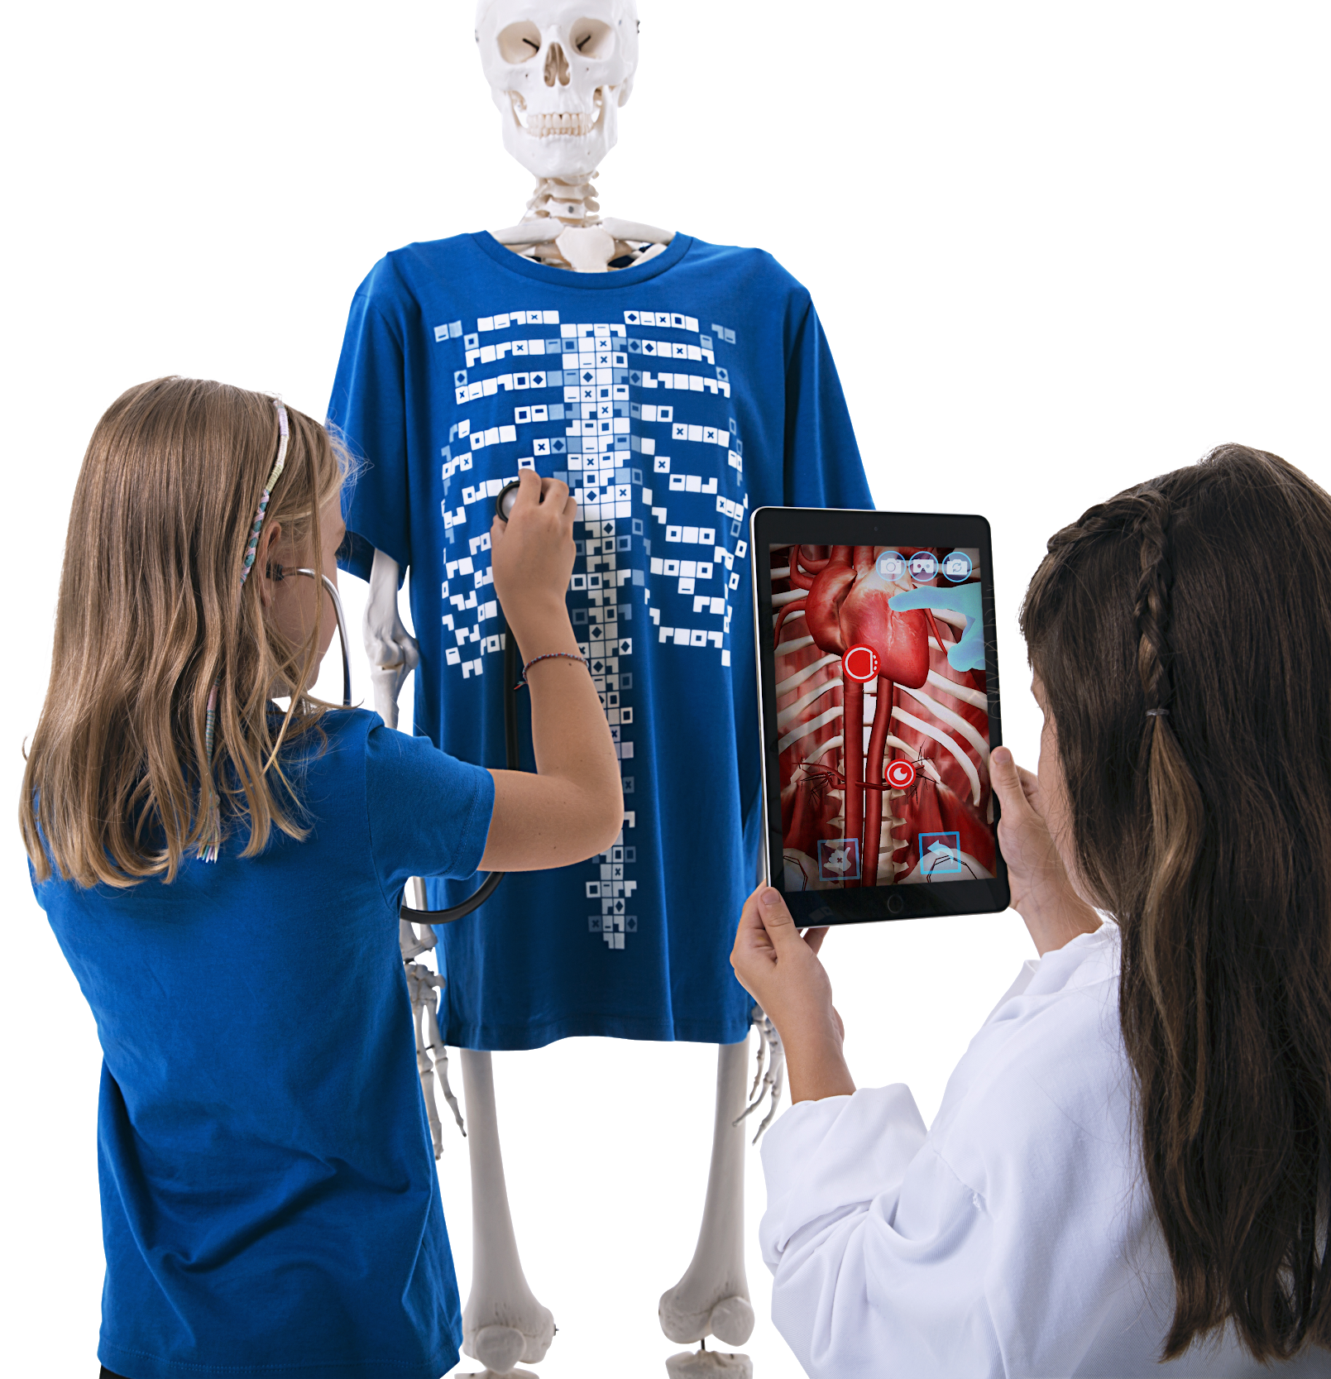
What is the Virtuali-Tee?
A t-shirt that lets us see inside YOUR body using Augmented Reality!
We’ll use a mobile device to scan the t-shirt with the app and open a portal so we can explore what is going on under your skin.

Slide 8
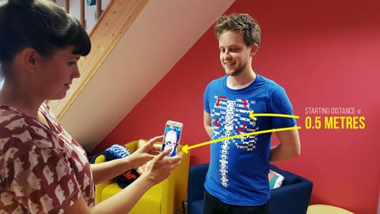
Step 1 - Getting started
To get started, simply open the Virtuali-Tee app and point at the t-shirt. The tracker image is best picked up by initially pointing at the upper chest with the device 0.5m/1.5ft from the t-shirt.
The tracking of the t-shirt requires that you are in a well lit space without heavy shadows and that the t-shirt is not stretched or heavily wrinkled.

Slide 9
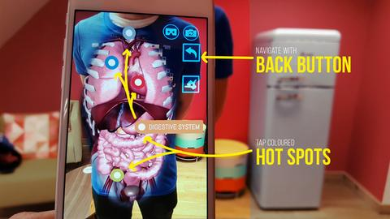
Step 2 - Wow, the organs look amazing…now what!?
Well, we have implemented some pretty cool features into the app. Just tap the screen to get started. You can then isolate the physiological system by tapping on the coloured hot spots. You’ll see some buttons floating outside the chest, use the back button to navigate between systems.
We encourage you to explore, if you see a button….tap it to find out what it does!

Slide 10
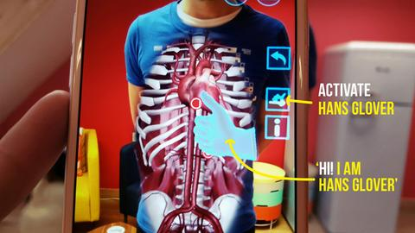
Step 3 - Surprise! Meet Hans Glover…. your virtual expert on the body!
Think of Hans as a holographic guide to the body. He’ll talk you through the anatomy and physiological systems in the body. Just tap the Hans button and he’ll appear.

Slide 11
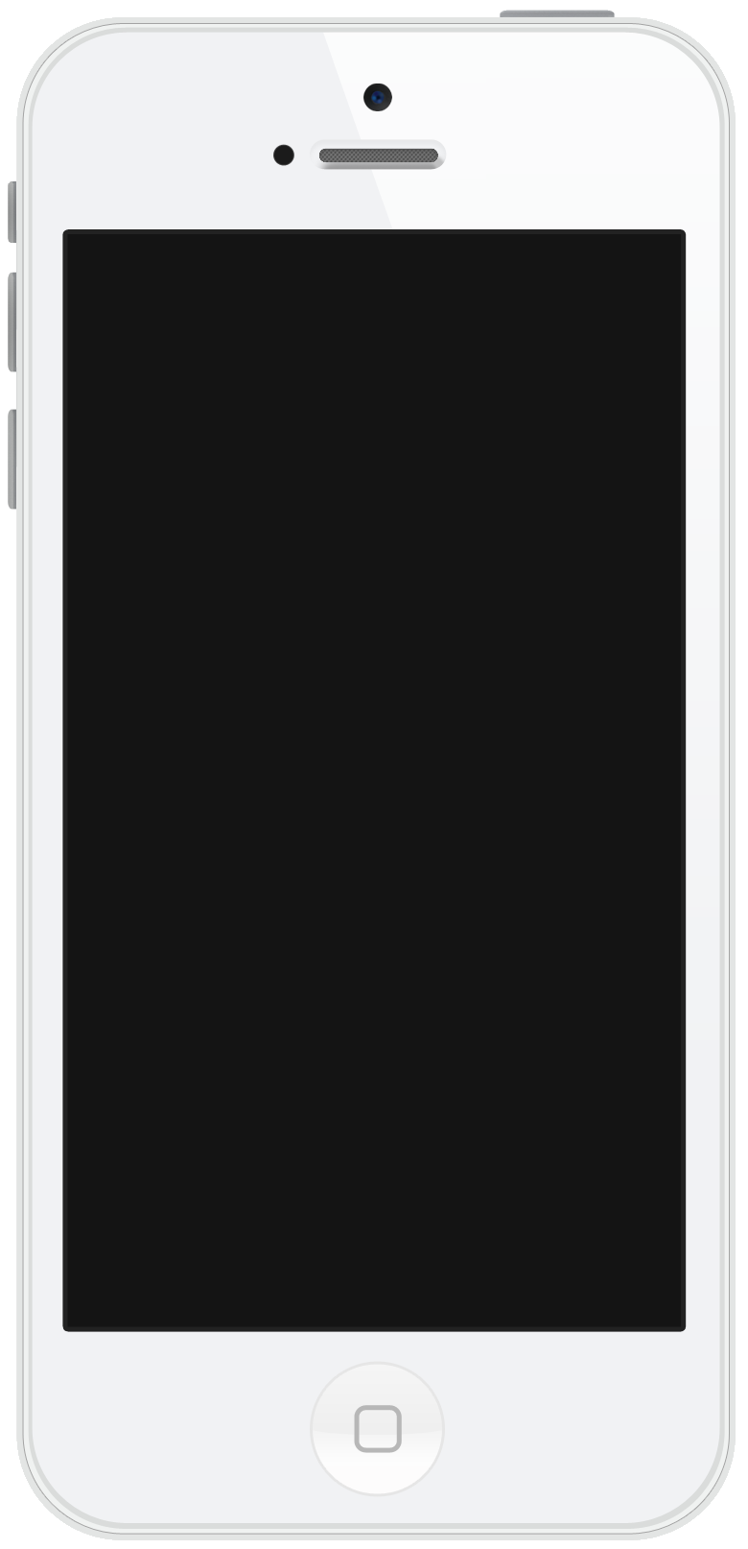
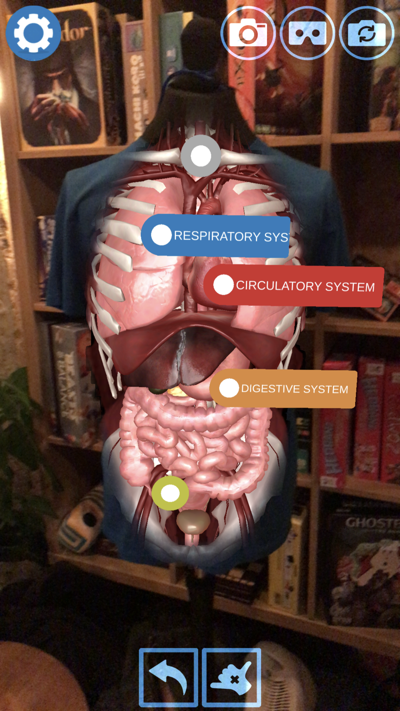


Getting into your circulatory system
Tap on the circulatory system hotspot and the app will isolate to just that system. See your heart beating!
Tap on the button to call Dr Hans, who will give you a guided tour!
Tap the button if you would like subtitles.

Slide 12
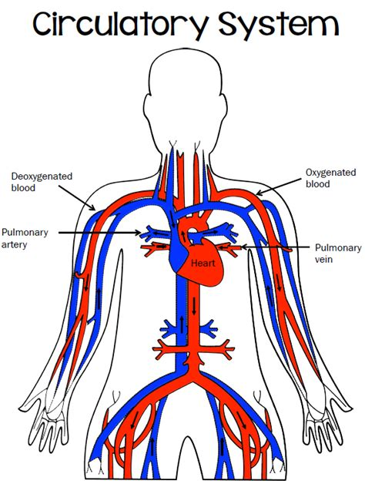
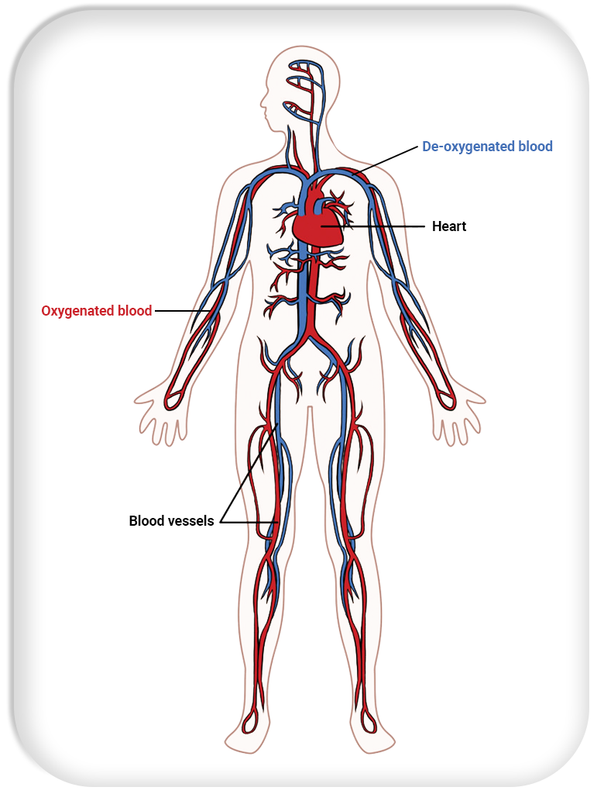
Circulatory system
The heart pumps blood through blood vessels around your body to deliver oxygen and nutrients to your organs and muscles.
Blood then returns to the heart with the oxygen and nutrients used up.
Tubes called Arteries take the blood away from the heart.
Tubes called Veins take the blood back to the heart.

Slide 13

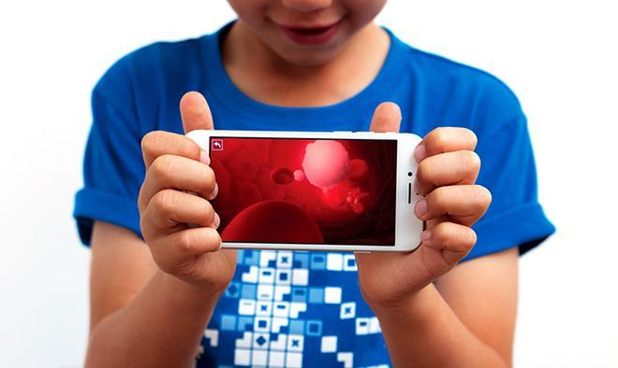
Your blood is amazing!
Tap on the icon in the circulatory system to look inside your bloodstream.
You can see the red blood cells and white blood cells and hear what they do.
Blood is made up of plasma (a yellowish watery liquid).
Inside the plasma are blood cells.
The red blood cells carry oxygen and make blood red.
White blood cells fight infection.
FUN FACT There are 250 million red blood cells in a single drop of blood!

Slide 14
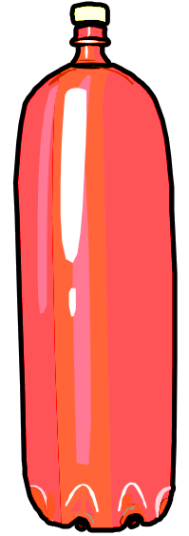
How much blood do you have?
An average 10 year old has 3 litres
The average adult has 5 litres
The amount of blood you have depends on your height and weight.

Slide 15
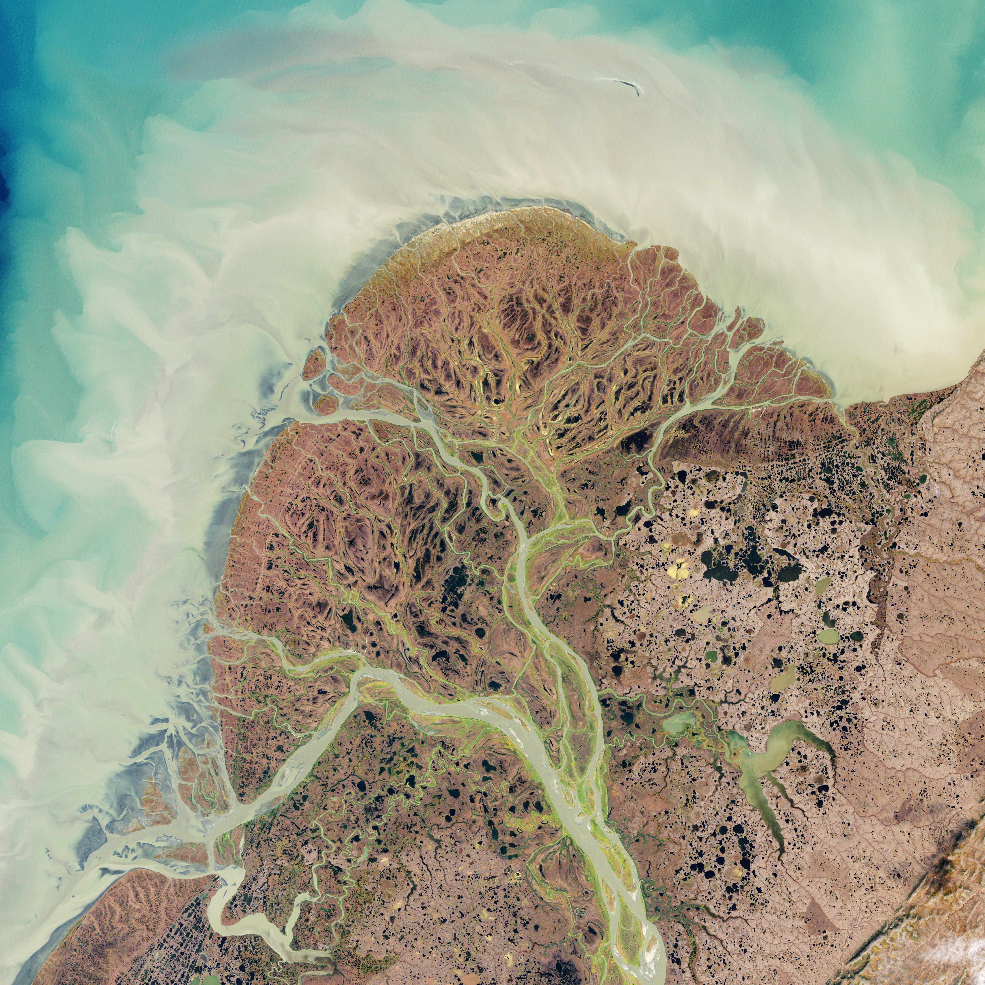
Curious facts!
If you were to lay all your blood vessels in a long line they would stretch about 60,000 miles (96,560 km)! (that’s over two times around the entire world).
Your heart beats about 100,000 times a day.
Your heart beats without you having to think about it.
The image on the right is a satellite image of rivers in Alaska. It’s interesting that they look like blood vessels.

Slide 16
Quiz
Can you fill in the blanks and show what you’ve learnt today? Use the words in blue to help you.
Our heart is a _______ which pumps blood through our body. You can feel your _______ in your wrist. You can feel your heartbeat by placing your hand on your________. If you get excited or do exercise your heart rate gets ________. Your blood delivers oxygen and nutrients to your body. A ten year old has about _________of blood in their body. Blood is made of plasma and blood cells. ________ is carried in red blood cells. White blood cells fight _________. The right side of the heart receives blood from the body and the left side sends _____________ from the lungs to the rest of the body. The process of blood going round the body is called ___________.
Oxygen - infection - faster - muscle - chest - pulse -
circulation - 3 litres - oxygen-rich blood

Slide 17
Quiz
Can you fill in the blanks and show what you’ve learnt today? Use the words in blue to help you.
Our heart is a muscle which pumps blood through our body. You can feel your pulse in your wrist. You can feel your heartbeat by placing your hand on your chest. If you get excited or do exercise your heart rate gets faster. Your blood delivers oxygen and nutrients to your body. A ten year old has about 3 litres of blood in their body. Blood is made of plasma and blood cells. Oxygen is carried in red blood cells. White blood cells fight infection. The right side of the heart receives blood from the body and the left side sends oxygen-rich blood from the lungs to the rest of the body. The process of blood going round the body is called circulation.

Slide 18
Keeping your heart healthy
Take regular exercise that makes your heart beat faster
Eat healthily – fruit and vegetables and not too much salt sugar or fat
Take time to relax and avoid too much stress
Don’t smoke

Slide 19
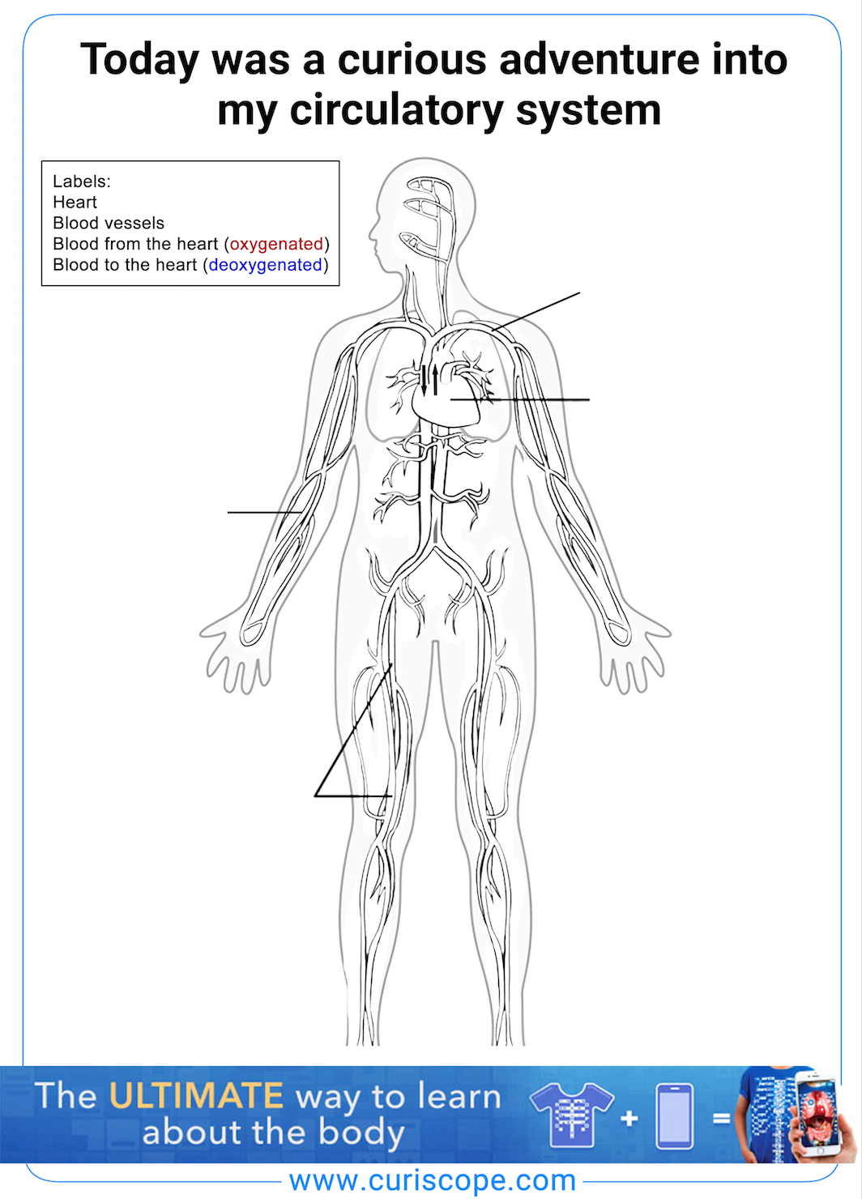
Print friendly take home sheet
Students can enjoy colouring in and labelling a circulation diagram, Indicating oxygenated blood in red and deoxygenated blood in blue. Arrows to be added to show the direction of blood flow.
The take home sheet is available in the teacher resources repository:
https://drive.google.com/drive/folders/17N-hPZnEAdBwevuxAYoTi-yasNatYQM9?usp=sharing

