Slide 1
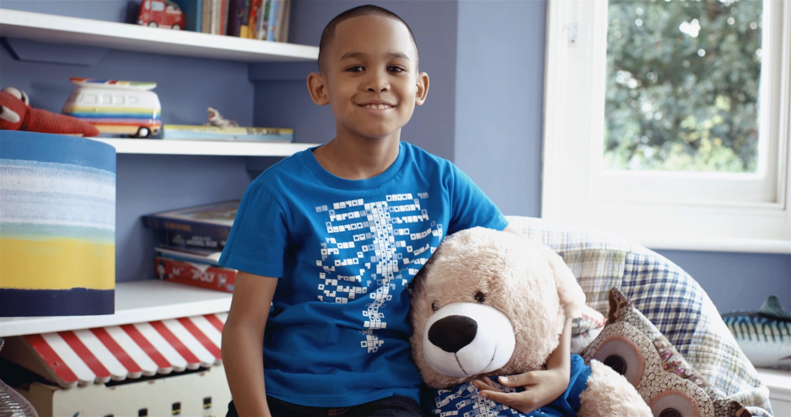

Digestive System
Primary/Elementary
“The world is full of magic! We created the Virtuali-Tee and these resources to enable you to unlock the curiosity that exists within every student”

Slide 2
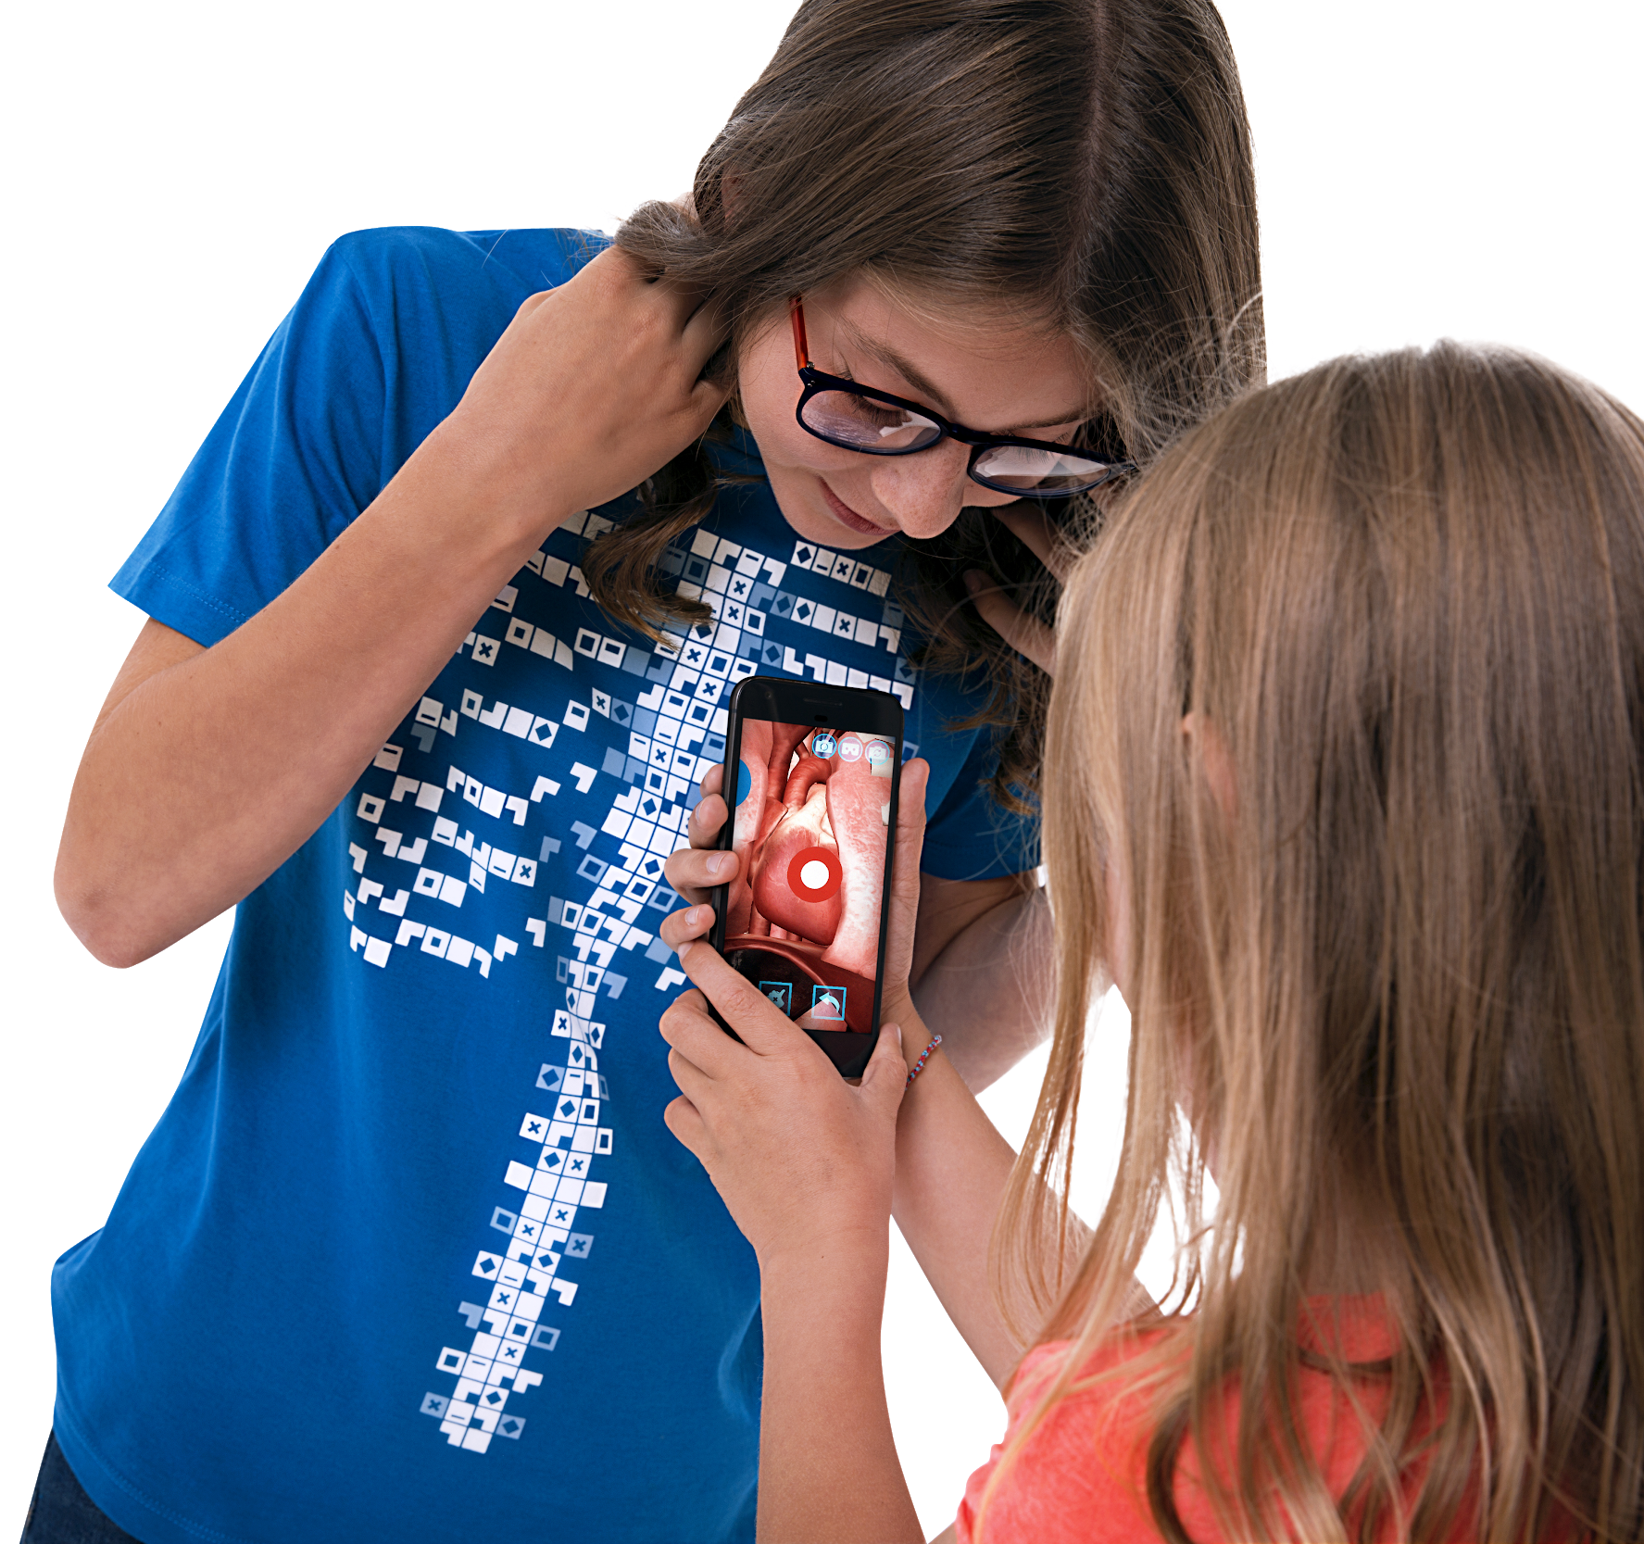
OVERALL LEARNING OUTCOMES Primary / Elementary
The Digestive System Model Objectives
To identify parts of the digestive system
To describe their function
To identify where nutrients enter the bloodstream
To describe what happens to food as it goes through the body

Slide 3

Let’s make a model digestive system!
For this activity, we will need…
Bread
A plastic bottle
A toothpaste tube
A plastic tray
A pair of tights or a sock
A zip lock plastic bag
Fizzy drink (cola)

Slide 4
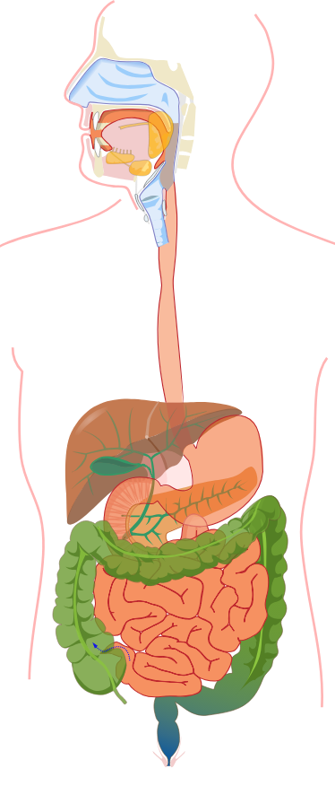
It begins in the mouth
Our mouth is where the digestive journey begins.
When we eat our food, our teeth begin the process and chew it to break it down. This makes it easier to swallow. Enzymes in our saliva also help with this process.
ACTION: Tear up pieces of the bread. This is what chewing does. Add a small amount of enzymes (fizzy drink!) to the bread. See what happens!
Mouth

Slide 5
What next?
From the mouth, we swallow our food and it heads down a soft tube into our body. The scientific name for this body part is the oesophagus.
As we swallow, the oesophagus squeezes the food down into our stomach.
When you swallow, can you feel the oesophagus behind your windpipe squeezing your saliva into your stomach?
ACTION: Try this with your toothpaste tube!
Oesophagus

Slide 6
The stomach
In the stomach, the food is mixed with special stomach juices which are able to break down the food even further.
ACTION: The plastic bag can act as our stomach. Add some fizzy drink and bread into the plastic bag as this will act like the food, juices and enzymes.
NOW SQUISH THE BAG TO MAKE A MUSH! This mush is called chyme.
Stomach

Slide 7
Then where?
Chyme leaves the stomach through the Duodenum.
Here food is broken down even further.
- The carbohydrates in starchy and sweet foods become simple sugars
- The proteins in foods such as meat become amino acids
- The fats in oily foods such as butter become fatty acids and glycerol
These are all called nutrients.
ACTION: Place the tights over half a cola bottle (like a filter). Then pour in the contents of your plastic bag.
Duodenum

Slide 8
The small intestine
Next is the small intestine, all of the pieces of food are now so small, they can be absorbed into the body.
The small intestine has small brush like heads in its lining like tiny tiny fingers called Villi and these let many of the particles of food into the bloodstream.
Once the particles have been absorbed into the bloodstream, the remaining product is waste and some water.
ACTION: Squeeze the tights to take all the small food particles and some water from the mush.
Small intestine

Slide 9
The finale!
In the colon, the remaining water is absorbed into the body and leaves behind solid waste.
The final waste product is expelled out of the anus.
ACTION: Empty the contents of the tights. Can you guess what this represents?
Colon
(Large intestine)

Slide 10

The finale!
In the colon, the remaining water is absorbed into the body and leaves behind solid waste.
The final waste product is expelled out of the anus.
ACTION: Empty the contents of the tights. Can you guess what this represents?

Slide 11
Let’s recap
Chewing (smaller pieces)
Swallowing (push down to the stomach)
Stomach (juices and enzymes)
Duodenum (more enzymes and breaking down)
Small intestine (absorbing nutrients)
Colon/Large intestine (absorbing more water)
Anus
POO!

