Slide 1
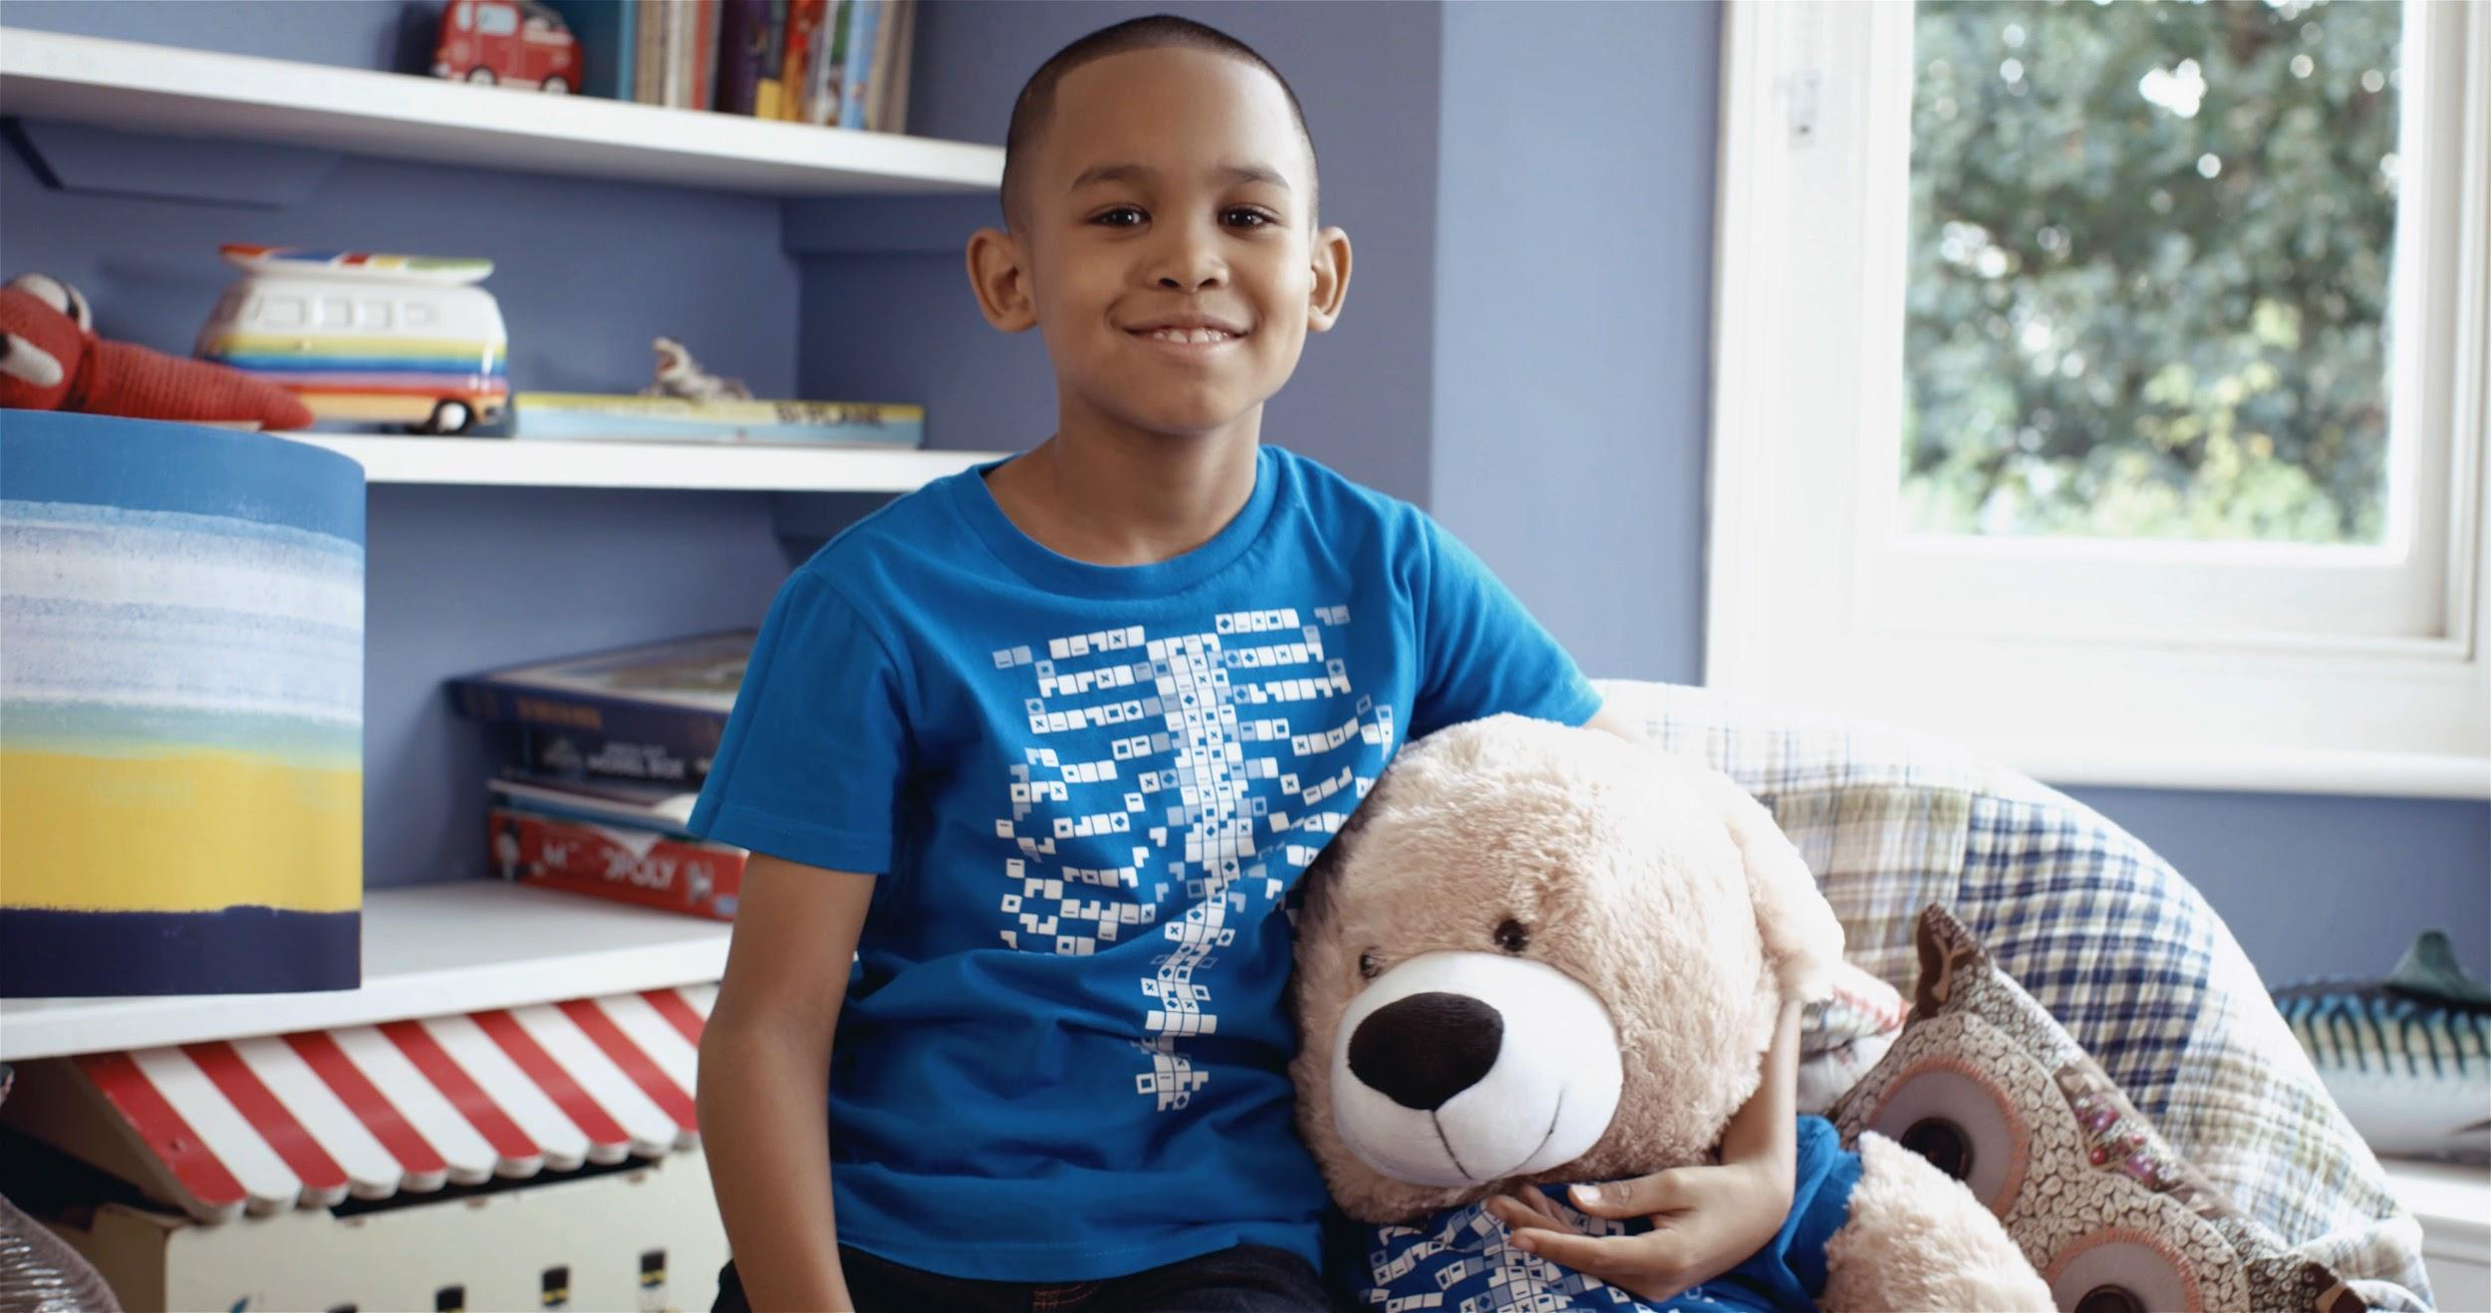

Digestive System Quiz
A note to teachers
This resource is recommended for use in two ways:
As the answer scheme to the Digestive System Challenge cards. Using the challenge cards, students discover the answers to each question as they are using the Virtuali-Tee app. Downloads are available in the teacher resources repository https://drive.google.com/drive/folders/17N-hPZnEAdBwevuxAYoTi-yasNatYQM9?usp=sharing
As a group quiz after using the Virtuali-Tee app.

Slide 2
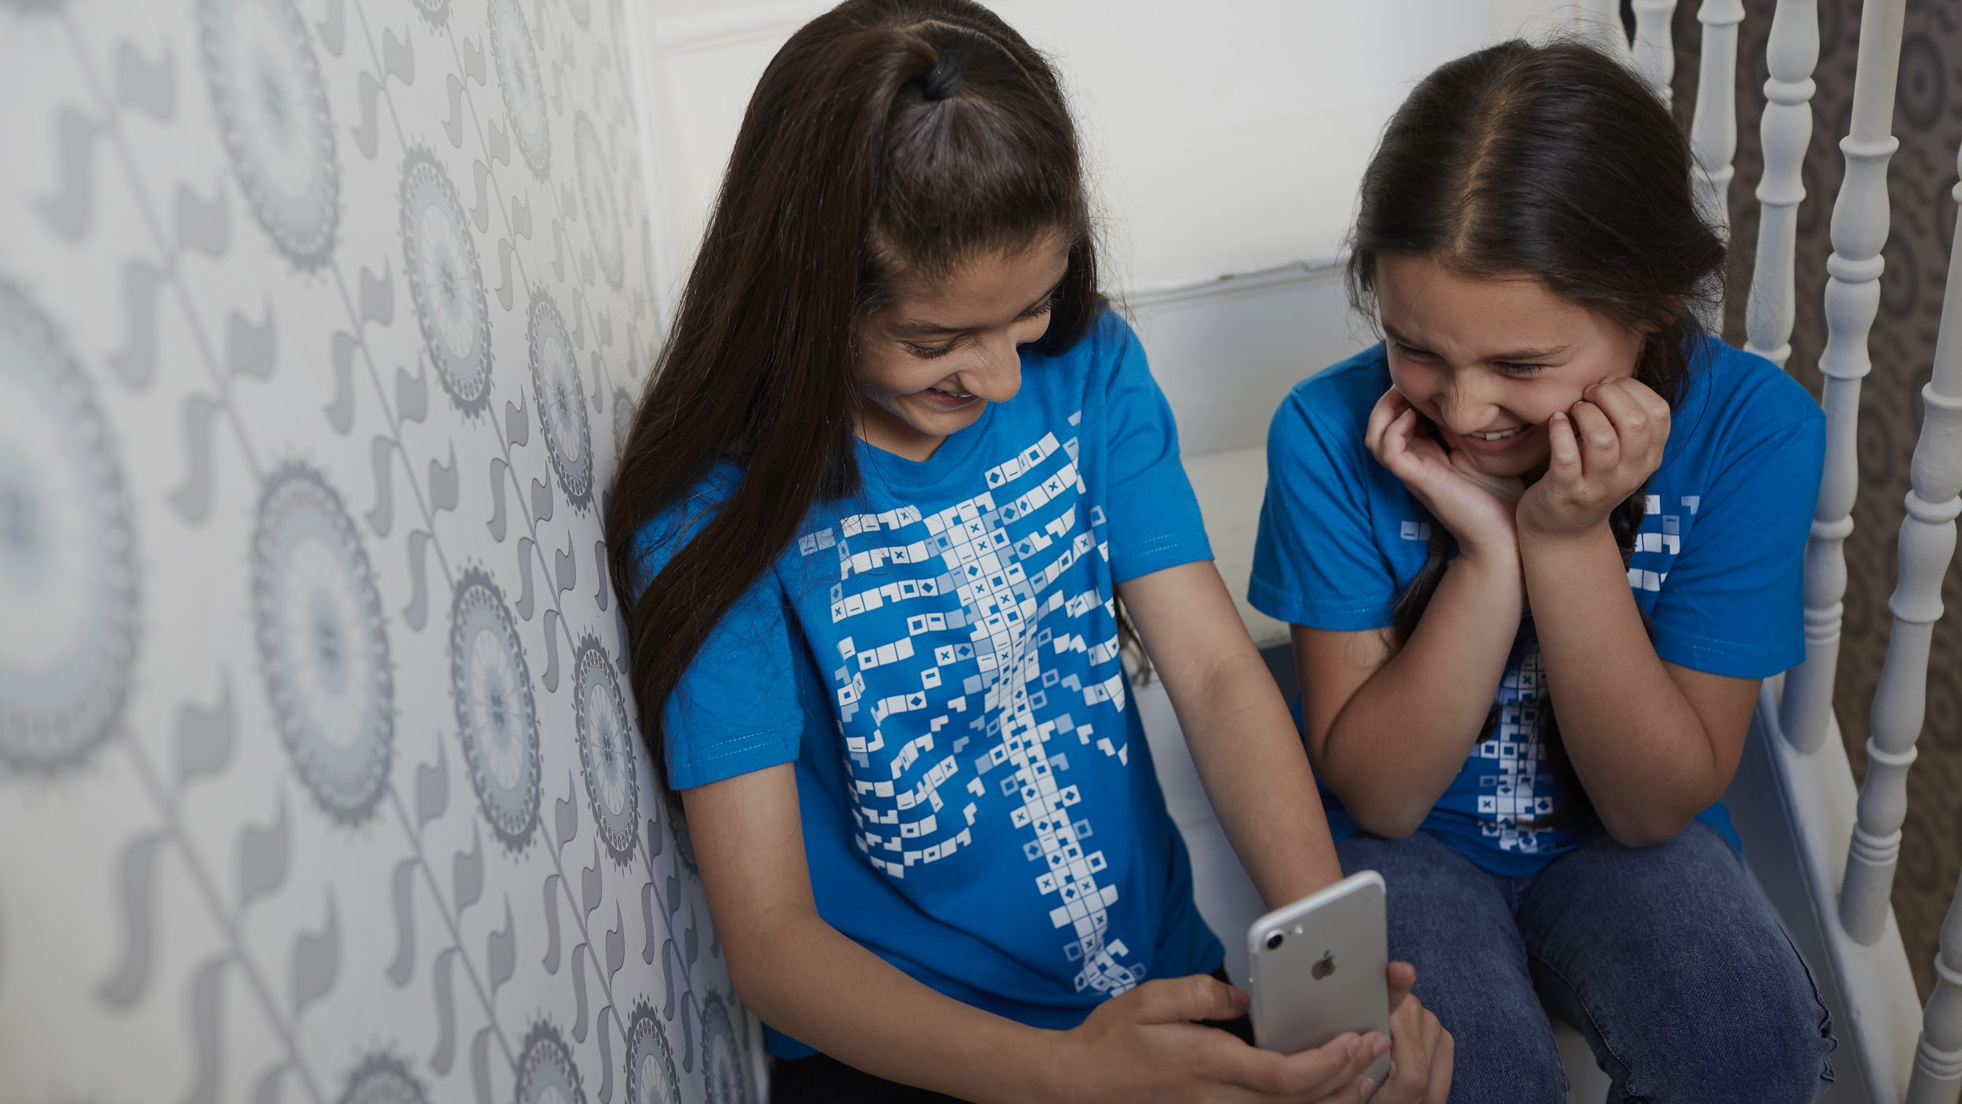
Digestive System

Slide 3

Which of the following is NOT found inside of the stomach?
Question 1
Acids
Chyme
Enzymes
Bile

Slide 4
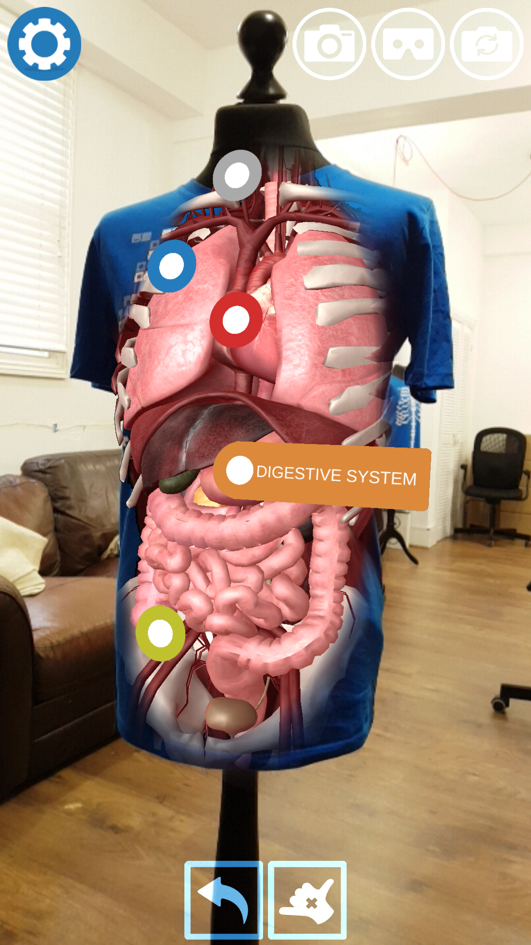
In which organ does peristalsis occur?
Question 2
Oesophagus
Small intestine
Large intestine
All of the above
Notes:
(also stomach)

Slide 5

Which of the following chemical secretions breaks down fats into fatty acids and glycerol?
Question 3
Acid
Saliva
Bile
Enzymes

Slide 6
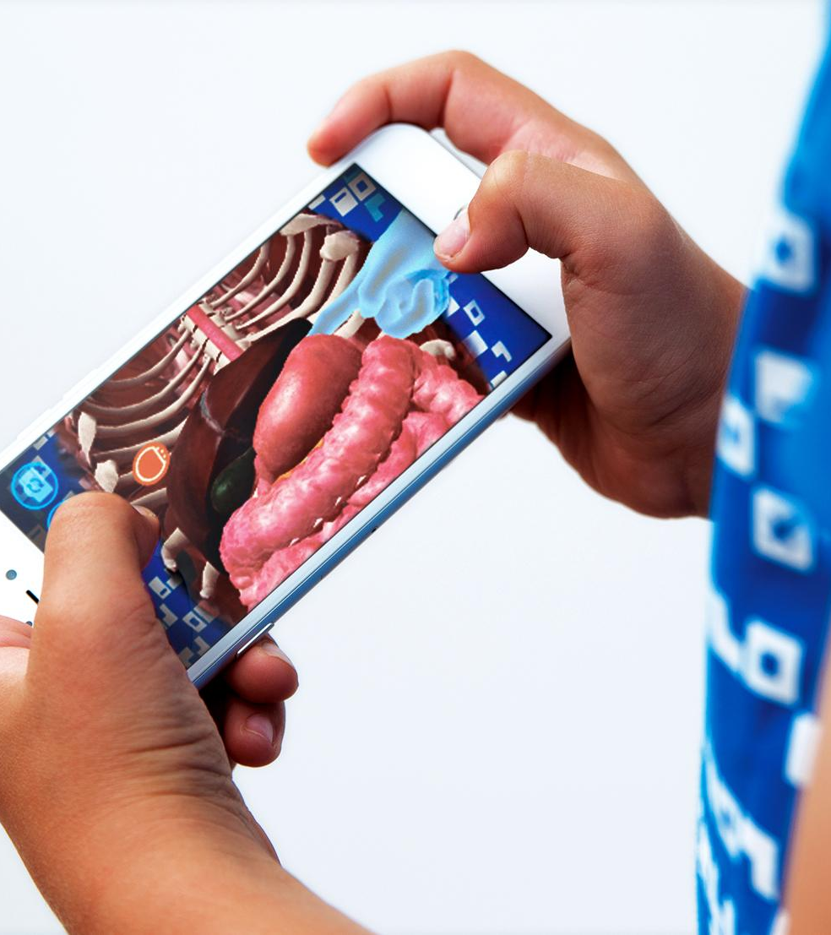
Bacteria in your gut make you …
Though it is entirely possible that a fart will make you laugh!
Question 4
Absorb water
Taller
Fart
Laugh

Slide 7
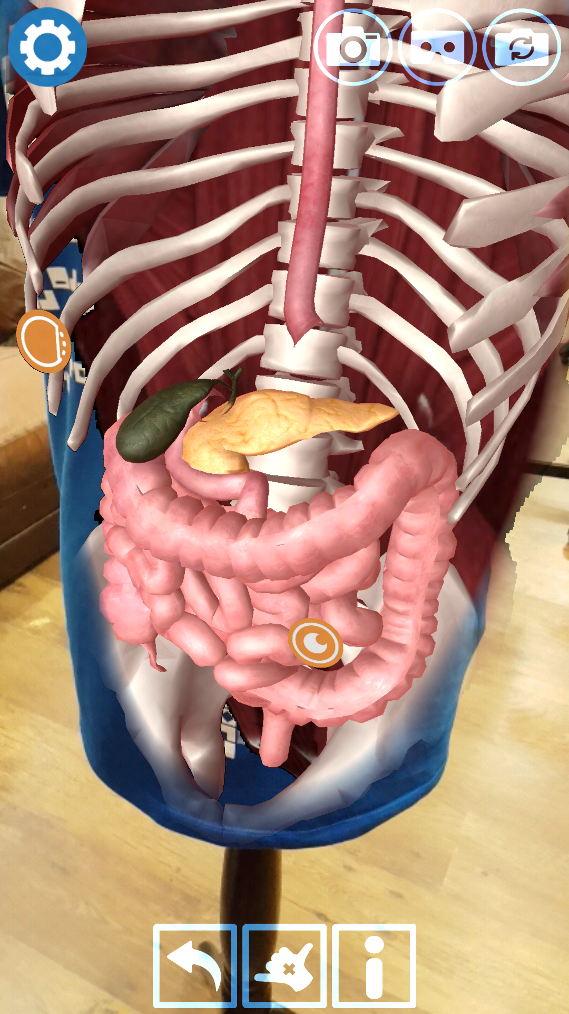
Acid in your stomach activates enzymes that start digestion. What else does it do?
A typical adult stomach produces 1.5 litres of hydrochloric acid per day!
Question 5
Keeps you hydrated
Converts carbohydrates to simple sugars
Cools you down
Kills bacteria

Slide 8
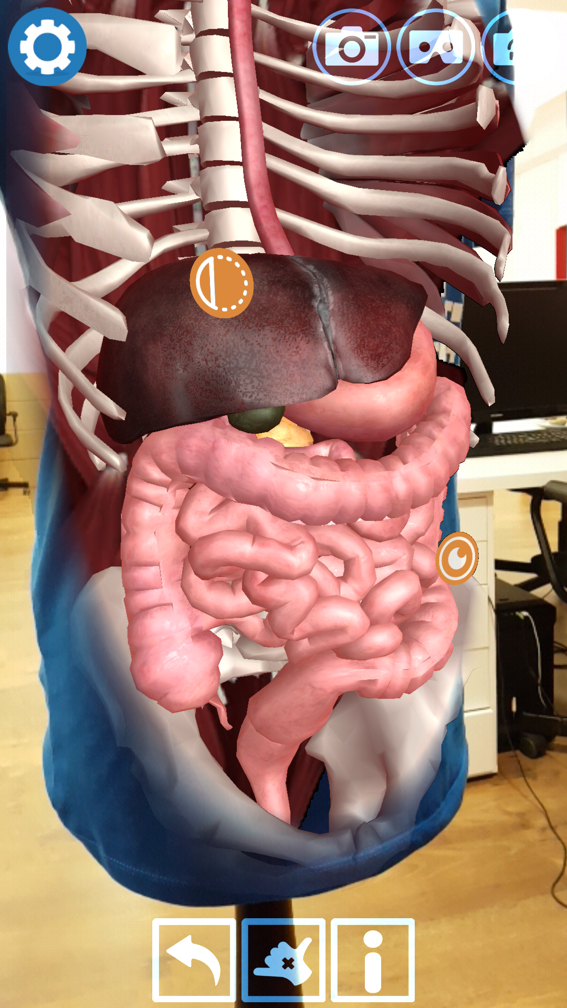
Which organ is NOT part of the digestive system?
Kidneys are part of the urinary system, and remove waste products from your bloodstream. We excrete these waste products as urine (pee)
Question 6
Stomach
Kidney
Rectum
Gall bladder

Slide 9
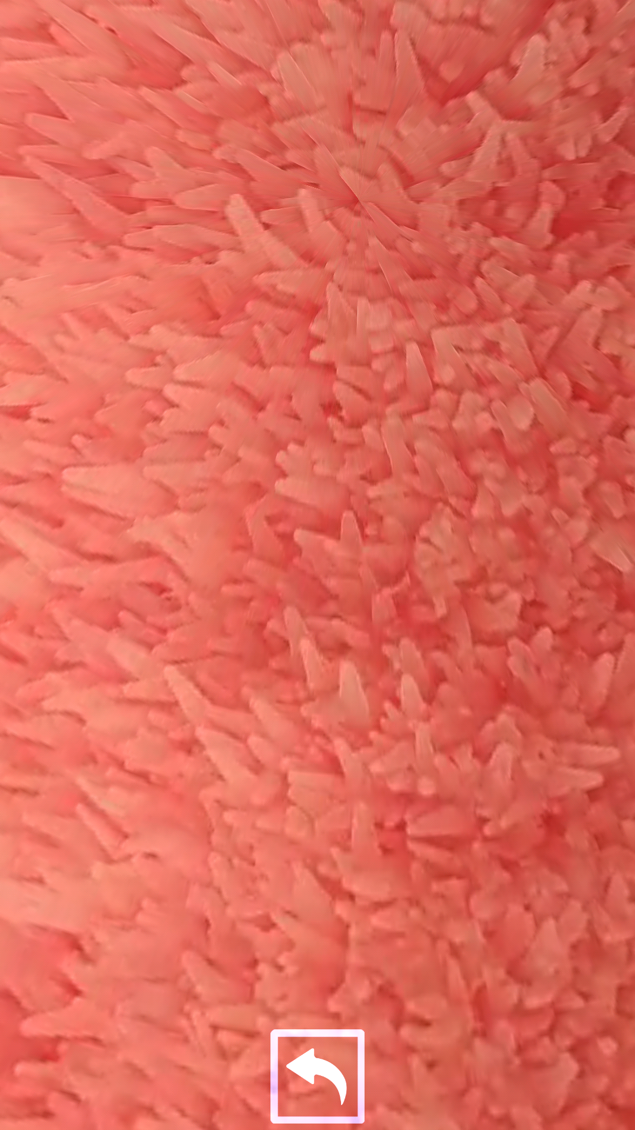
Which statement about Villi is false?
Question 7
Villi line the walls of the large intestines
Villi increase surface area
Villi allow for the absorption of broken down food into the bloodstream
Villi are finger-like projections along the walls of the small intestine.

Slide 10
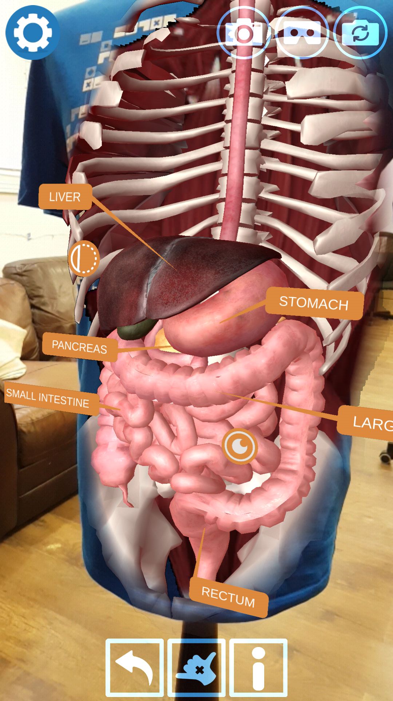
Which organ is not part of the Gastro-Intestinal Tract (alimentary canal)
The sound of bubbles in your gut is often peristalsis.
Question 8
Oesophagus
Liver
Stomach
Small intestine

Slide 11
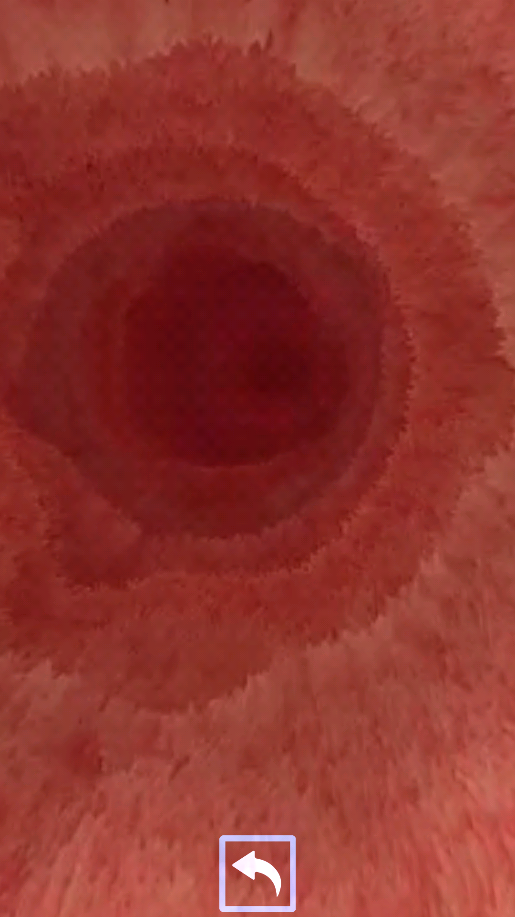
The first section of small intestine is actually…
The mashed up food that exits the stomach and enters the duodenum is known as chyme.
Question 9
The mouth
The duodenum
The stomach
The semicolon

Slide 12
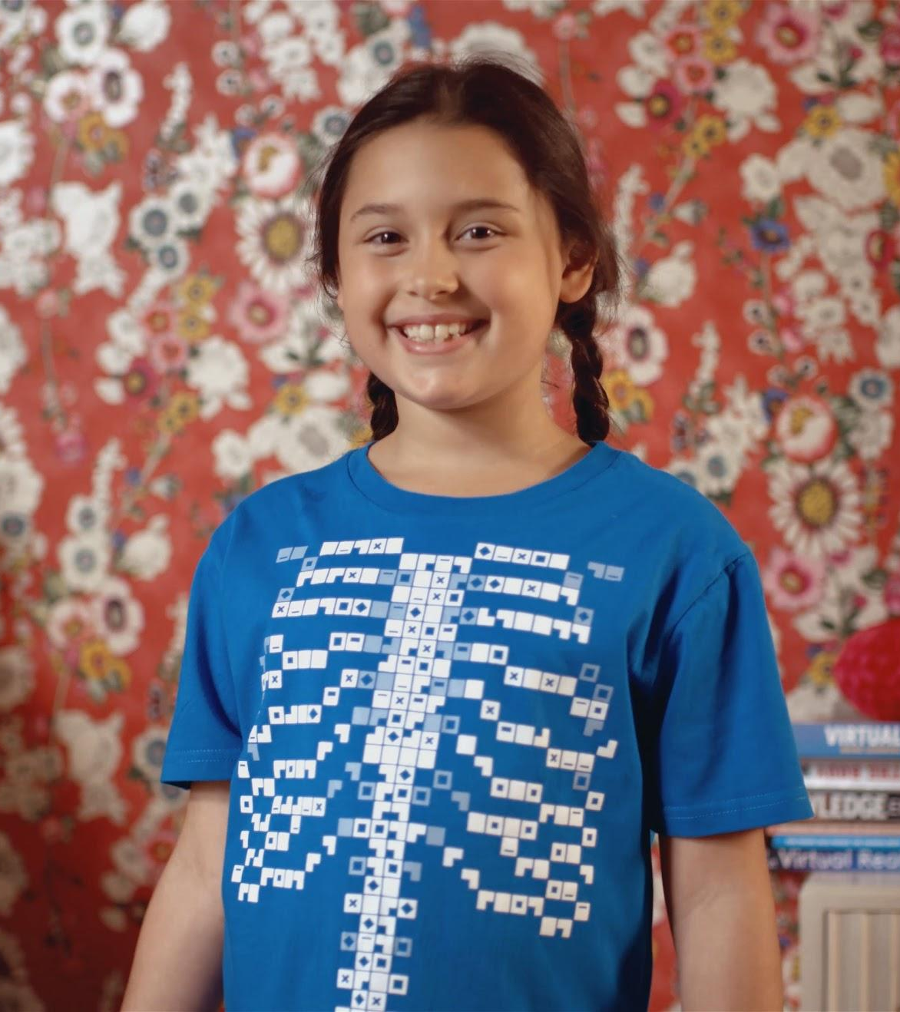
Bile is produced in the…
Bile is a green secretion that also helps to neutralise the strong acidic chyme mixture before it enters the small intestines. Without this neutralisation, chyme would burn your intestinal lining.
Find out… why doesn’t the acid in the stomach destroy the stomach lining?
Question 10
Gall bladder
Duodenum
Liver
Pancreas

