Slide 1


Circulatory System Quiz
A note to teachers
This resource is recommended for use in two ways:
As the answer scheme to the Circulatory System Challenge cards. Using the challenge cards, students discover the answers to each question as they are using the Virtuali-Tee app. Downloads are available in the teacher resources repository https://www.curiscope.com/pages/science-lesson-plans-human-body
As a group quiz after using the Virtuali-Tee app.

Slide 2

Circulatory System

Slide 3
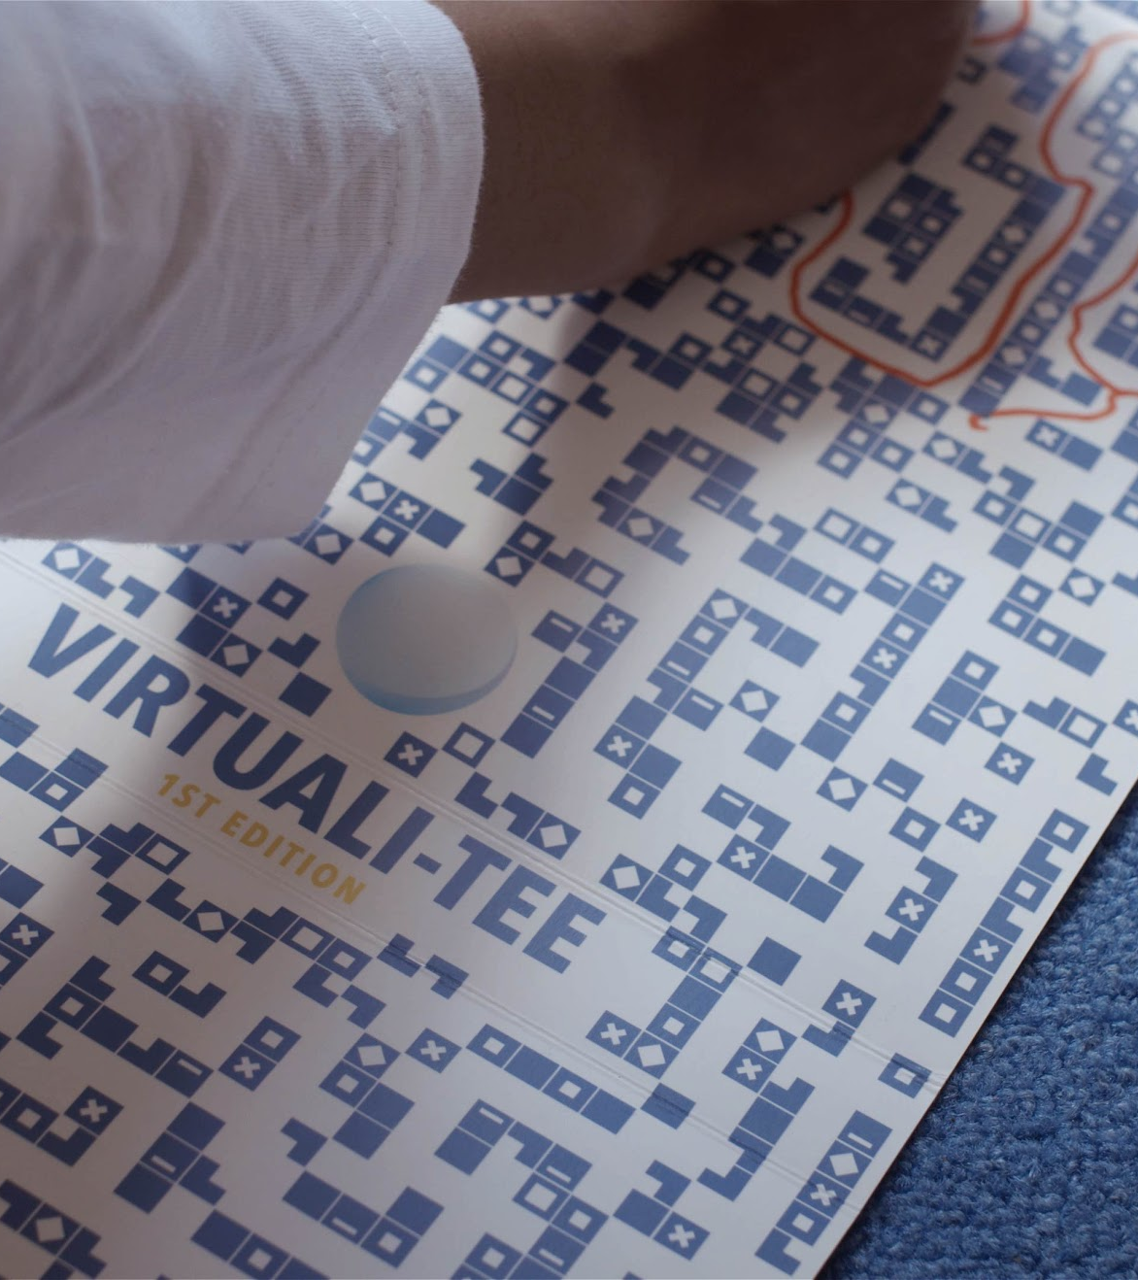
How many miles (or kilometers) of blood vessels are in the average human body?
Compare that to the earth circumference of only 24,000 miles (38,600km) !
Question 1
10 miles (16 km)
100 miles (160 km)
6000 miles (9,656 km)
60000+ miles (96,560 km)

Slide 4
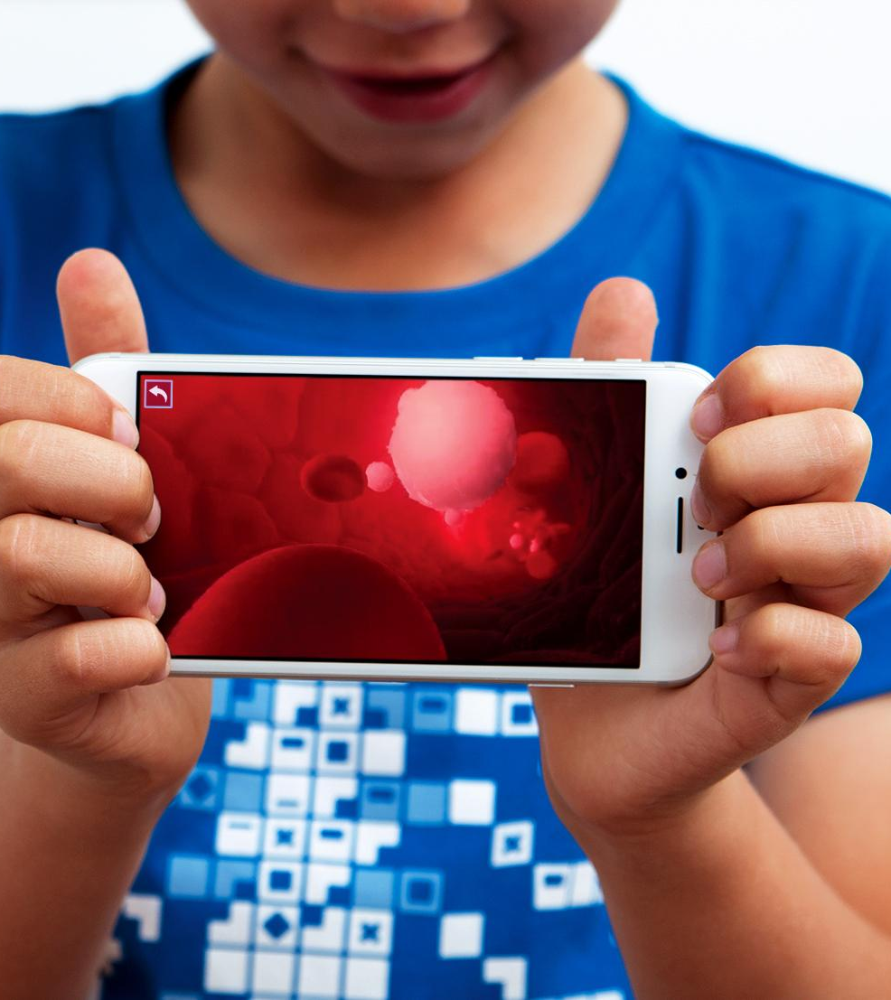
Blood that enters the lungs to receive oxygen is known as …
The blood has had oxygen removed and is therefore “de” oxygenated.
Question 2
Deoxygenated blood
Oxygenated blood
Detoxified blood
Retoxified blood

Slide 5
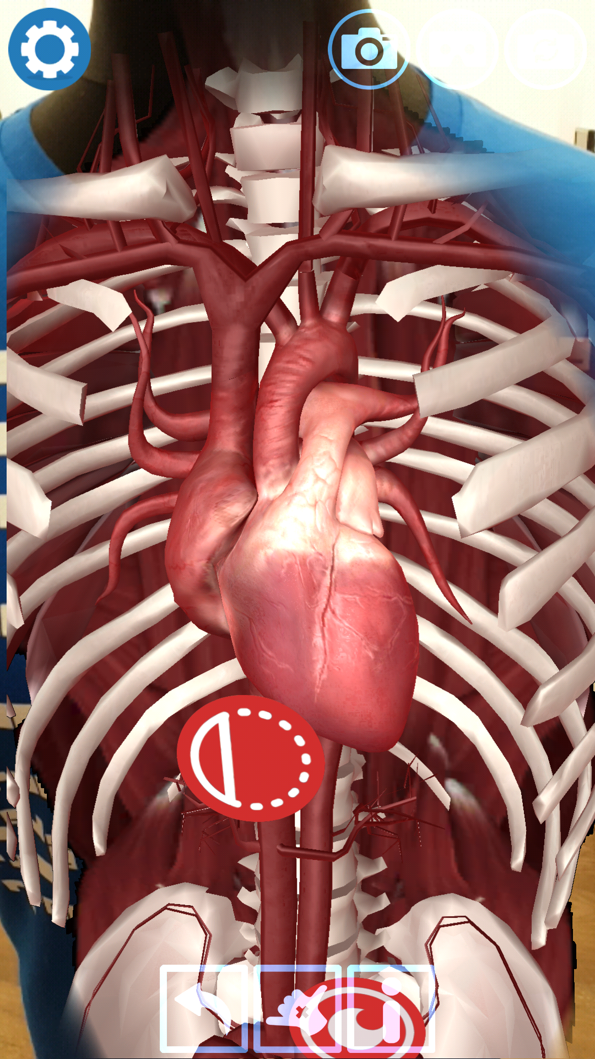
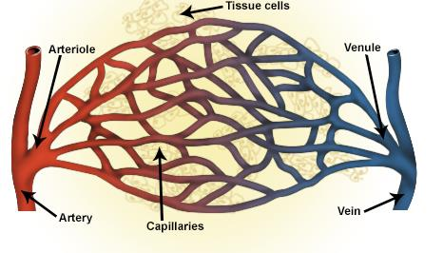
Which one of the following is in the correct order of blood flow:
“Capillar” comes from the Greek for “hairlike”.
Question 3
Vein, artery, arteriole, capillary
Vein, arteriole, capillary, artery
Artery, arteriole, capillary, vein
Artery, capillary, vein, artery

Slide 6
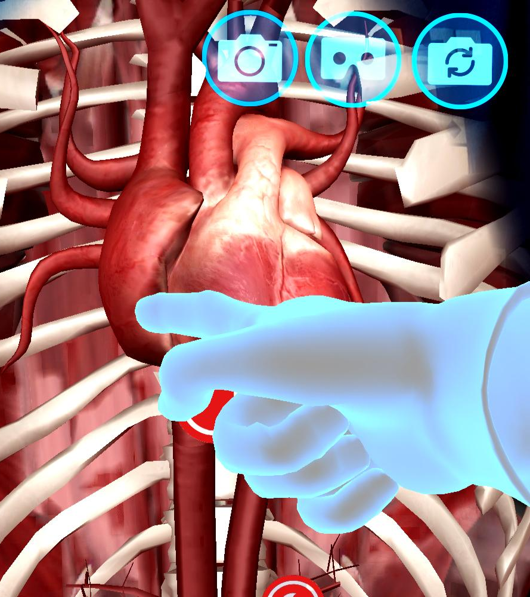
How often does the heart beat?
Your heart is busier than you, beating even when you are resting; between 60 and 100 times a minute!
Question 4
Every time you blink
1 million times a day
Every time you breath in
100,000 times a day

Slide 7
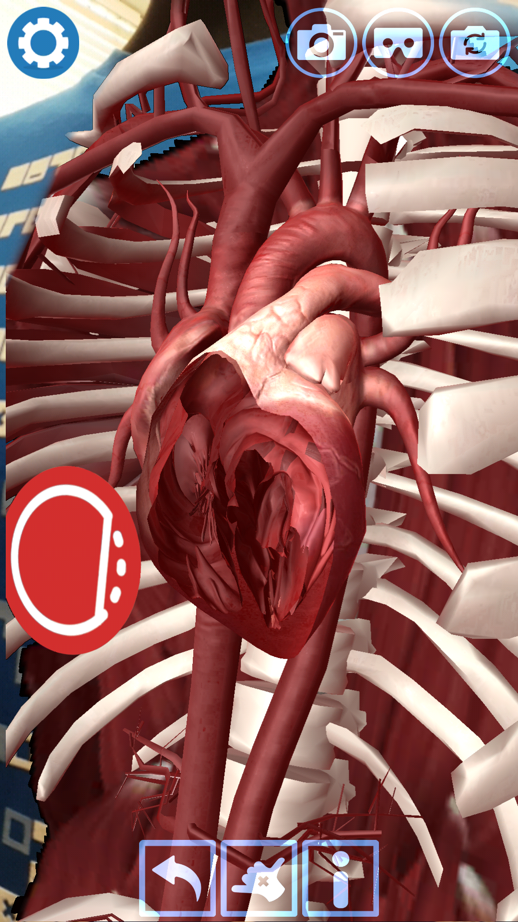
What is the name of the upper chambers of the heart?
Atria is also the name used for large open spaces in a building, and comes from the Latin “Atrium”, which was the word for the central court in a house.
Question 5
Ventricles
Atria
Valves
Veins

Slide 8
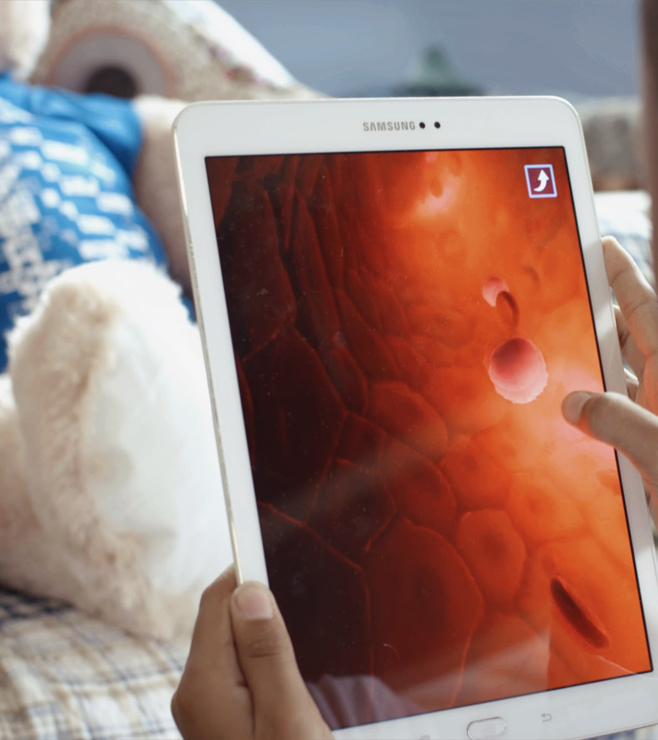
What stops the blood in your heart from flowing the wrong way?
Just like in a bicycle pump, valves control the direction of blood flow in the heart.
Question 6
Gravity
Pistons
Valves
Cogs

Slide 9
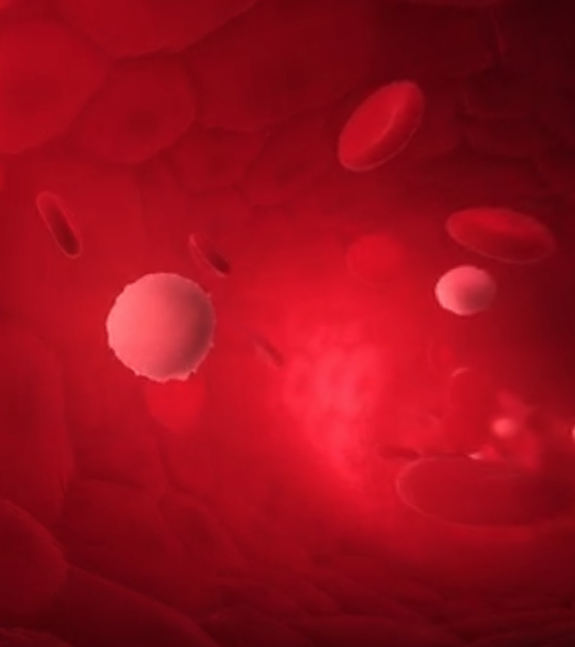
What do red blood cells carry?
Red blood cells carry oxygen to tissues and organs in the body, and that oxygen is used to clean the blood.
Question 7
Carbon dioxide to the lungs
Nutrients to the muscles
Instructions from the brain
Oxygen around the body

Slide 10
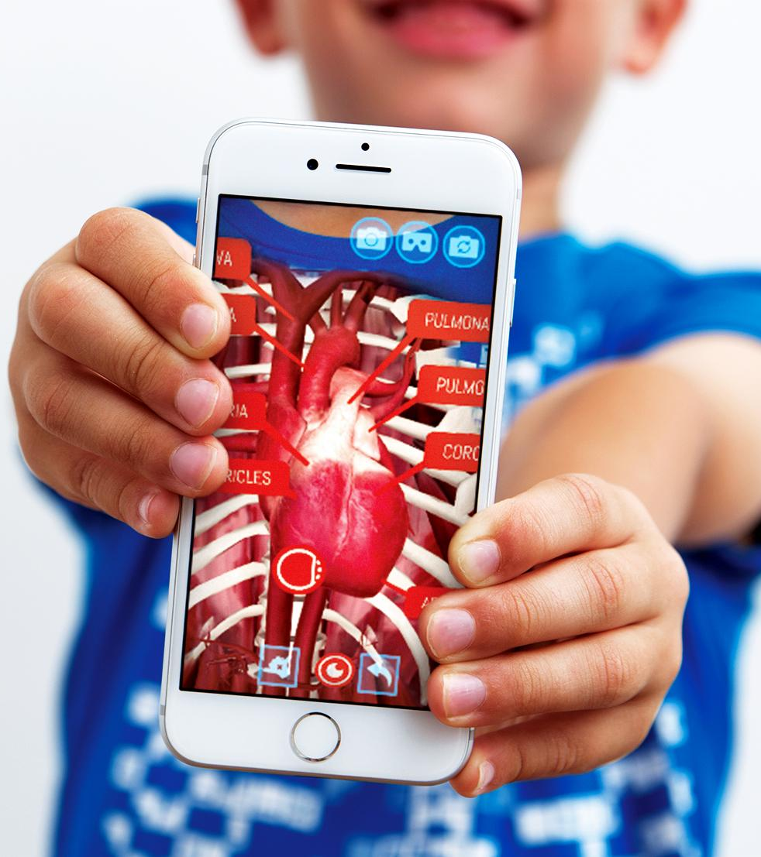
Which statement is correct?
Veins carry blood back to the heart; they are darker than arteries as they carry back deoxygenated blood. Arteries are much thicker to contain the high pressure of blood pumping through to your entire body.
Question 8
All blood that returns to the heart is deoxygenated
Exchange of carbon dioxide to the lungs occurs in the bronchioles
Blood flows away from your heart via arteries
None of the above

Slide 11

Which of the following carries waste away from tissues and organs?
Plasma makes up for approximately 55% of total blood volume. Plasma is also the coolest name in the body! It is a clear, straw-coloured fluid. It also helps carry the blood cells around your body.
Question 9
Platelets
White blood cells
Plasma
Red blood cells

Slide 12
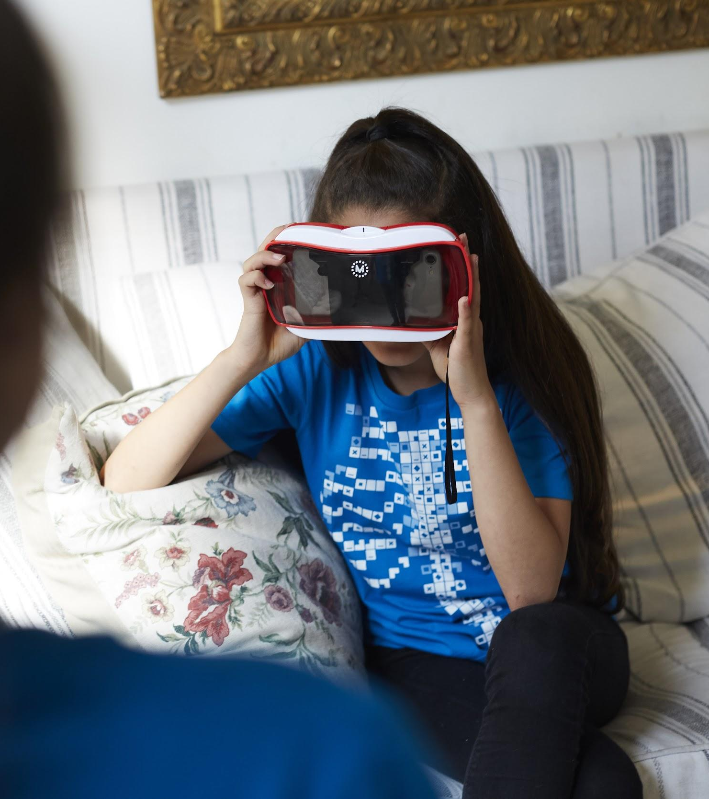
The LUB-DUB sound that the heart makes is caused by:
A defective valve can cause a hissing sound when a stream of blood squirts backwards through the valves.
Question 10
Flow of blood into the heart
Push of blood out of the heart
Closing of the valves
Opening of the valves

