Slide 1
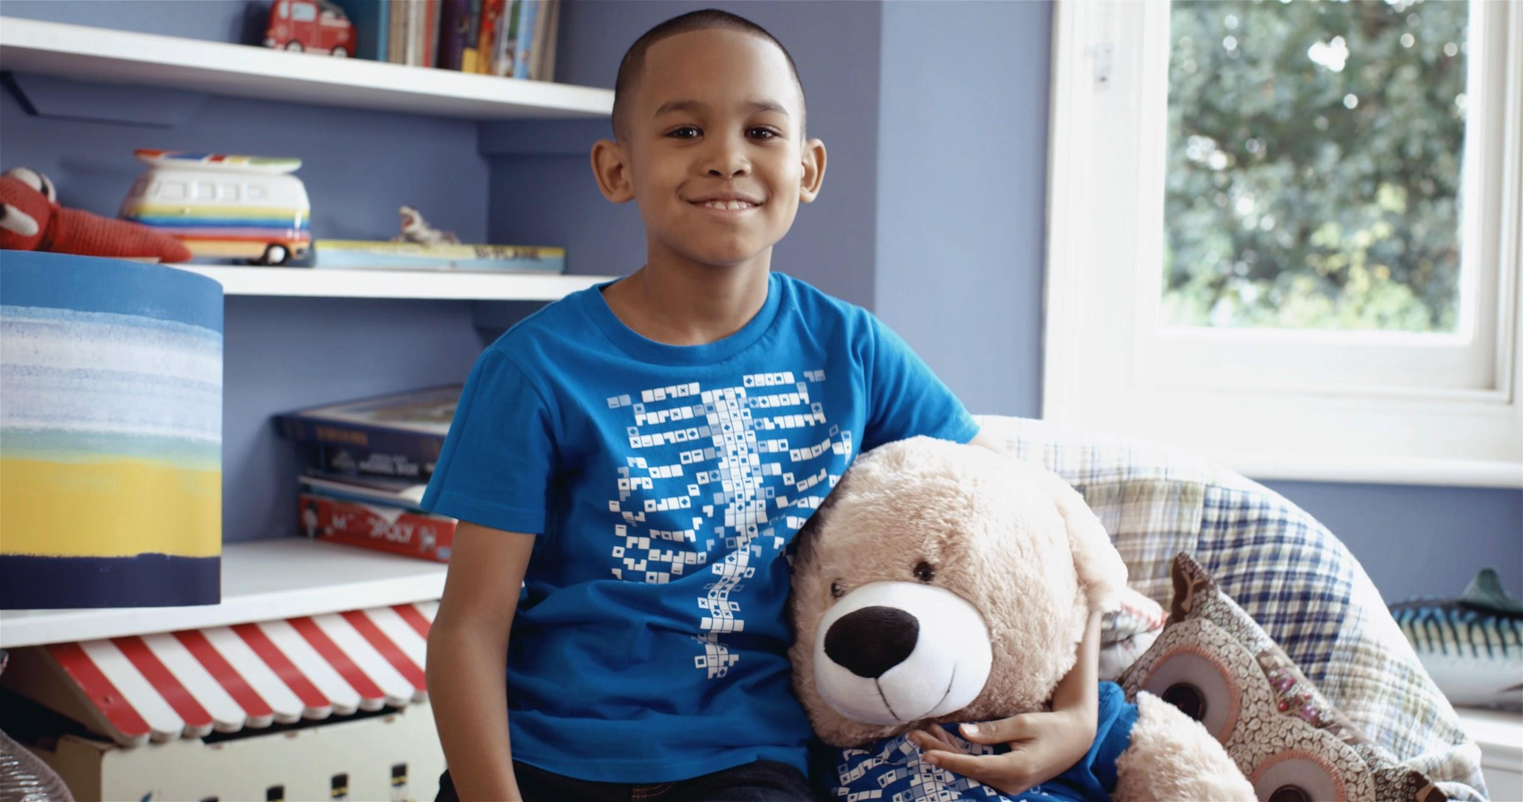

Digestive System Quiz
A note to teachers
This resource is recommended for use in two ways:
As the answer scheme to the Digestive System Challenge cards. Using the challenge cards, students discover the answers to each question as they are using the Virtuali-Tee app. Downloads are available in the teacher resources repository https://drive.google.com/drive/folders/17N-hPZnEAdBwevuxAYoTi-yasNatYQM9?usp=sharing
As a group quiz after using the Virtuali-Tee app.

Slide 2
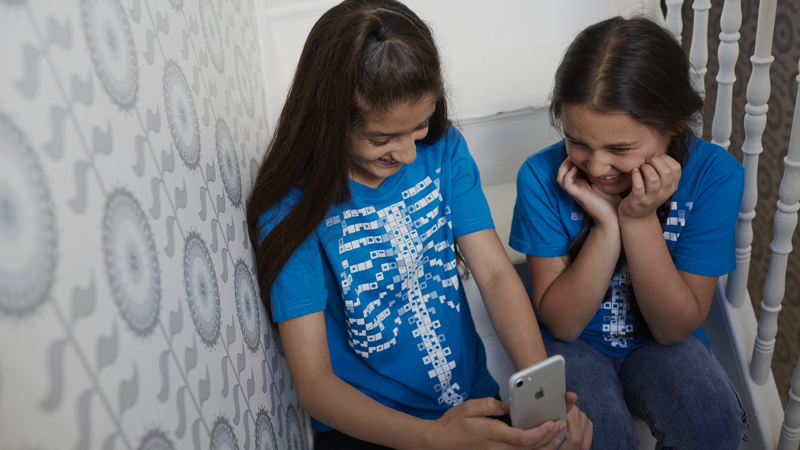
Digestive System

Slide 3
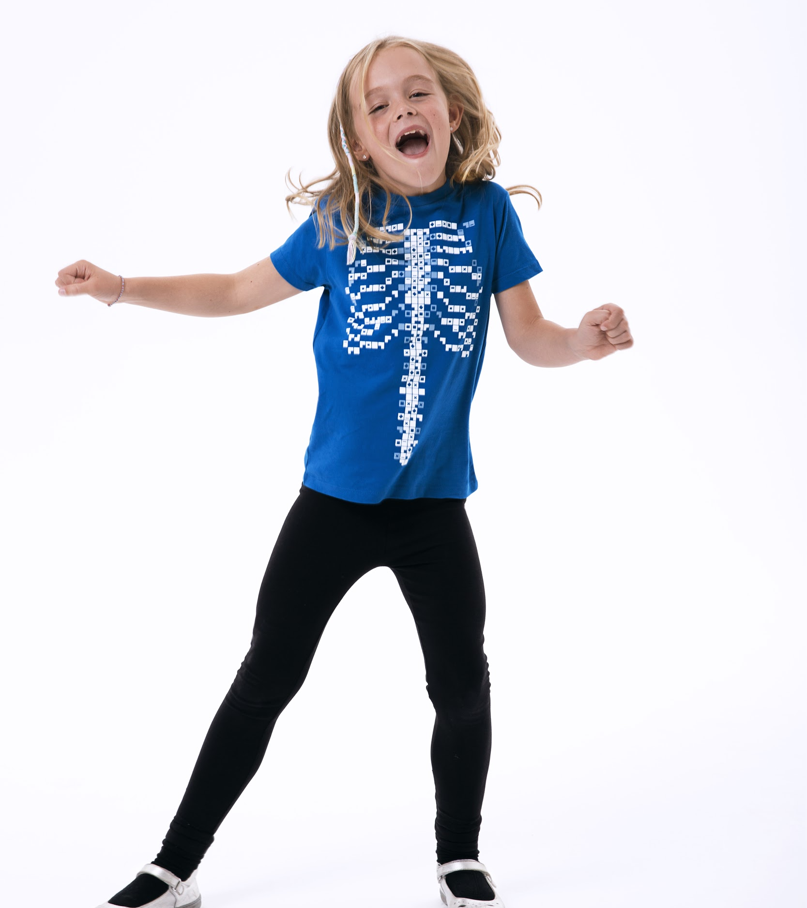
Which of the following do we get from our food?
We measure the amount of energy in food as calories.
Question 1
Power
Energy
Volts
Amps

Slide 4
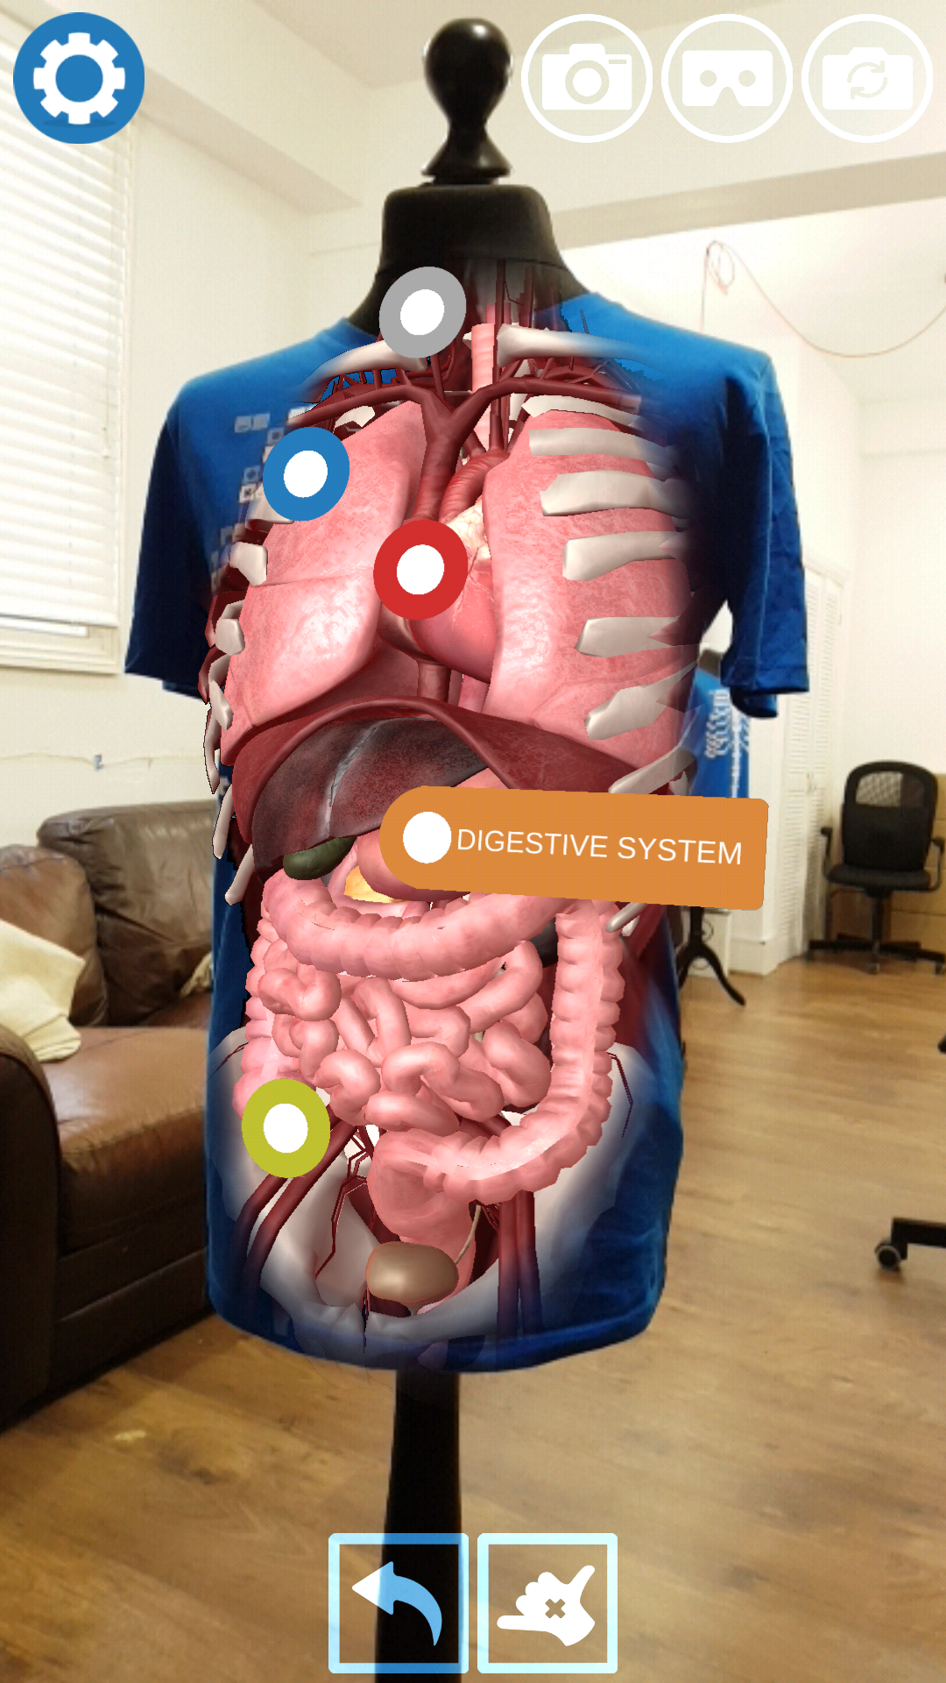
Before the stomach the food travels down through the …
A process called peristalsis, which acts like a wave, pushes food down to the stomach.
Question 2
Oesophagus
Duodenum
Arteries
Triceratops

Slide 5
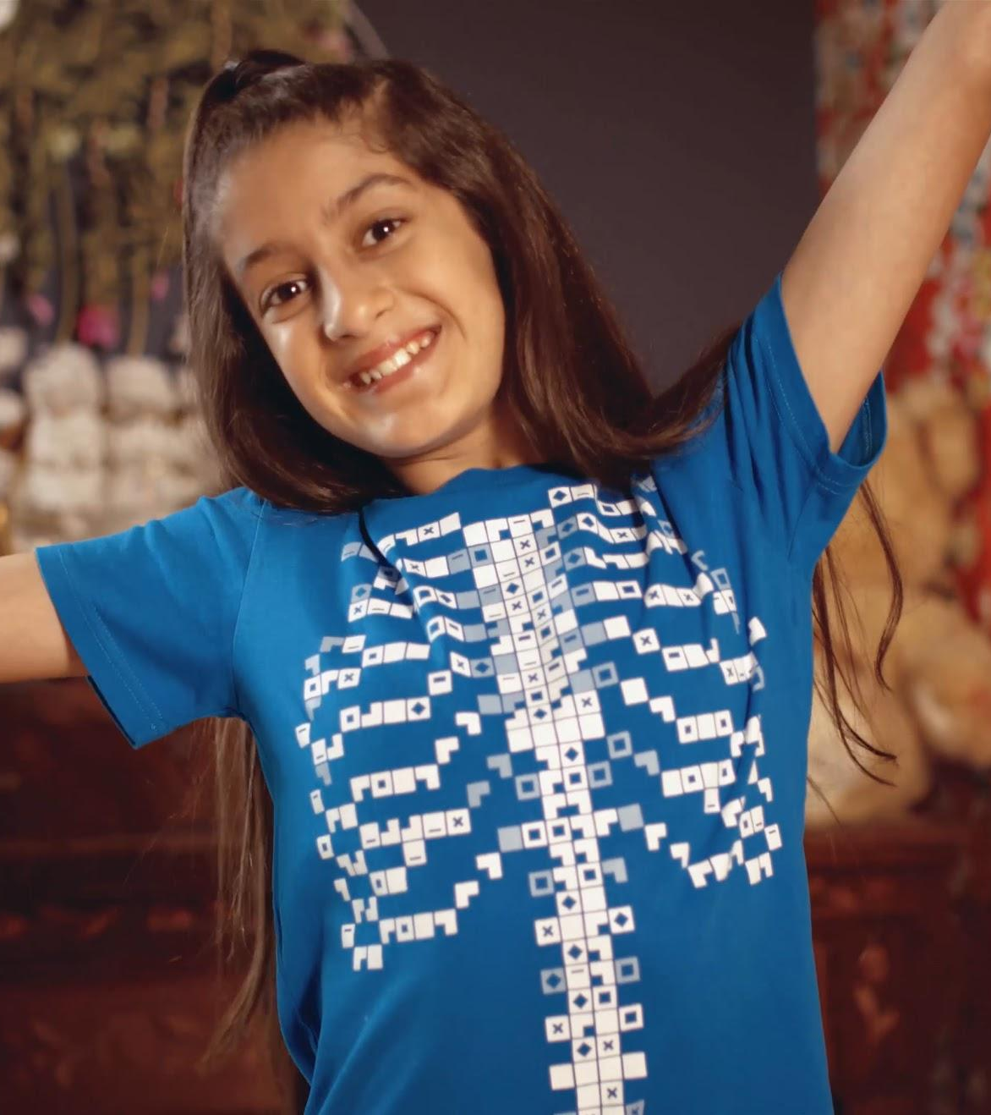
What do enzymes do?
Enzymes help kick off chemical reactions that break down the food that we eat.
Question 3
Cool down hot food
Separate meat from vegetables
Help break down your food
Help you convert oxygen to water

Slide 6
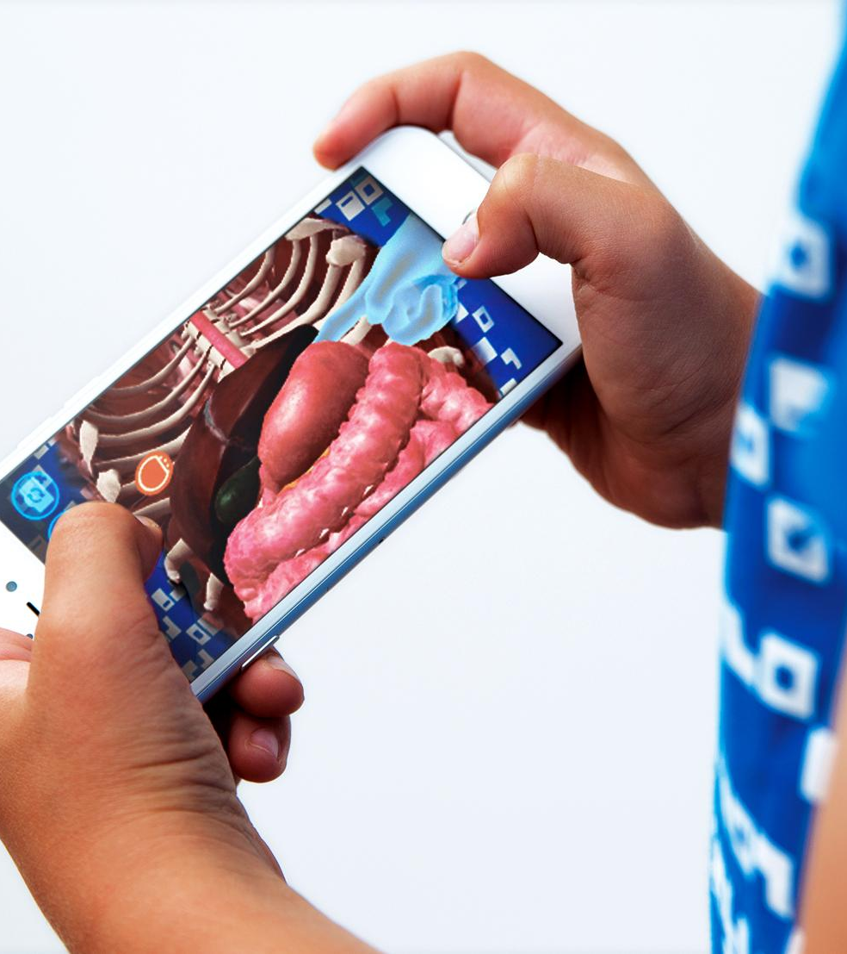
Bacteria in your gut make you …
Though it is entirely possible that a fart will make you laugh!
Question 4
Smarter
Taller
Fart
Laugh

Slide 7
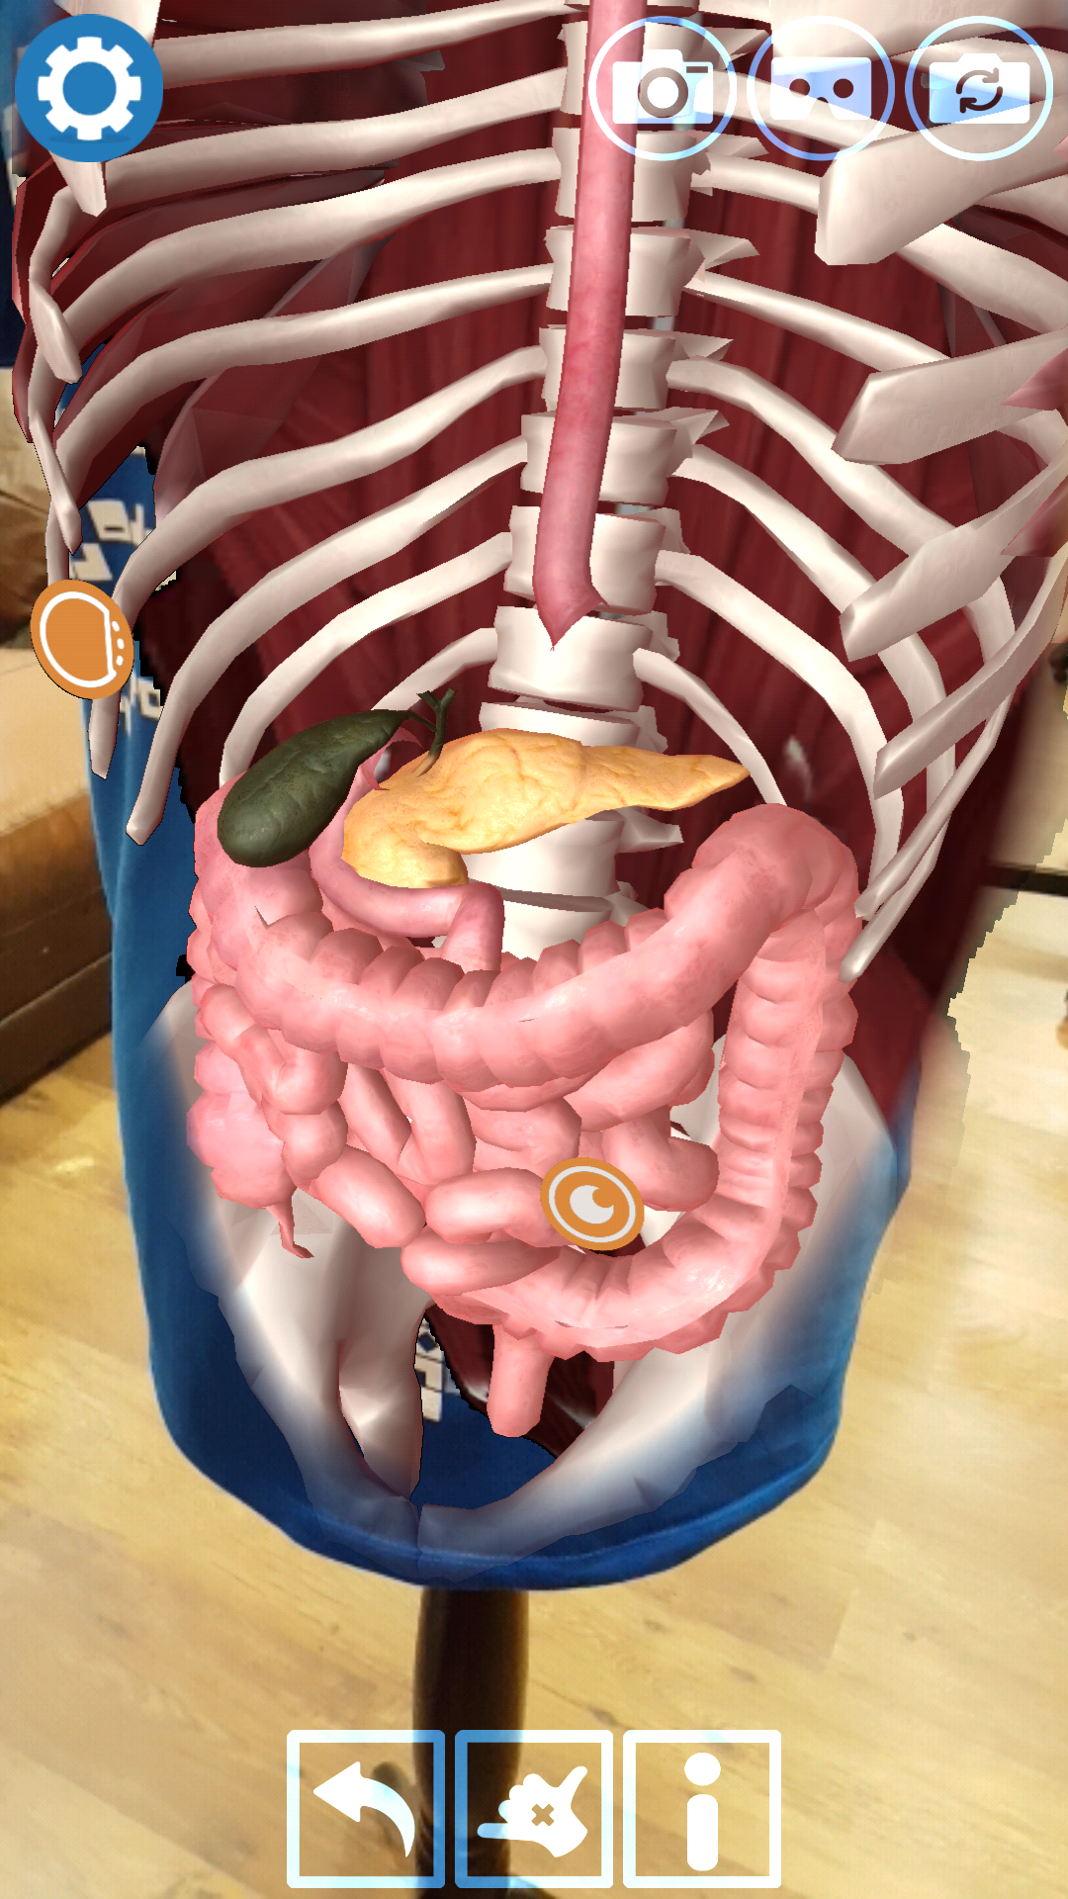
Acid in your stomach activates enzymes that start digestion.
What else does it do?
A typical adult stomach produces 1.5 litres of acid per day!
Question 5
Keeps you hydrated
Converts carbohydrates to sugars
Cools you down
Kills bacteria

Slide 8
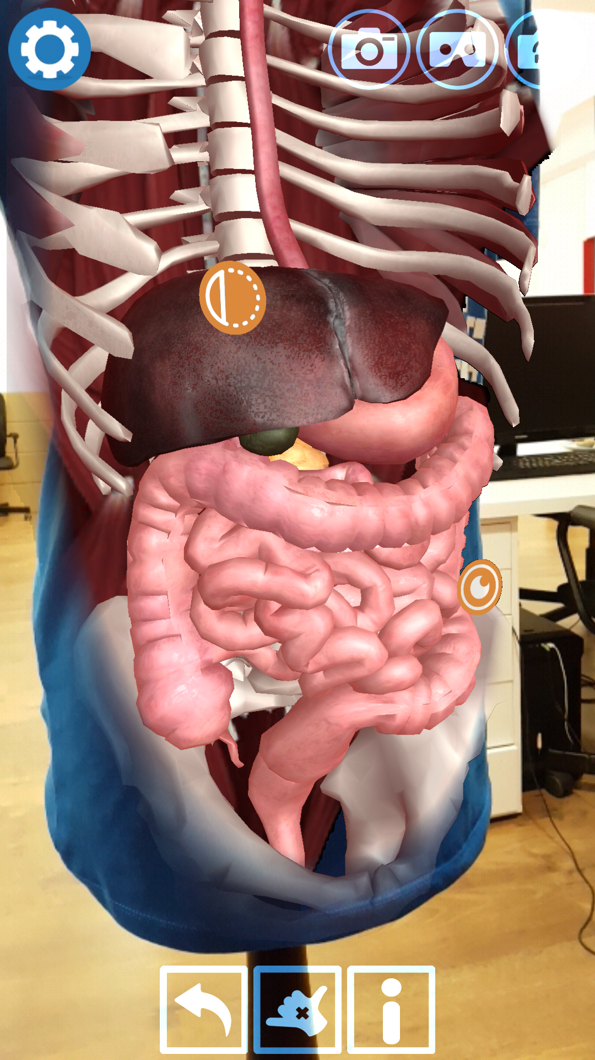
Which organ is NOT part of the digestive system?
Kidneys are part of the urinary system, which is about how you pee rather than how you digest your food.
Question 6
Stomach
Kidney
Rectum
Gall bladder

Slide 9
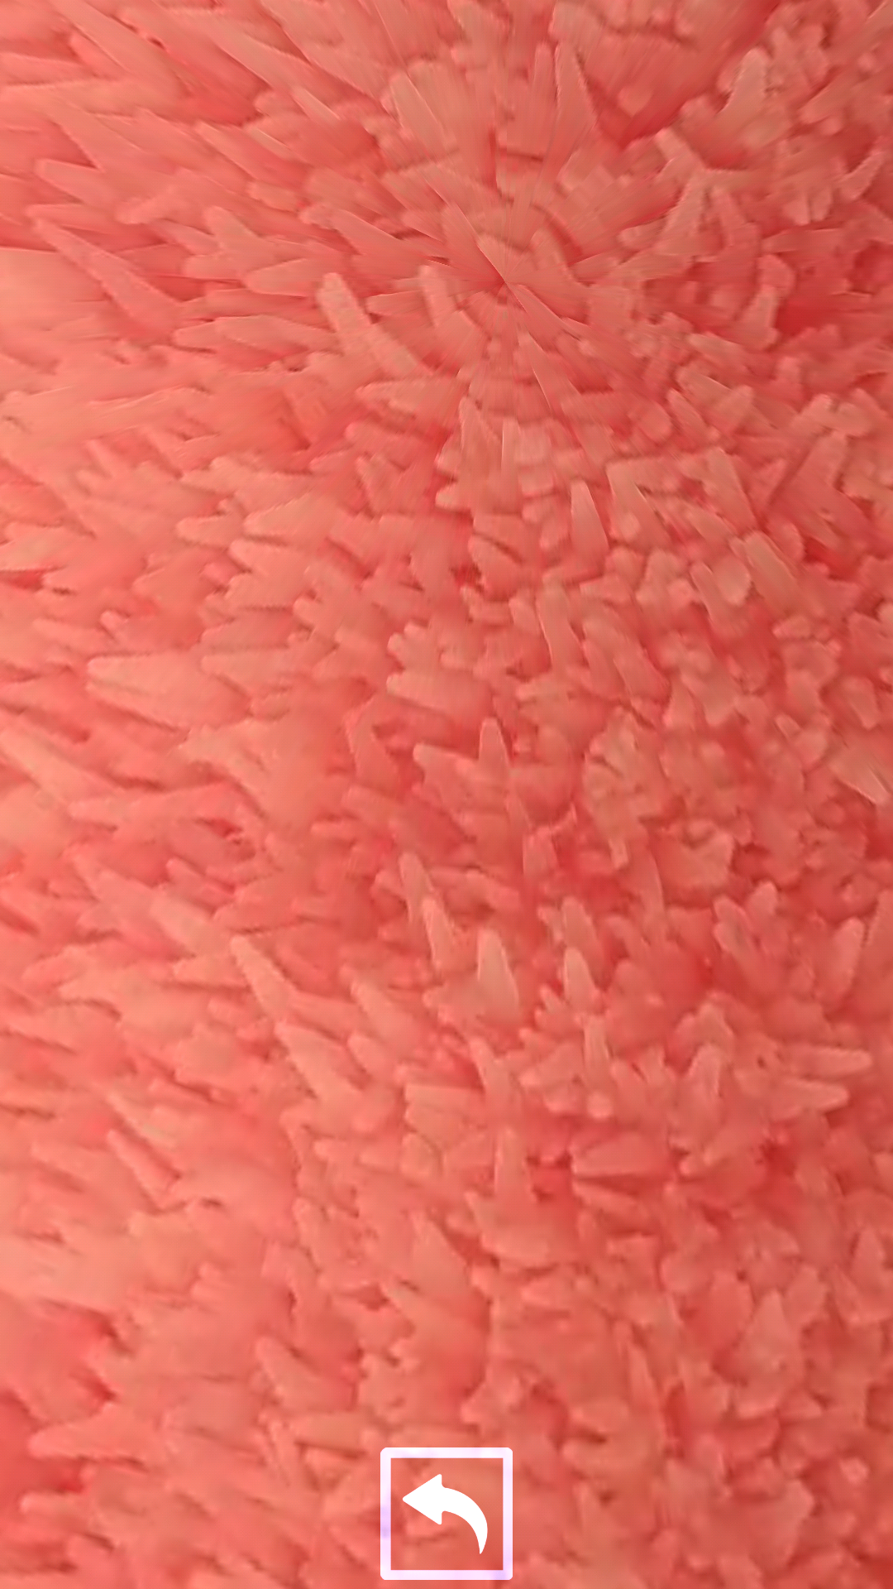
What lines the walls of the small intestine?
Villi are tiny but make up an enormous surface area to absorb nutrients.
Question 7
Villi
Cilli
Billi
Willi

Slide 10
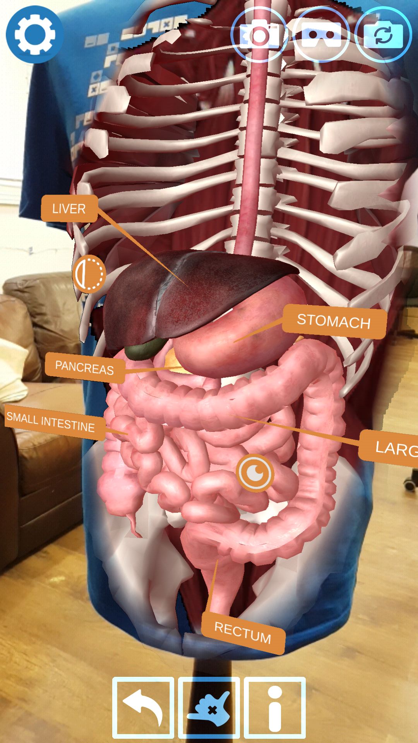
Peristalsis is responsible for …
The sound of bubbles in your tummy is often peristalsis.
Question 8
Blindness
Pushing food along the gut
Migraines
Nausea

Slide 11
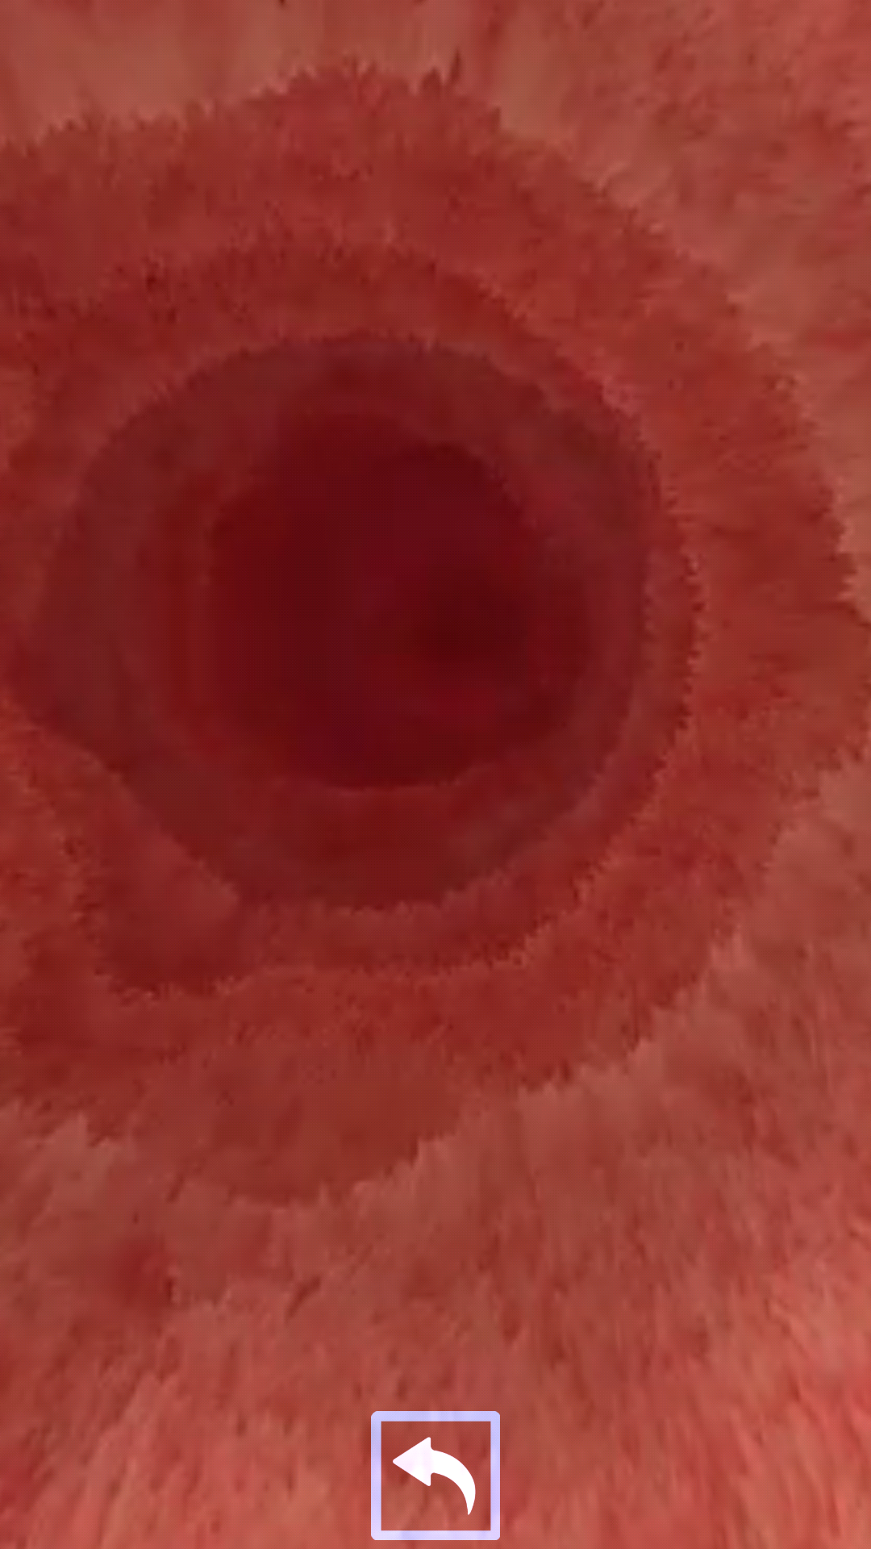
The first section of small intestine is actually …
The mashed up food that exits the stomach and enters the duodenum is known as chyme.
Question 9
The mouth
The duodenum
The stomach
The semicolon

Slide 12
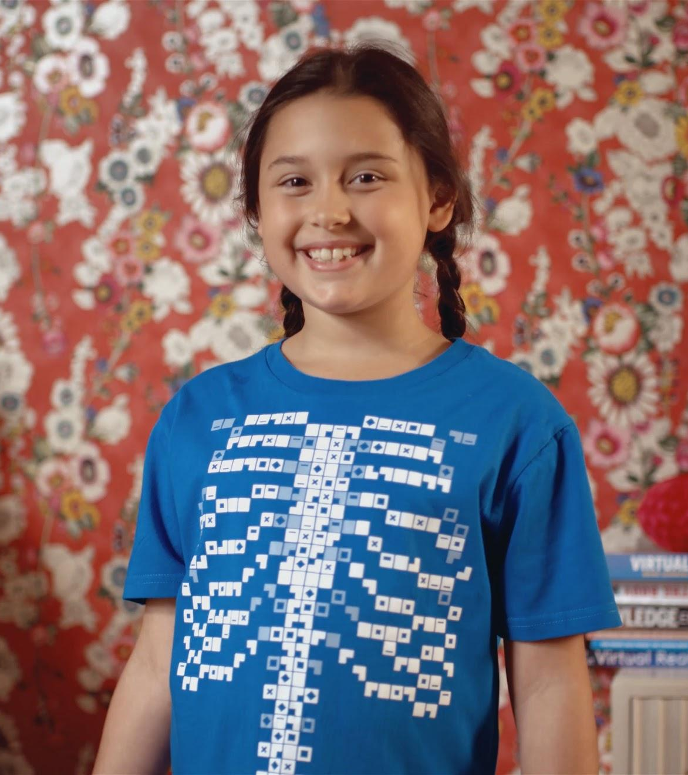
Green bile is responsible for …
Whilst bile is green, it has nothing to do with eye or skin colour.
Question 10
The colour of your eyes
The colour of your skin
Breaking down fats
Killing bacteria in your gut

