Slide 1


Skeletal System Quiz
A note to teachers
This resource is recommended for use in two ways:
As the answer scheme to the Skeletal System Challenge cards. Using the challenge cards, students discover the answers to each question as they are using the Virtuali-Tee app. Downloads are available in the teacher resources repository https://www.curiscope.com/pages/science-lesson-plans-human-body
As a group quiz after using the Virtuali-Tee app.

Slide 2
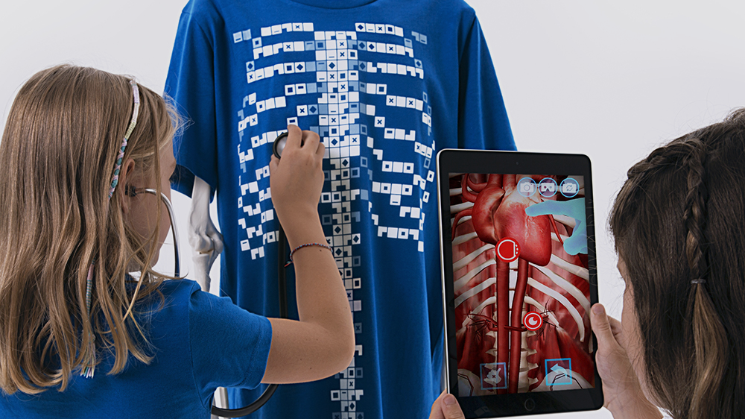
Skeletal System

Slide 3
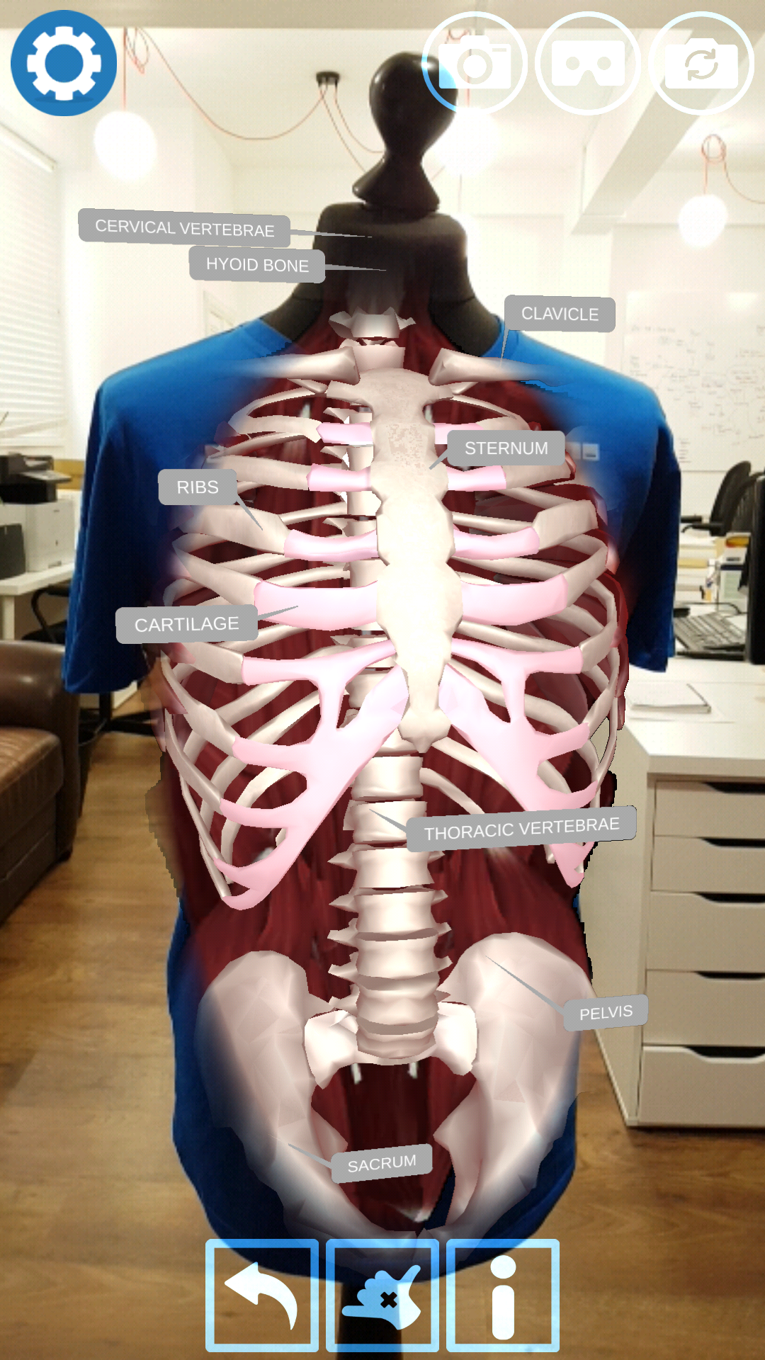
Without bones you would …
Falling over would be the least of your worries!
Question 1
Float
Sink
Fall over
Look the same

Slide 4
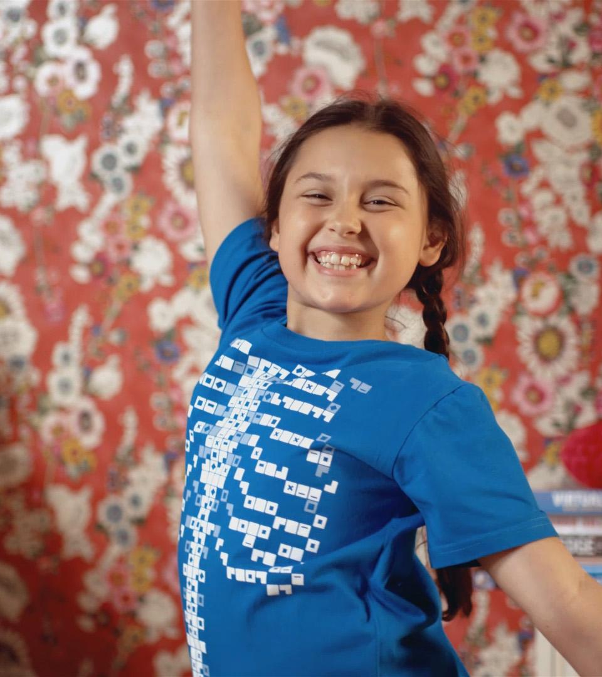
Which of the following is NOT an organ?
Bones are organs too!
Cells make up every organ in our body but are not organs in themselves, they are the building blocks.
Question 2
Cells
Lungs
Bones
Heart

Slide 5

Bones are made of…
Collagen adds flexibility to the calcium, which forms the firm framework of the bone. Together they can handle great strain while still being able to flex.
Carbon fibre is often used for prosthetic running blades.
Question 3
steel
carbon fibre
collagen and calcium
hardened muscles

Slide 6
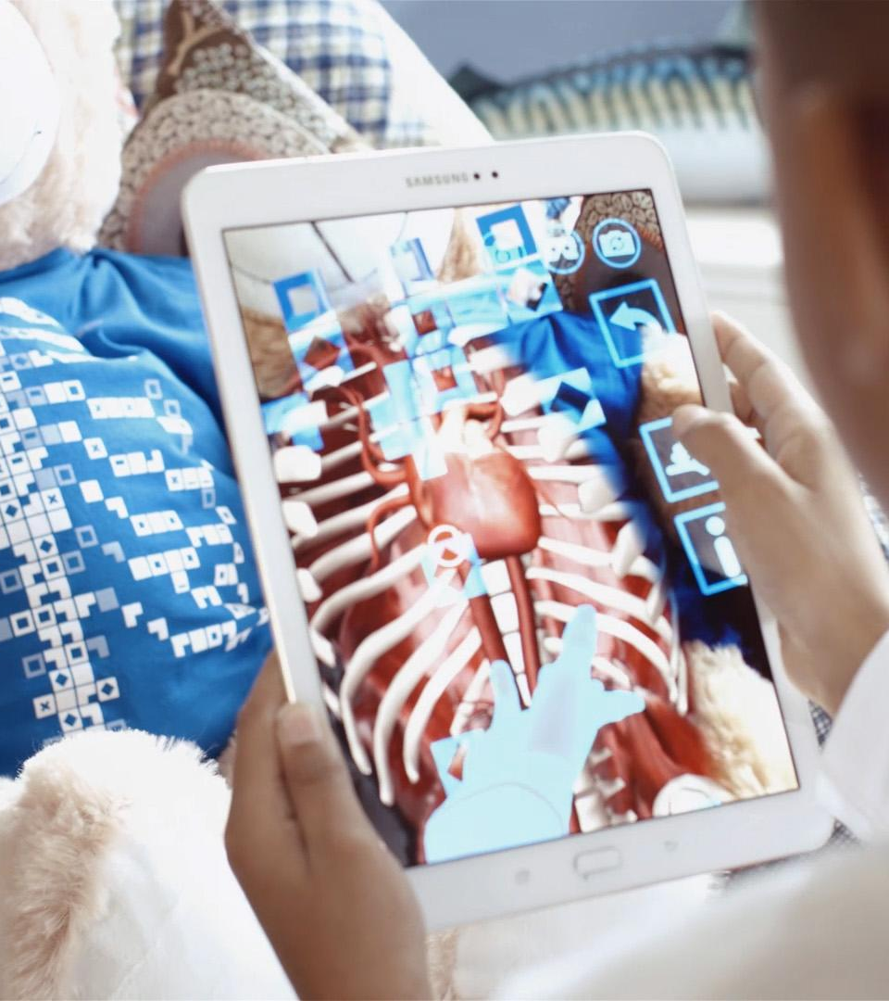
Astronauts can come back to earth with …
Weightlessness has many strange effects on the body.
Question 4
More teeth
More bones
Lighter bones
A heavy heart

Slide 7

Which of the following can have stronger than average bones?
Perhaps your gym teacher too!
Question 5
Accountants
Animators
Athletes
Art teachers

Slide 8
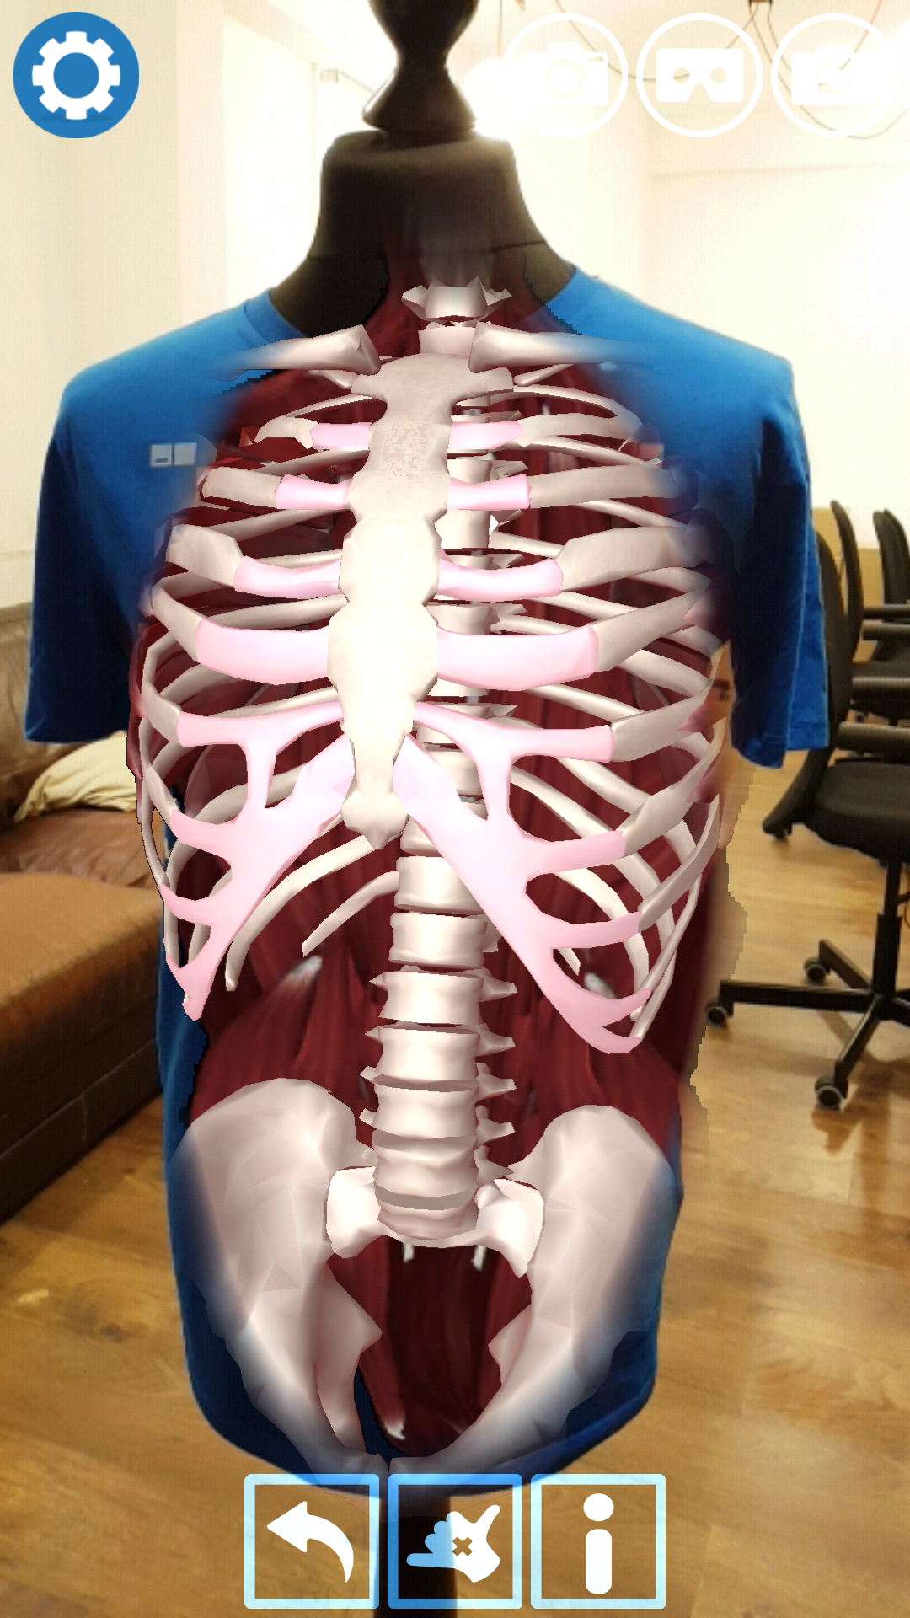
What can be found inside bones?
To be fair, marrow does share its name with a vegetable (overgrown courgettes aka zucchini).
Question 6
Turnips
Marrow
Courgette
Carrots

Slide 9
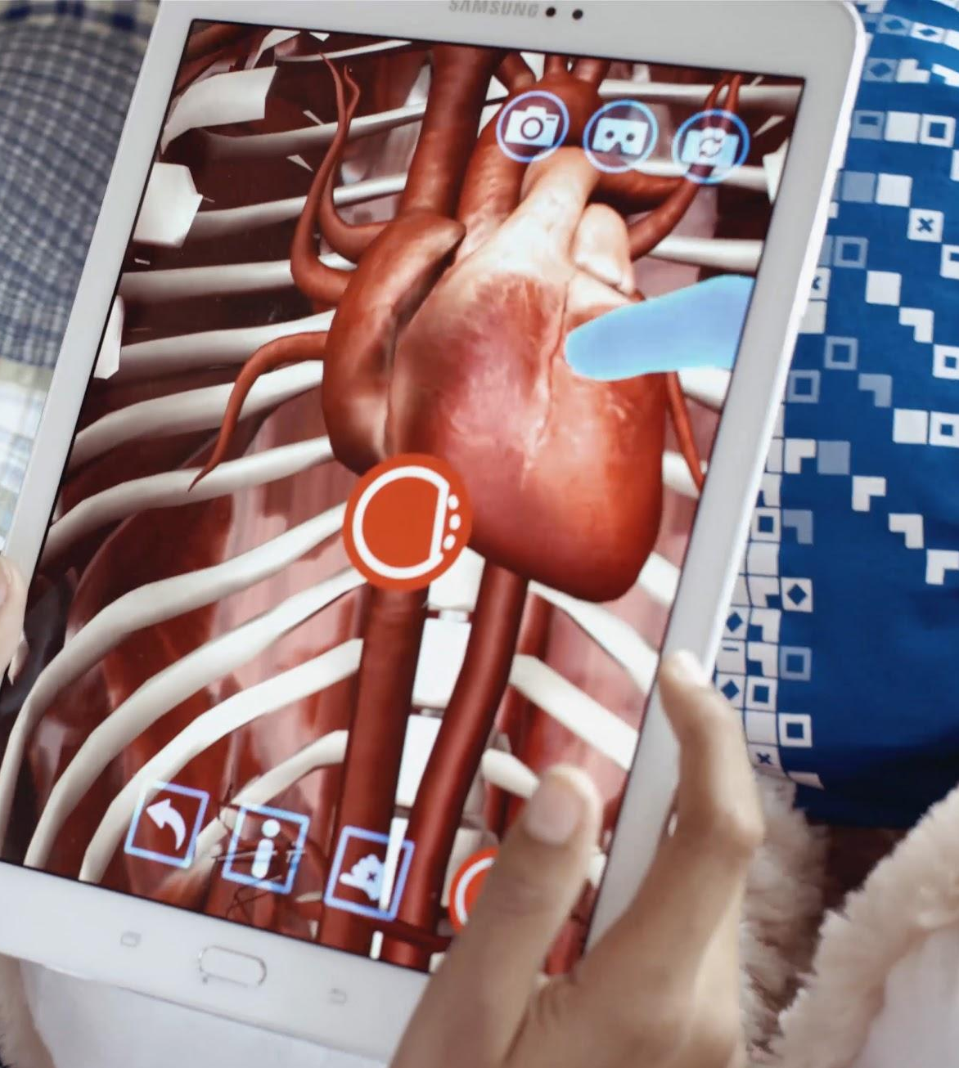
What is marrow responsible for?
Marrow is soft and spongy and works day and night to renew your red and white blood cells.
Question 7
Storing oxygen
Producing red and white blood cells
Filling in the gaps
Filtering your blood

Slide 10
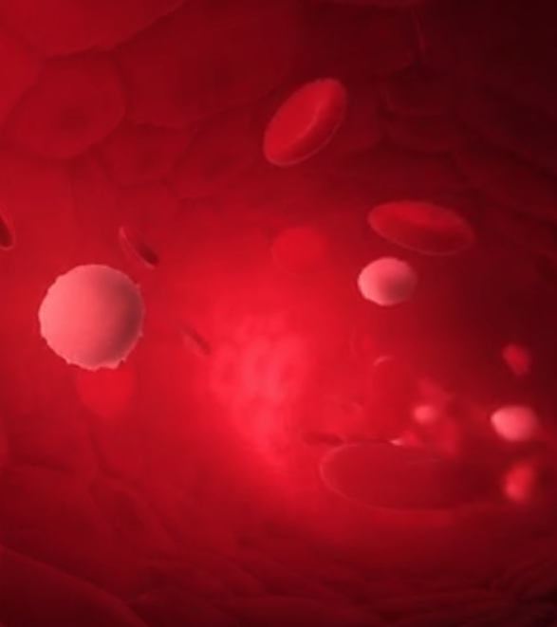
White blood cells are able to ...
Pus contains dead white blood cells, fallen heroes in the battle to protect your body.
Question 8
Change colour
Carry oxygen
Defend the body
Carry instructions to organs

Slide 11

Collagen can also be found in…
Collagen is our bodies most abundant protein, making up to 35% of your total protein content.
Question 9
Apples
Hair
Steel
Pencils

Slide 12
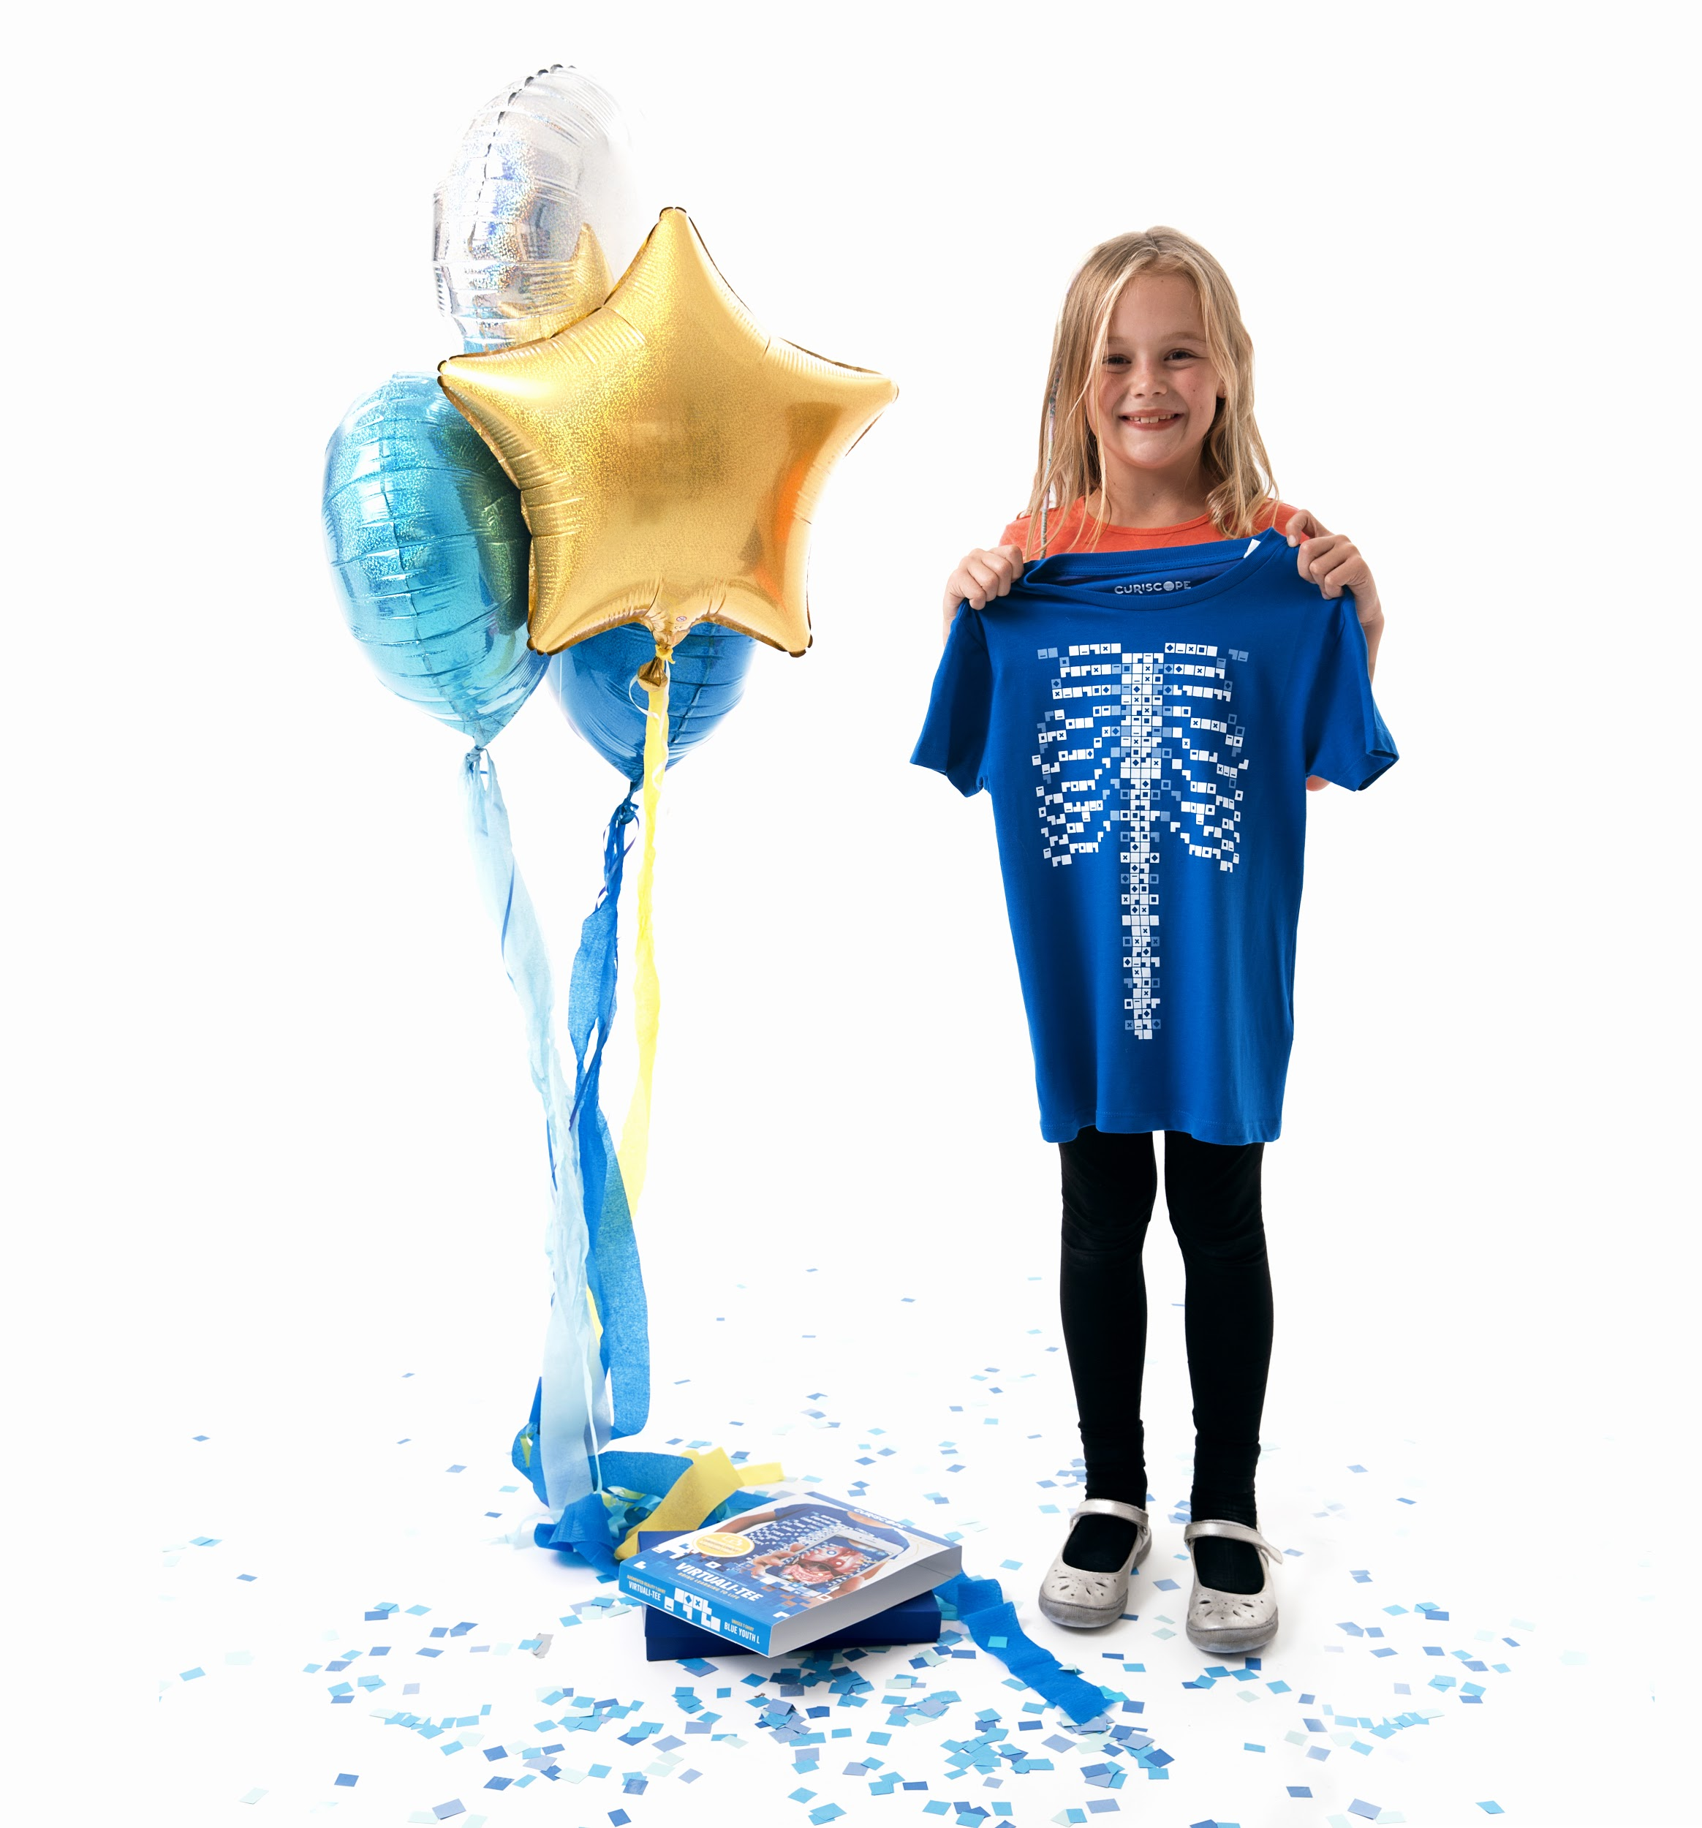
You can improve the health of your bones through …
It's always a good idea to think and read about your health, but it is best to be active throughout your life.
Question 10
Eating foods that are high in calcium
Exercise
Taking vitamin D
All of the above

