Slide 1


Respiratory System Quiz

Slide 2

Respiratory System

Slide 3
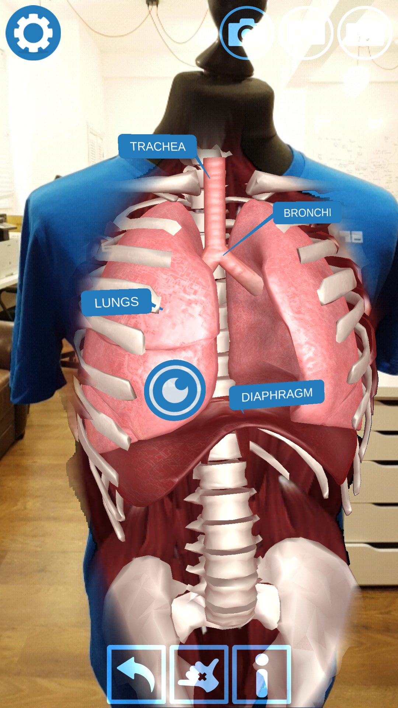
Roughly how many times do we breathe in and out?
Adults normally breathe 12-20 times a minute when resting, but for children it is normal to take almost twice as many breaths.
Every time you blink
1 million times a day
Every time you breath in
100,000 times a day

Slide 4
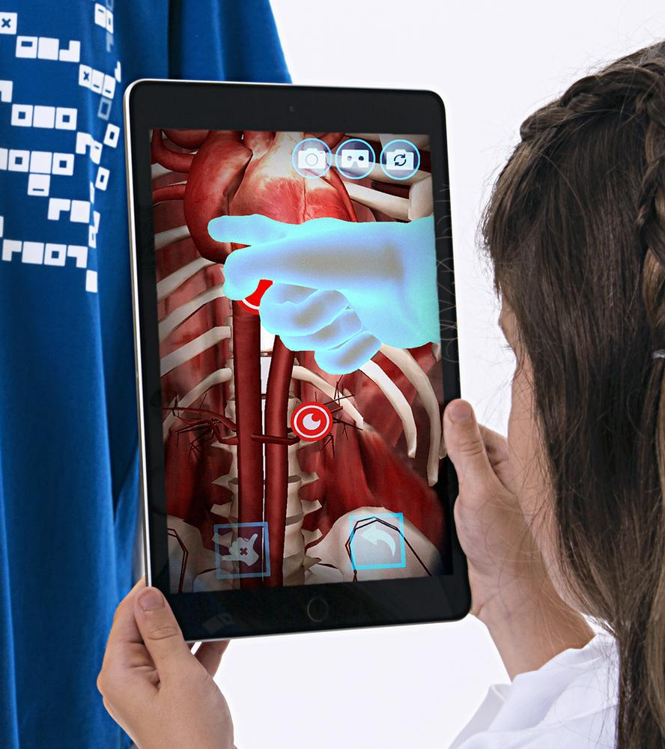
Why do we need Oxygen?
A process involving oxygen is known as aerobic. In our bodies aerobic respiration is the way we convert sugars into the energy our bodies need.
To make water with Hydrogen
To digest our food
To conduct electricity
To convert sugars to energy

Slide 5

How many bronchi do you have?
Bronchi is plural for your left and right Bronchus - they are the extensions of your windpipe into the lungs.
2 for each lung
4
2
Millions

Slide 6

What are the small air sacs in lungs called?
Whilst it is possible to get Anchovy in your lungs, it is not recommended!
Abalone
Alveoli
Ravioli
Anchovy

Slide 7
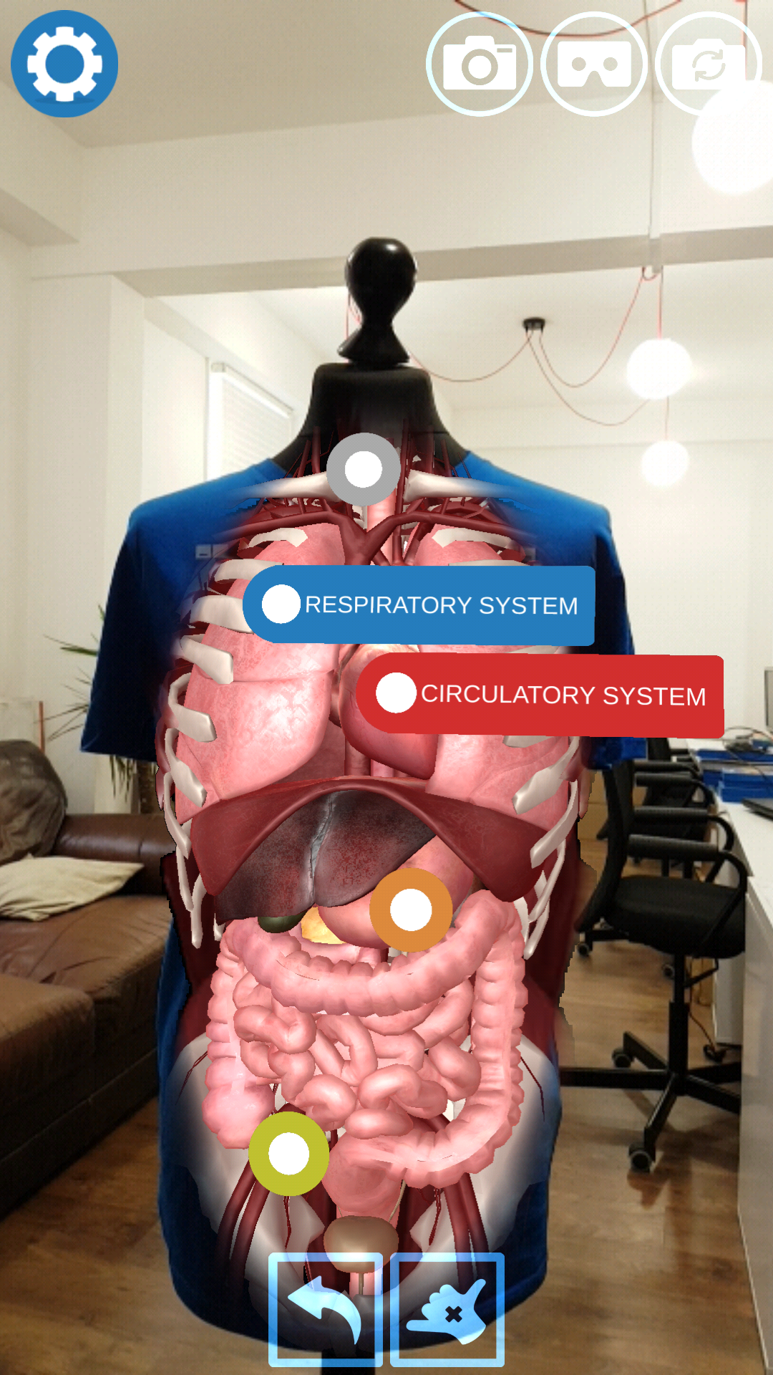
Which of these muscles pull air into your lungs?
The diaphragm is a dome shaped sheet of muscle that separates your chest from your abdomen.
Heart
Tongue
Diaphragm
Bicep

Slide 8
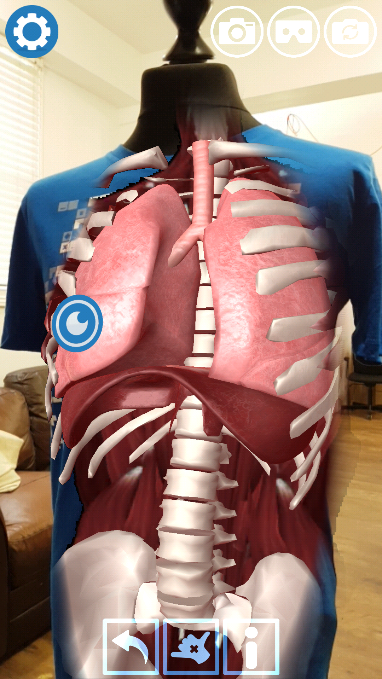
What causes hiccups?
Hiccups are spasms caused by irritation of the nerves of the diaphragm, luckily they rarely last too long!
Involuntary contractions of your diaphragm
Involuntary contractions of your heart
Involuntary contractions of your throat
Involuntary contractions of your tongue

Slide 9
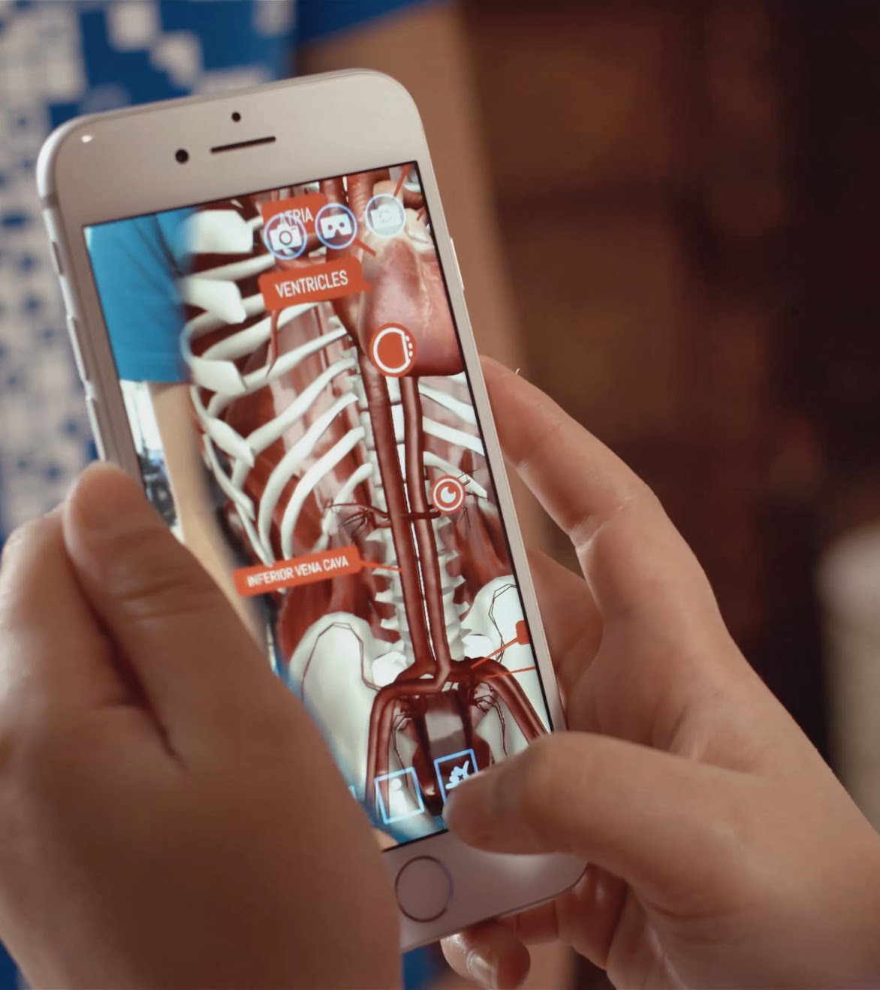
Blood flows to the lungs AFTER which organ?
And don’t forget, the blood also flows back to the heart AFTER the lungs - where it has been oxygenated.
The brain
The heart
The kidneys
The spleen

Slide 10
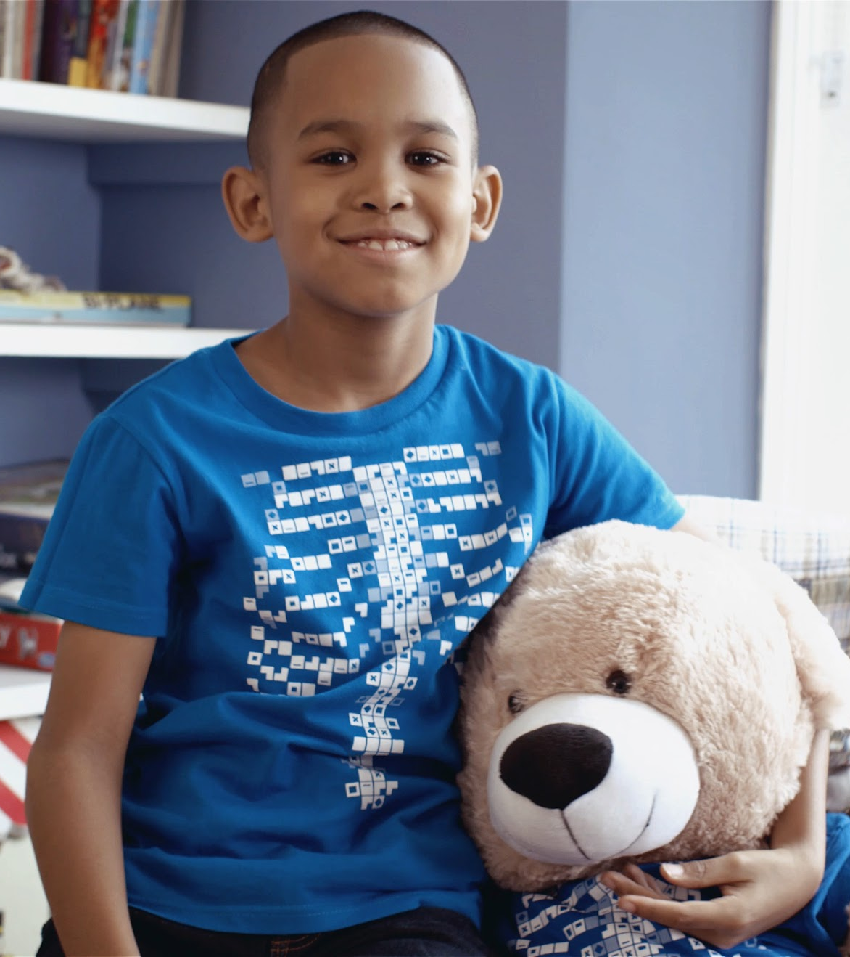
What can help recover your breath after exercise?
Placing your hands on your hips opens up more air space in your lungs.
Facing north
Placing your hands on your hips
Rolling your tongue
Shutting your eyes

Slide 11
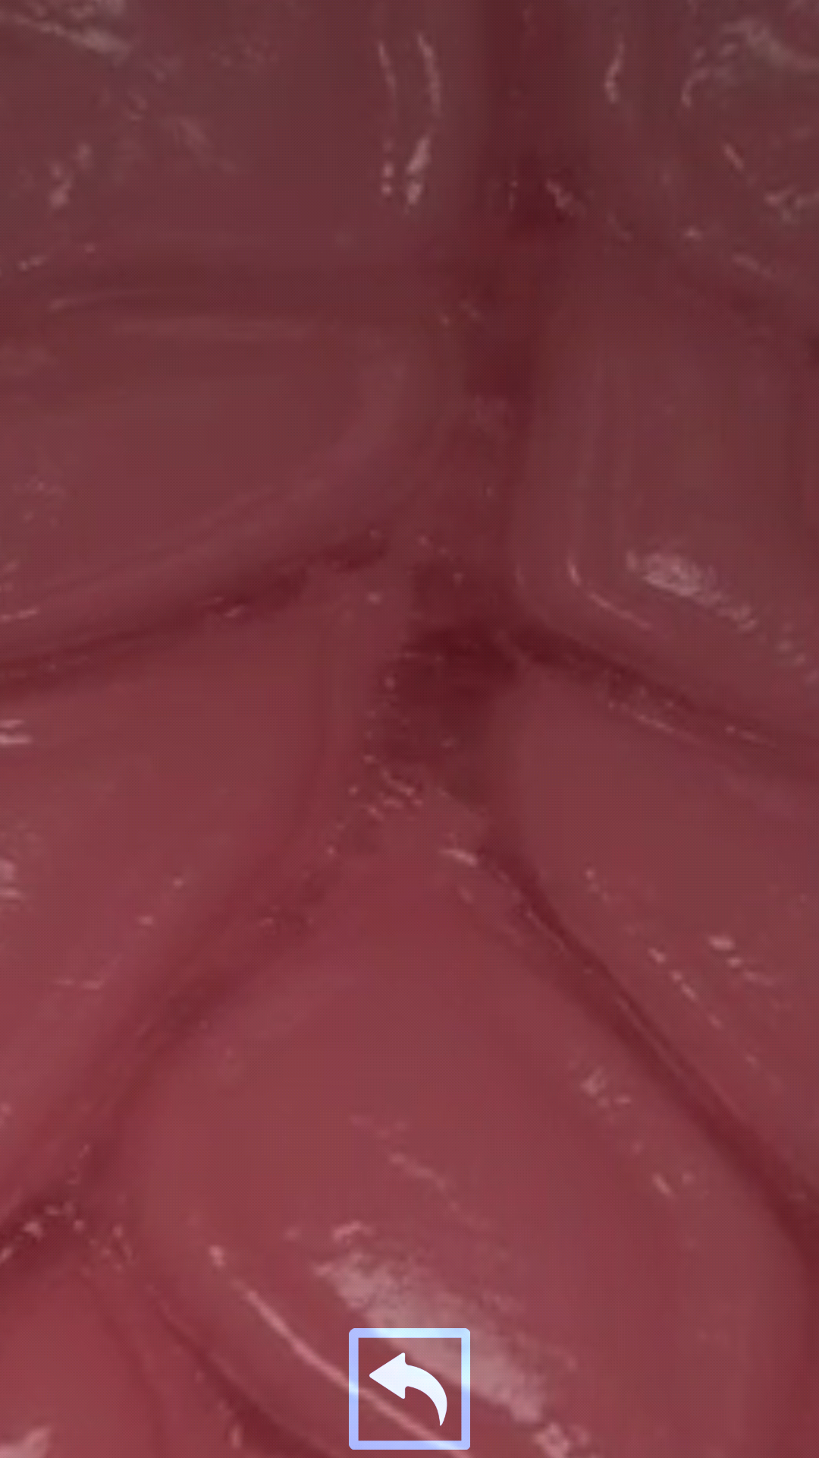
What exchanges in an Alveoli?
Two gases exchange in the alveoli of our lungs: Carbon Dioxide and Oxygen.
Glucose
Gases
Vitamins
Blood

Slide 12

What happens to Carbon Dioxide in the lungs?
To prevent reaching toxic levels, Carbon Dioxide is removed from the blood by the alveoli and sent back to the lungs to be breathed out. Nice!
You breathe it out
It converts to Oxygen
It converts sugars to energy
It turns to liquid

