Slide 1
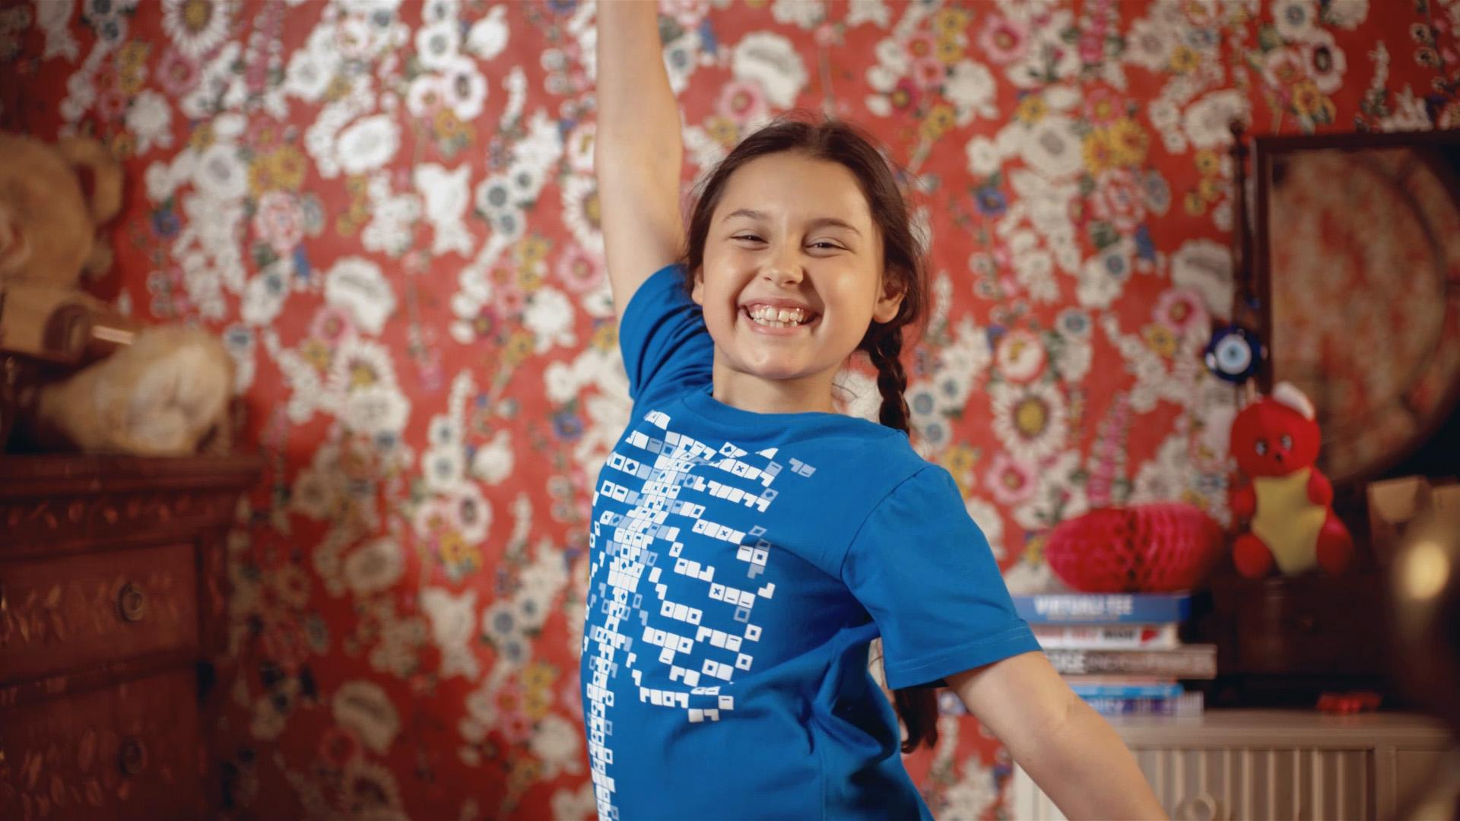

Urinary System Quiz

Slide 2
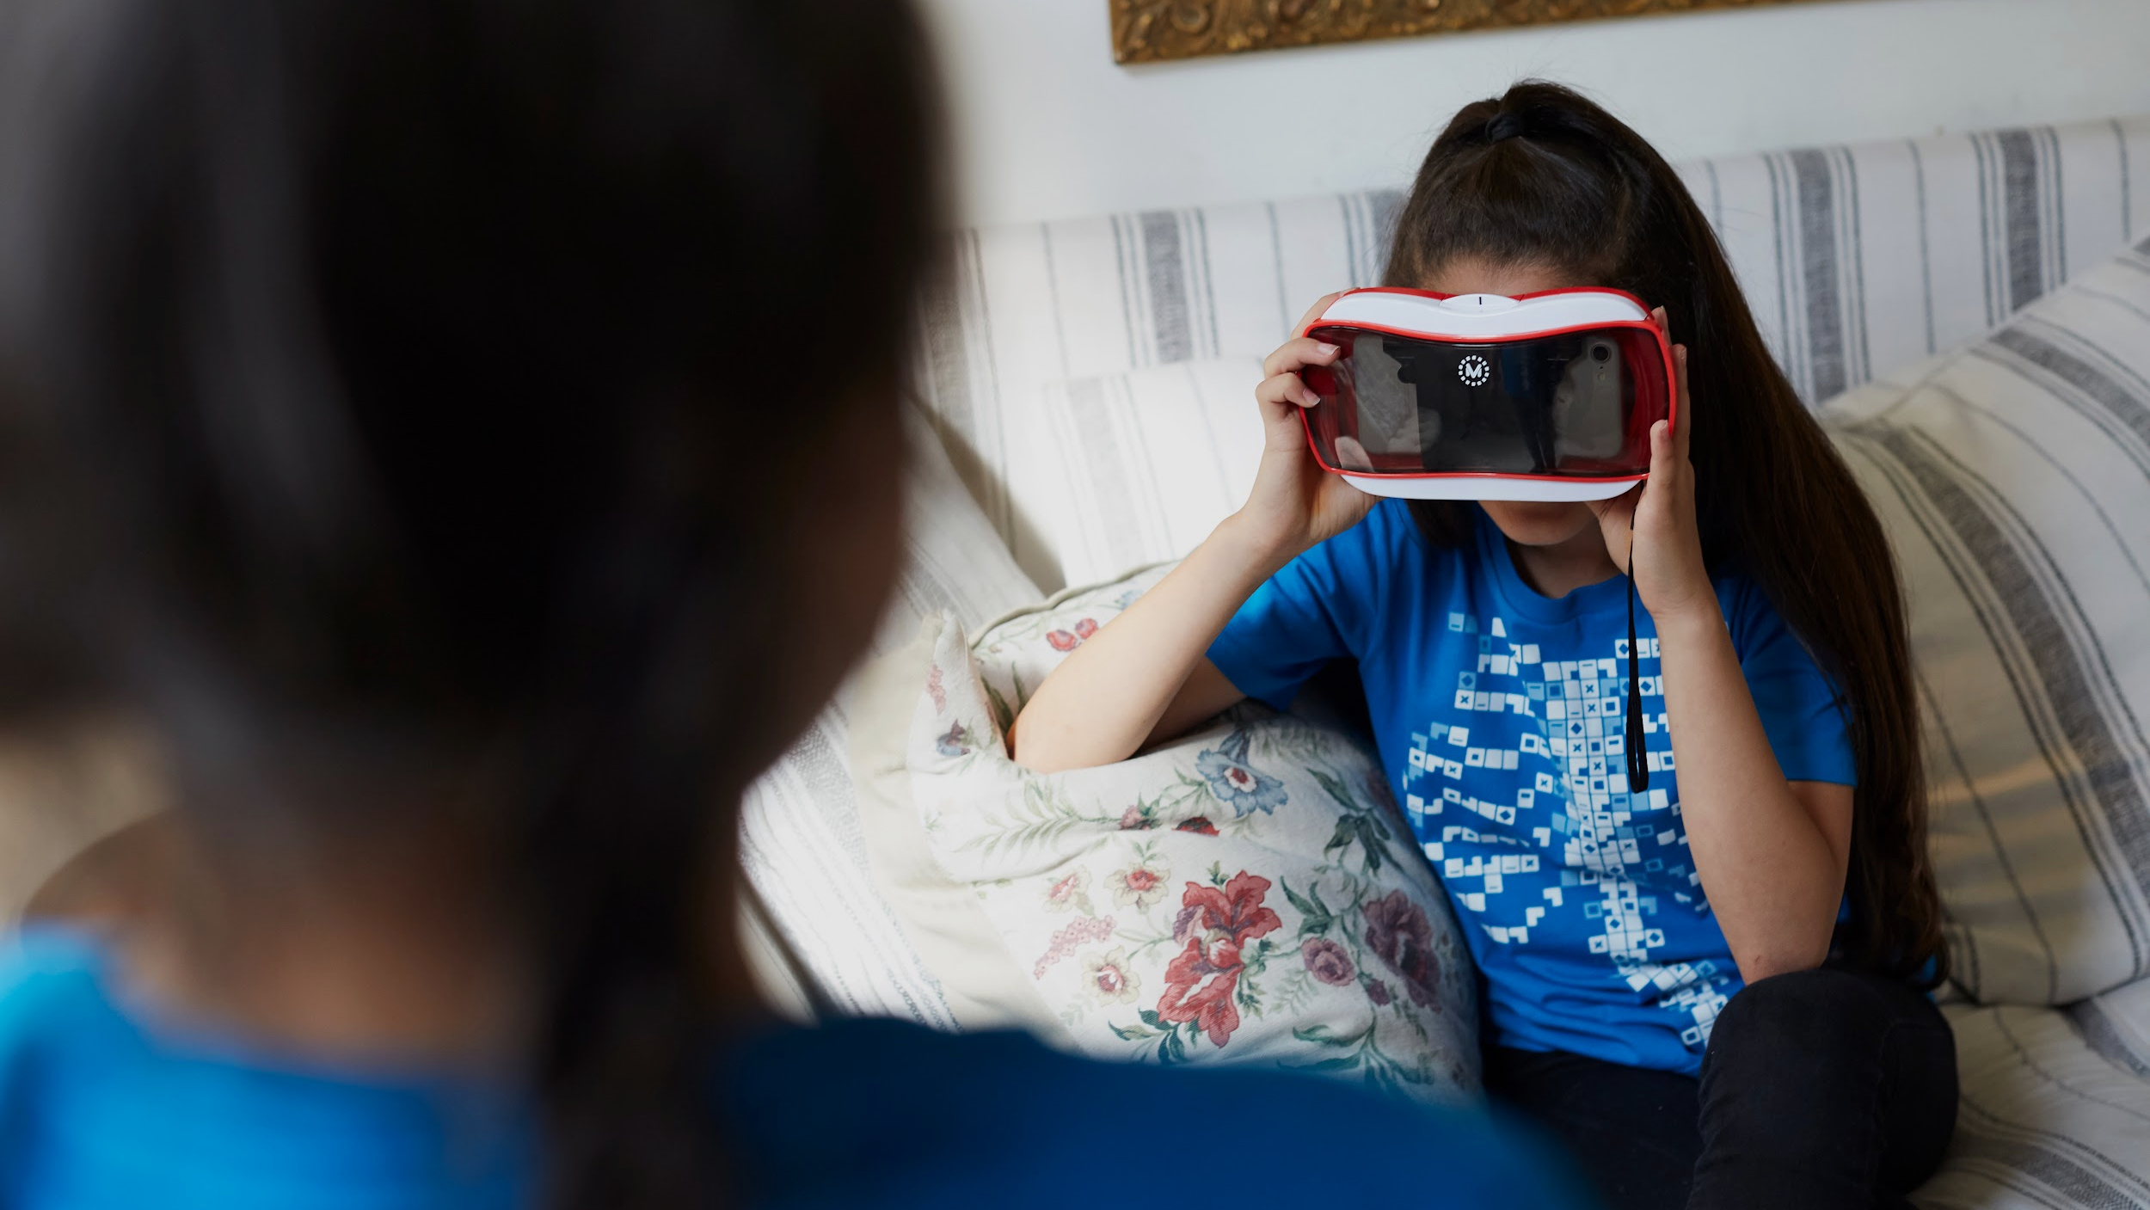
Urinary System

Slide 3
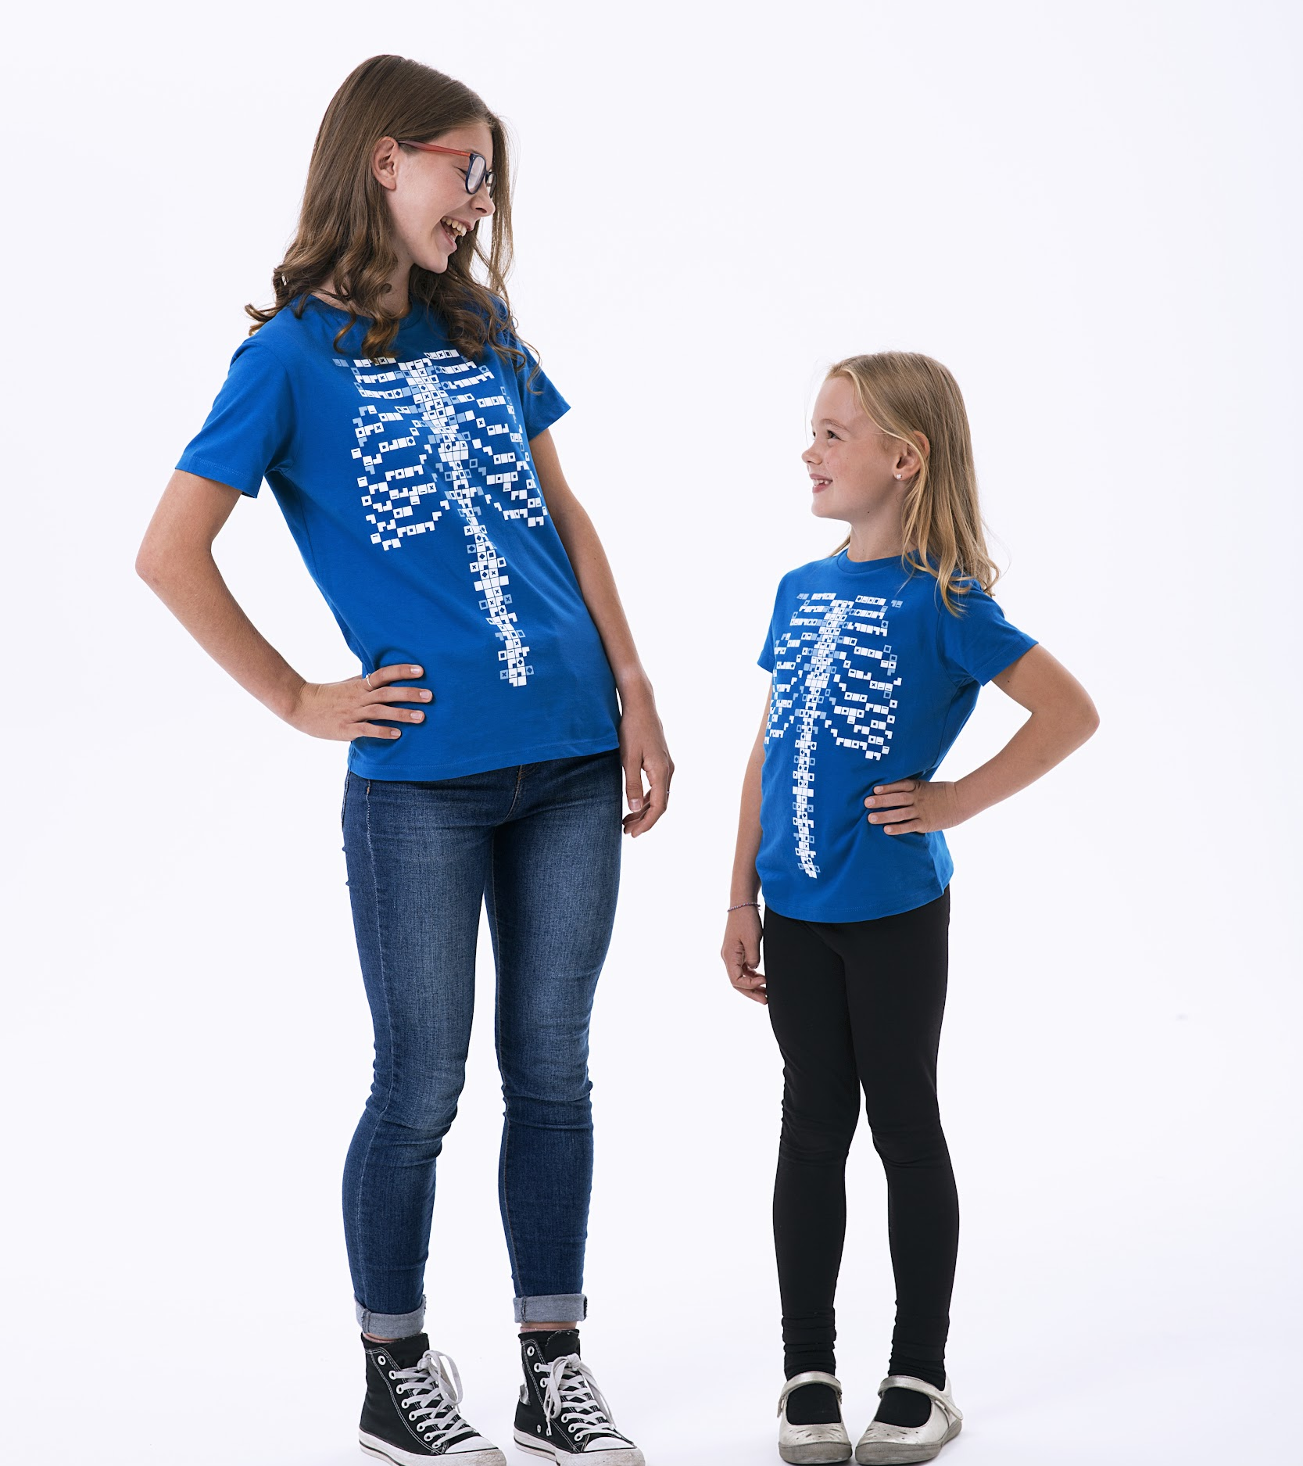
The urinary system is primarily responsible for …?
It is also known as the urinary system (“urina” in Latin means “pee”).
Removing waste products and toxins
Maintaining body temperature
Brain function
Hair growth

Slide 4
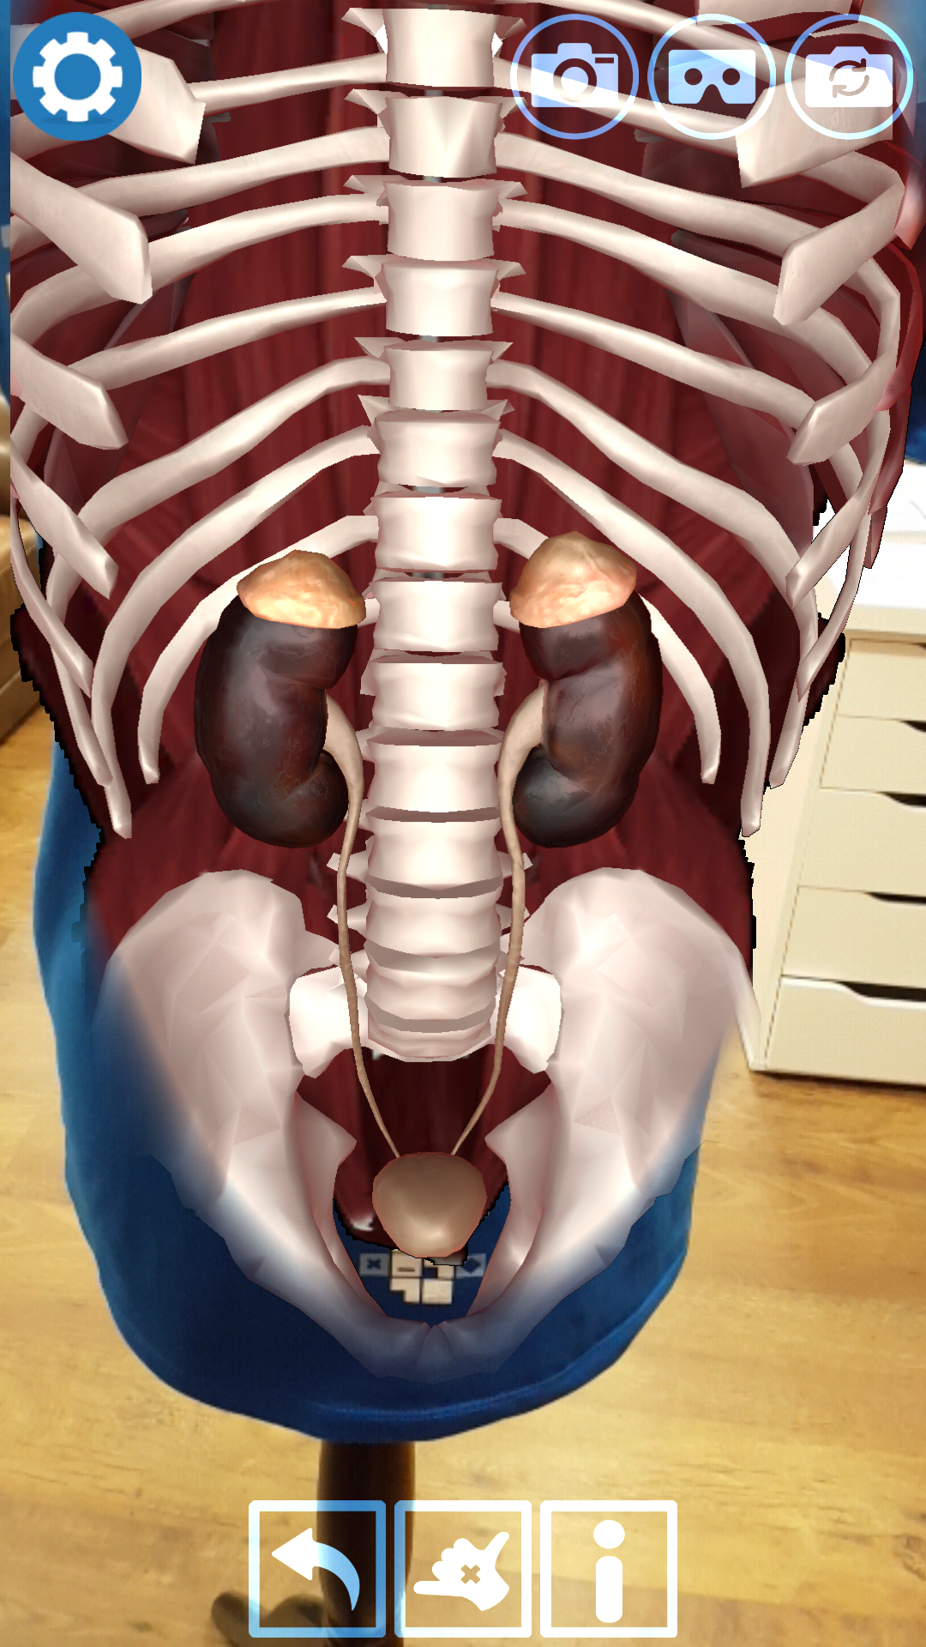
Which organ is part of the urinary system?
The kidneys are shaped like giant beans!
Liver
Pancreas
Spleen
Kidneys

Slide 5
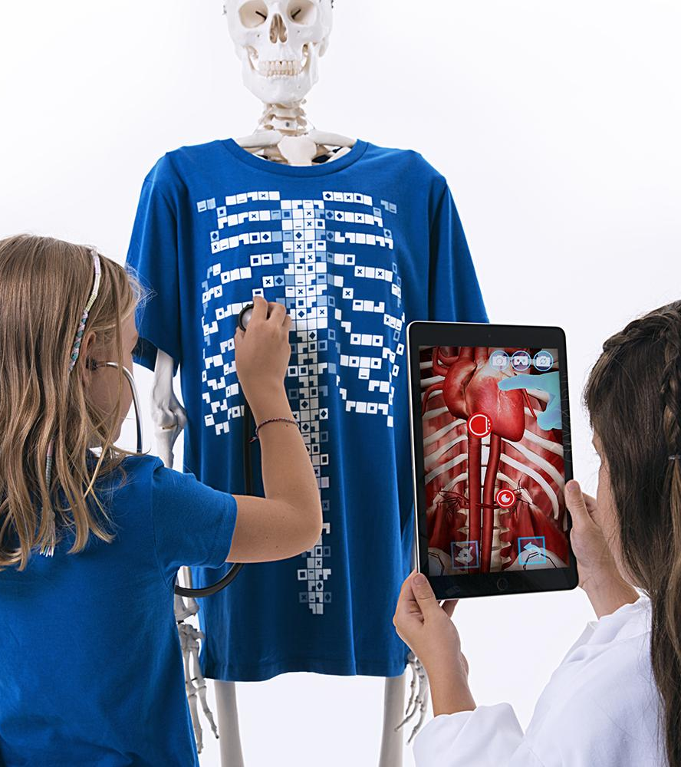
How many kidneys do you need to survive?
1 in 750 people are born with only one kidney. Kidneys do not have to function at 100% to keep doing their job.
5 per day
None
1
2

Slide 6
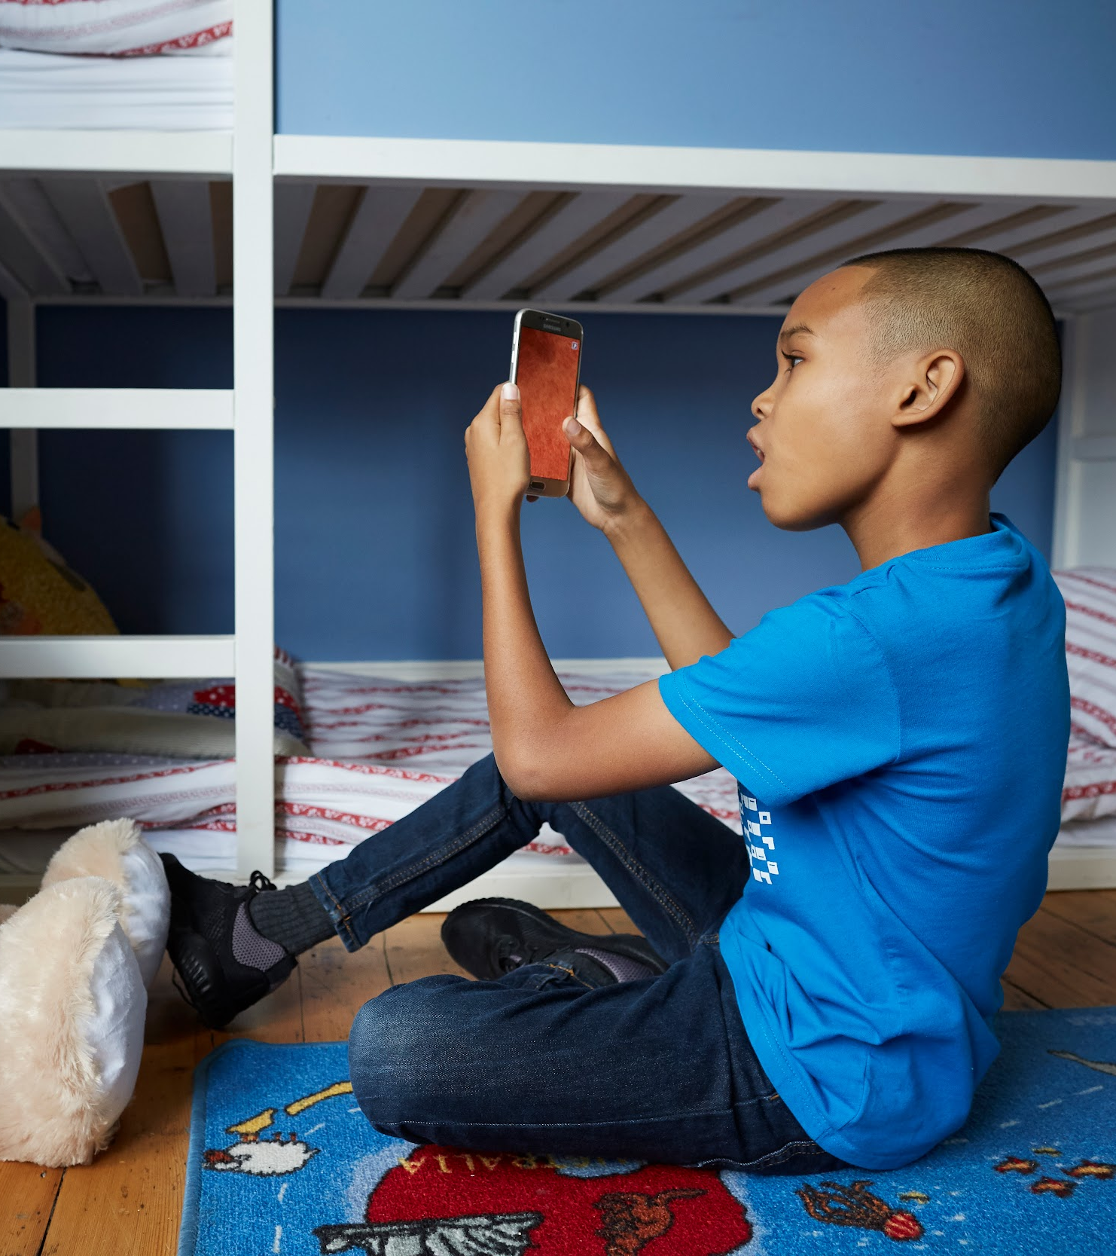
People born with only one kidney …?
Also some people can be born with two kidneys, but only one is functioning.
Need immediate medical attention
Can’t digest vegetables
Should avoid sports
Never find out

Slide 7
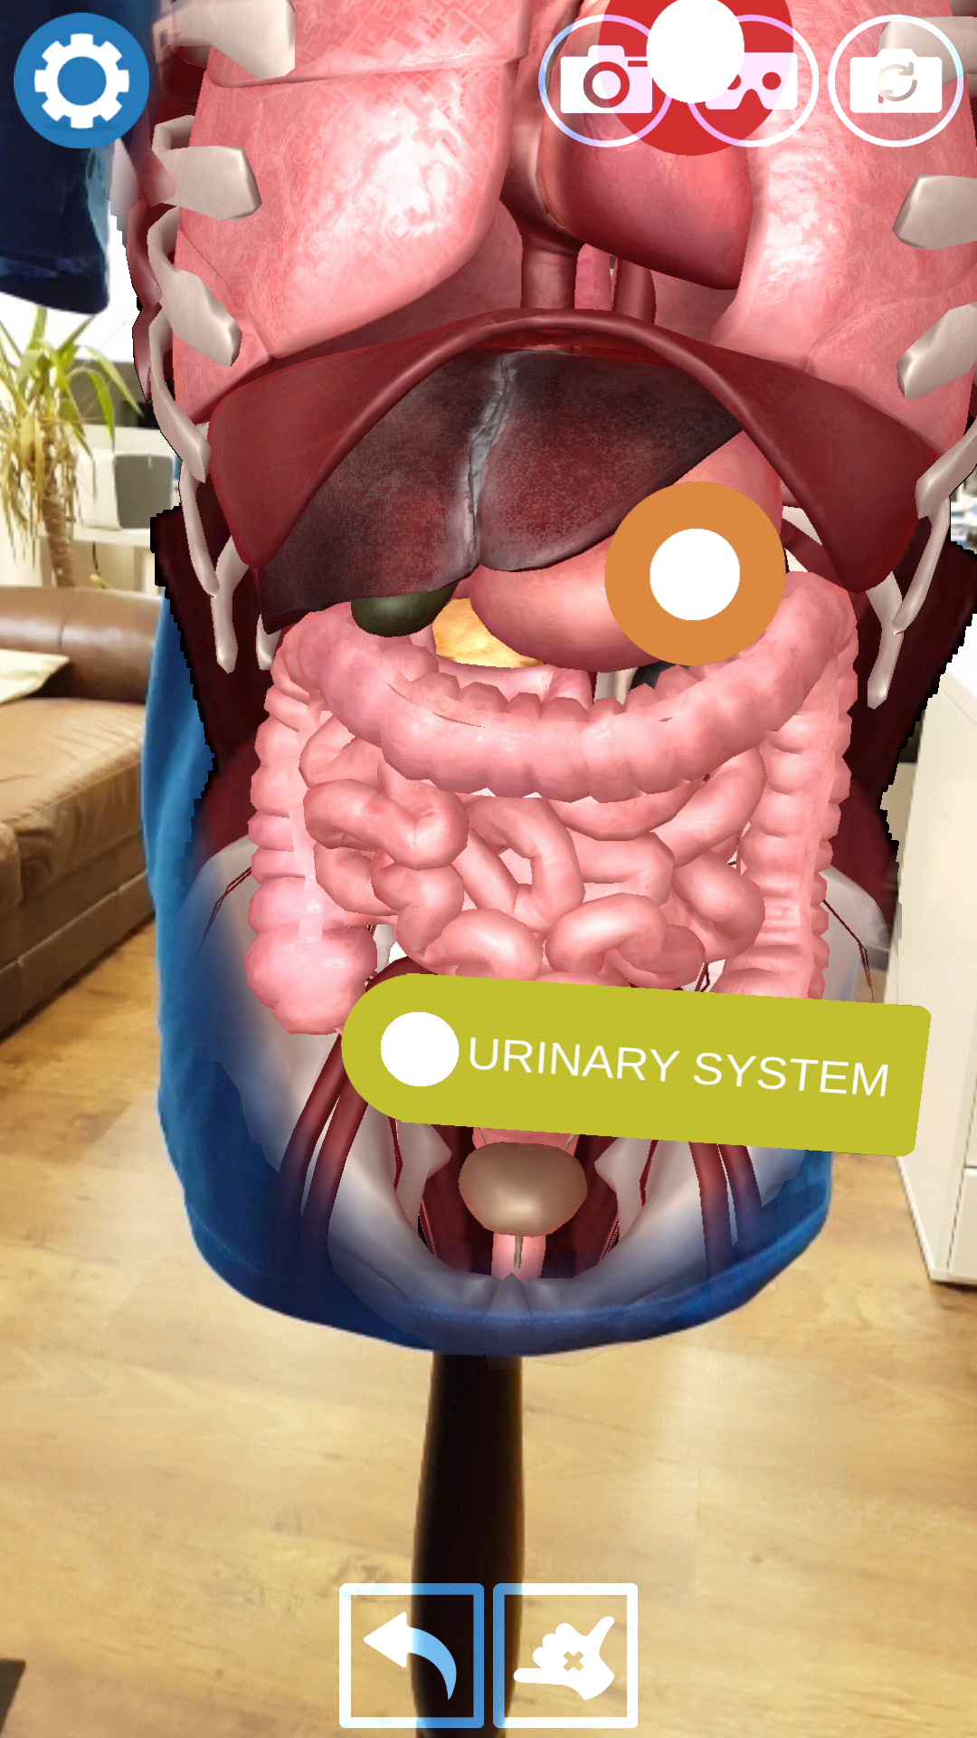
Adrenaline comes from…?
Adrenal glands sit on top of your kidneys like little bobble hats.
Sports drinks
Glands
Food
The spleen

Slide 8
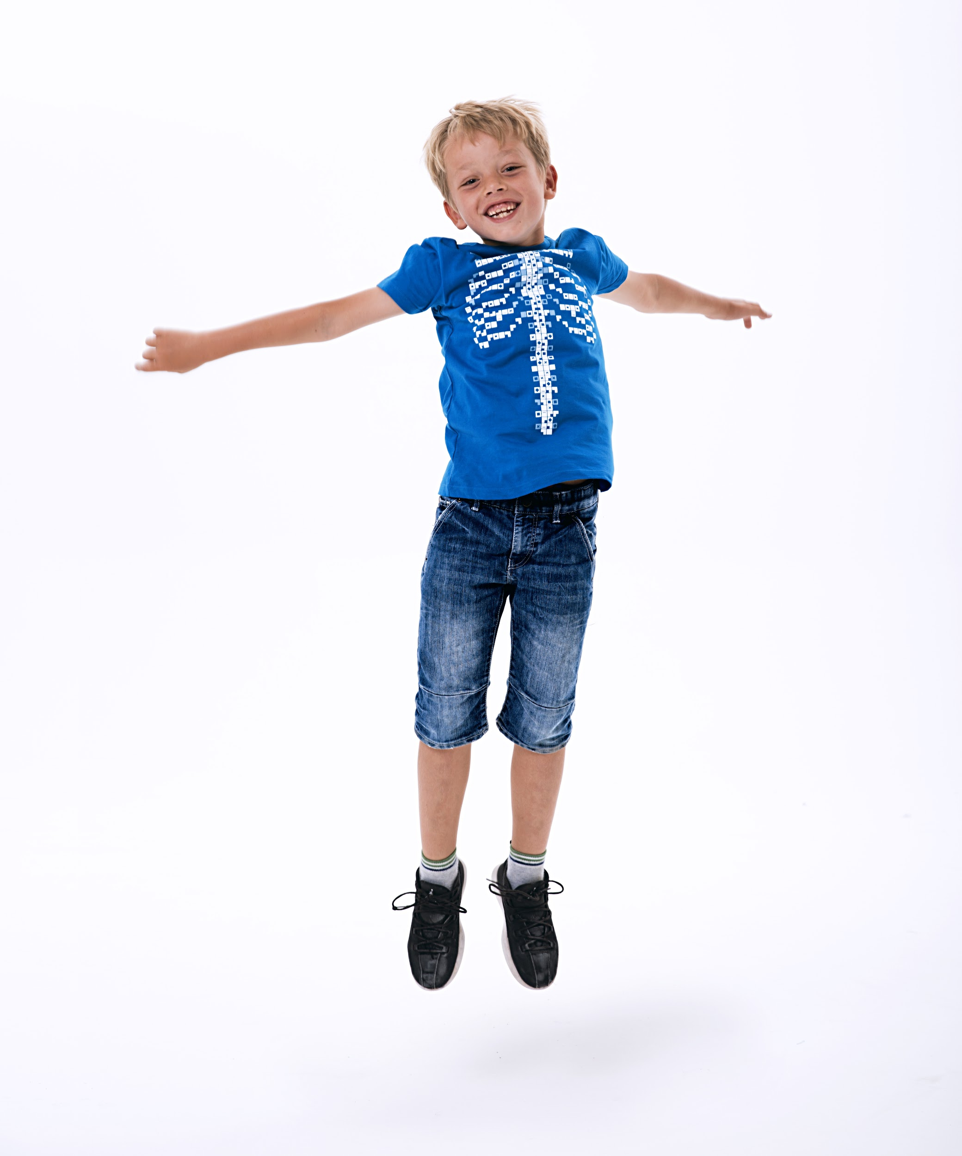
Adrenaline can …?
While it doesn’t give you night vision, adrenaline does dilate your pupils letting in more light.
Make you go blind
Make you grow tall
Make your heart beat faster
Make you see in the dark

Slide 9
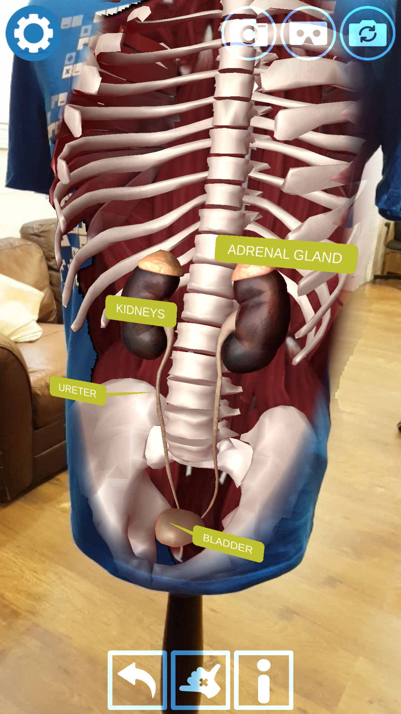
Why do you pee?
Peeing also removes excess fluids along with the waste products.
Because it turns snow yellow
To lower your heart rate
To remove waste products
To empty the gallbladder

Slide 10
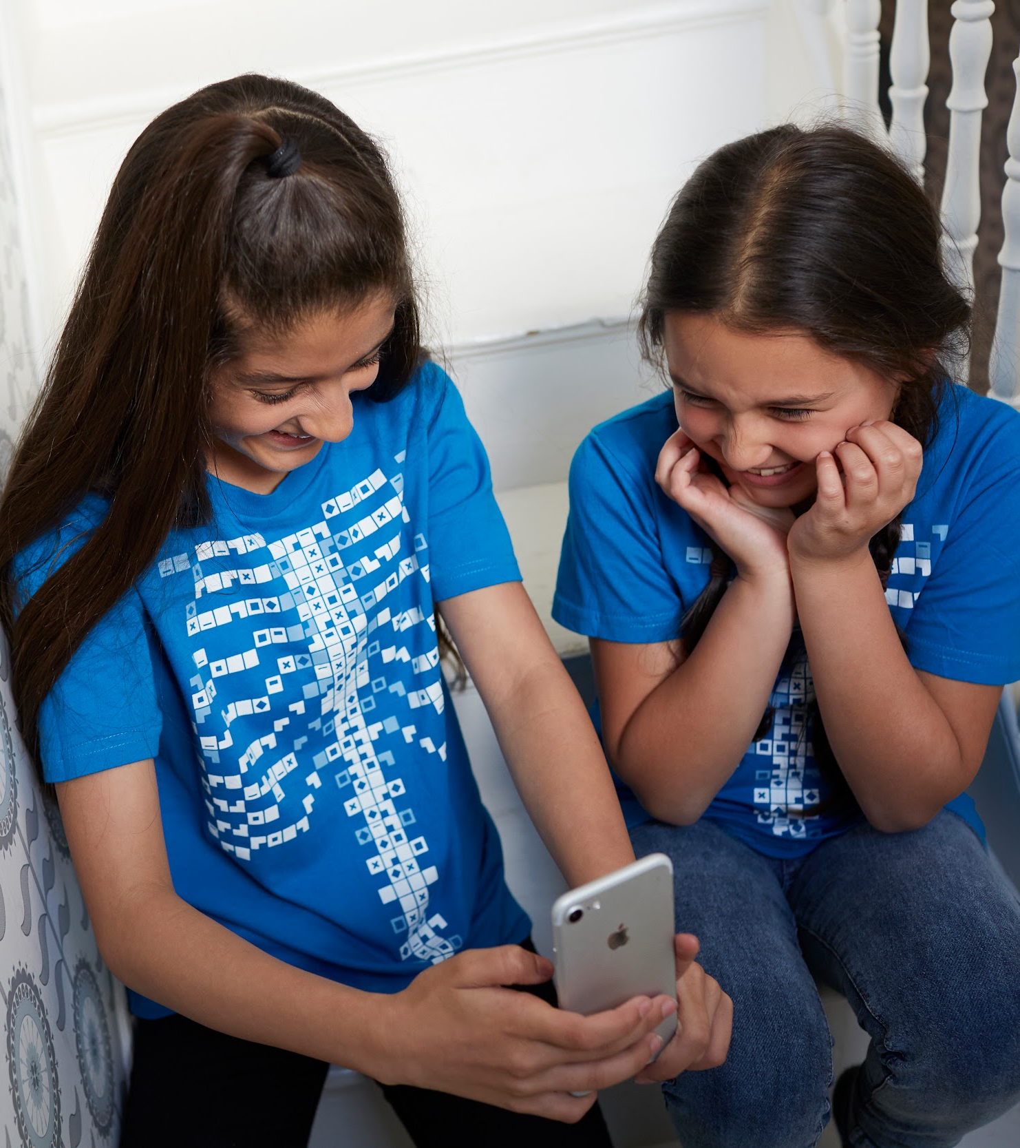
Kidneys act like …?
The kidneys are made up of millions of nephrons, which are like tiny filters for catching waste products from your body.
Storage
Filters
Pumps
Valves

Slide 11
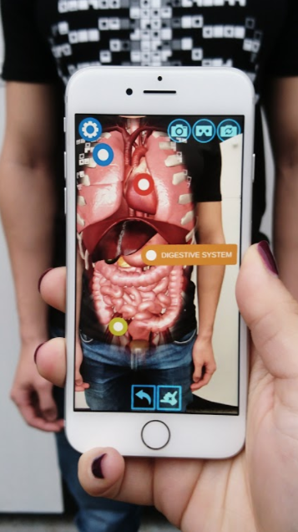
You pee through your …?
Despite the differences in gender, we all have a urethra, which is essentially the tube connected to our bladders.
Chiminea
Urethra
Eureka
Ulricacaca

Slide 12
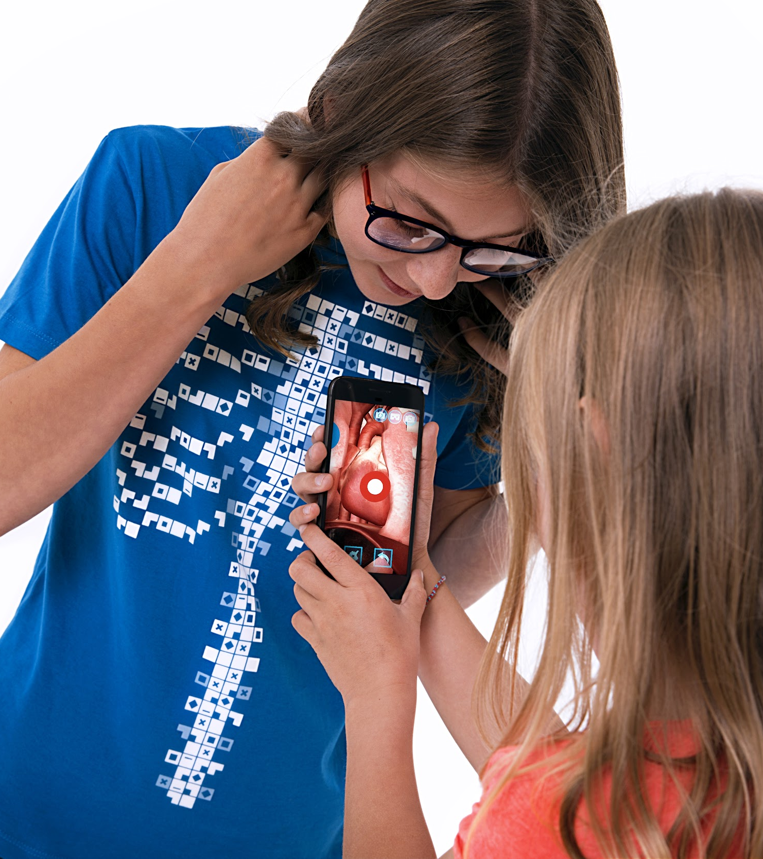
What carries toxins to the kidneys?
Plasma in the blood carries the toxins to be filtered out by the kidneys.
The digestive system
The lymphatic system
The circulatory system
The nervous system

